Slide 1

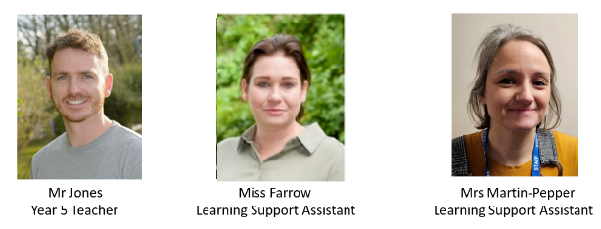
Year 5 Meet the Teacher
Summer Term
Mr Jones | Miss Farrow| Mrs Martin-Pepper
https://www.rudyardkiplingprimary.co.uk/

Slide 2
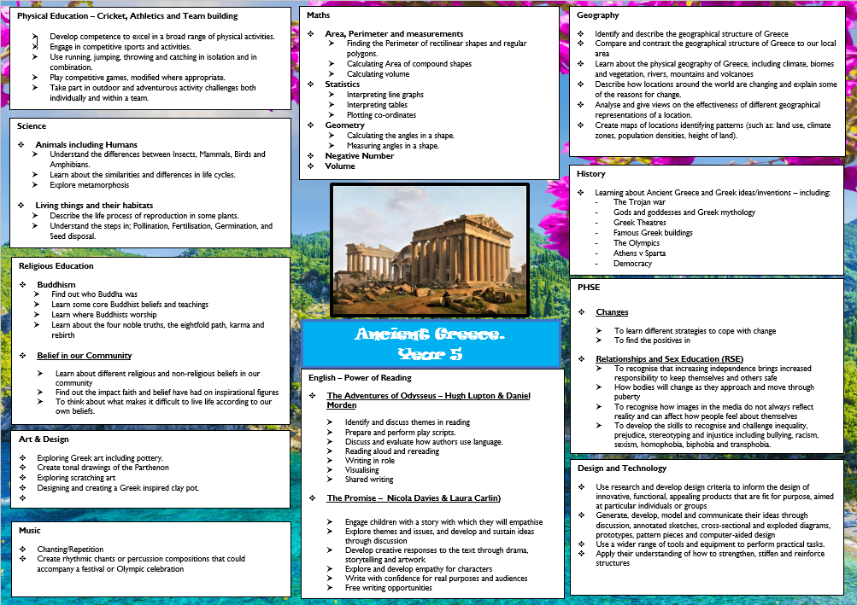

Slide 3



English

Slide 4
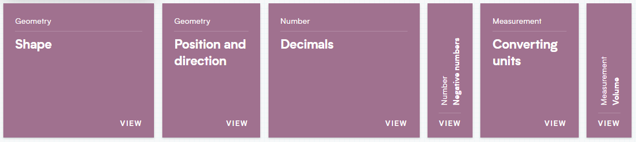
Maths

Slide 5
Science
Plants
Animals including humans – life cycles
Bees – life-cycle, where honey comes from and their importance in the world

Slide 6

History and Geography
Ancient Greece and Greece

Slide 7
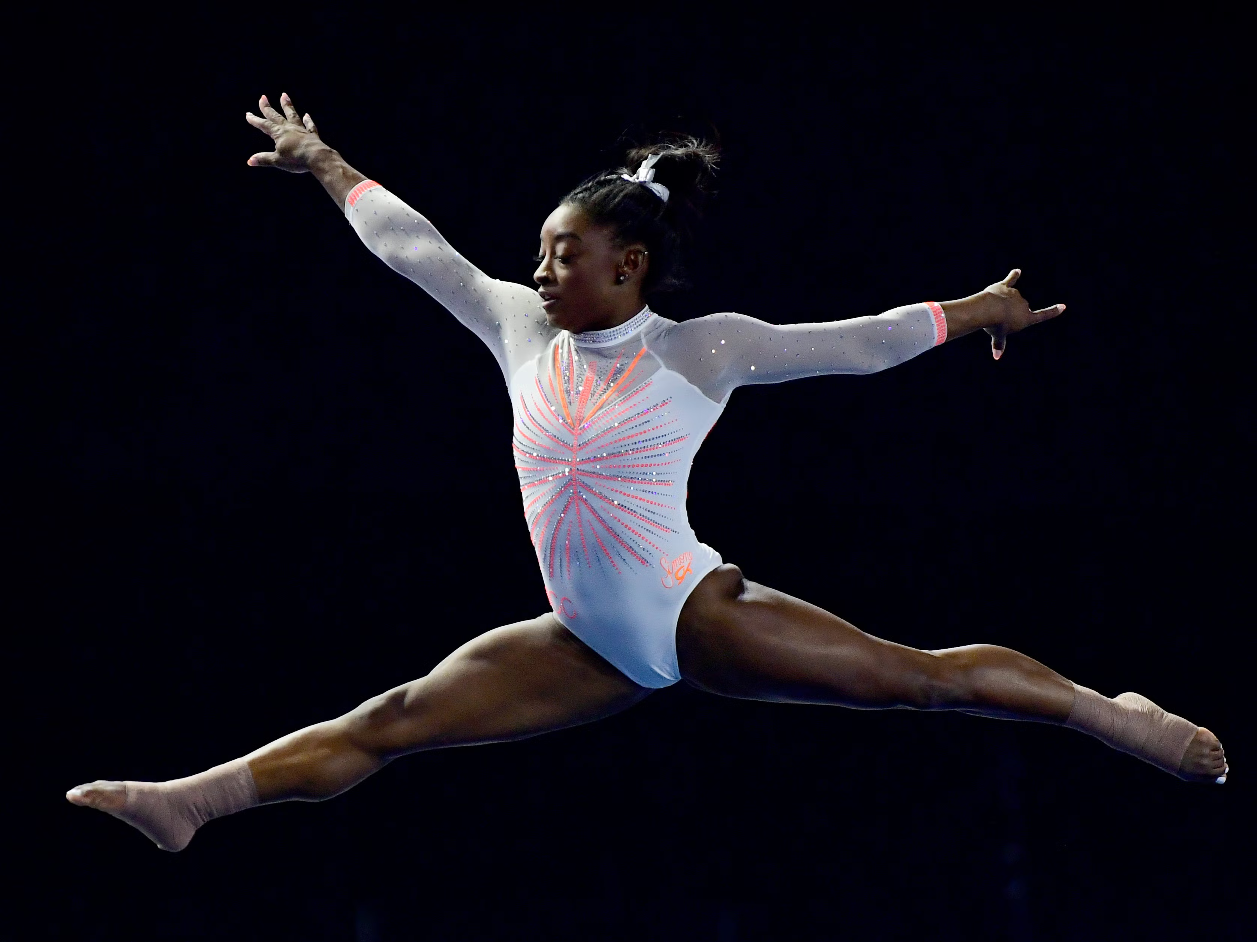
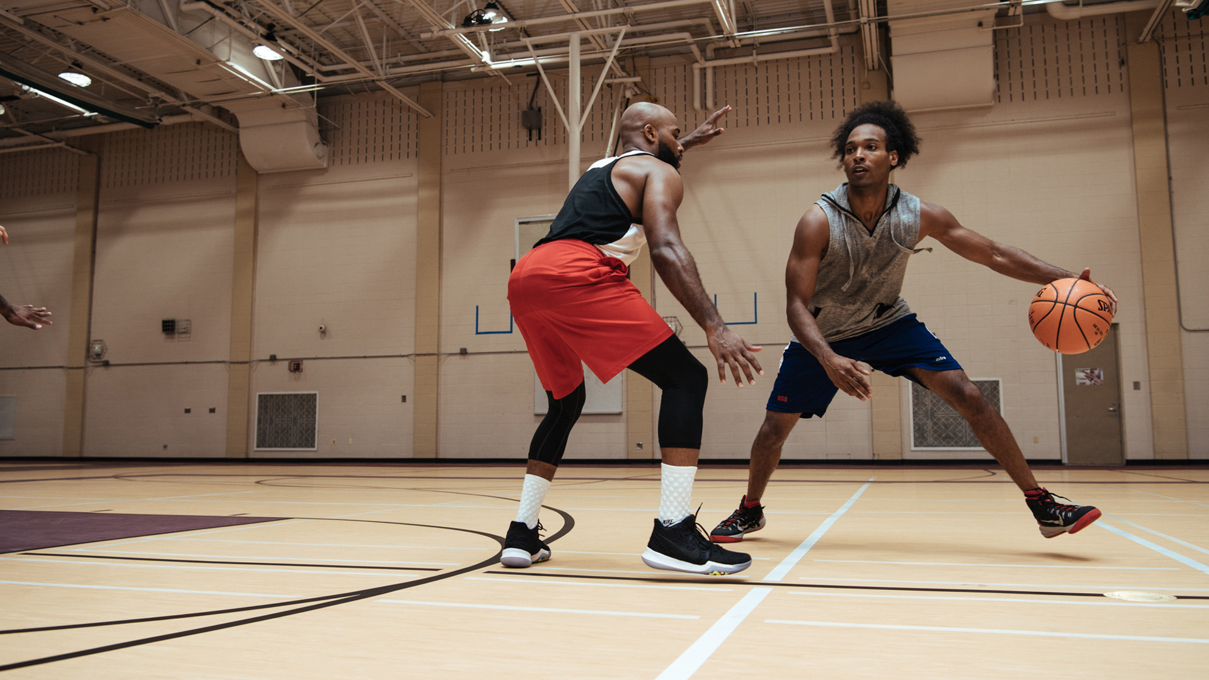
PE
Monday and Friday
  Cricket
  Athletics
All children need to have a PE kit. This is made up of the school navy PE t-shirt, dark shorts or navy joggers and plimsolls/trainers. However your children are welcome to wear a plain navy t-shirt.
Make sure trainers are comfortable.

Slide 8
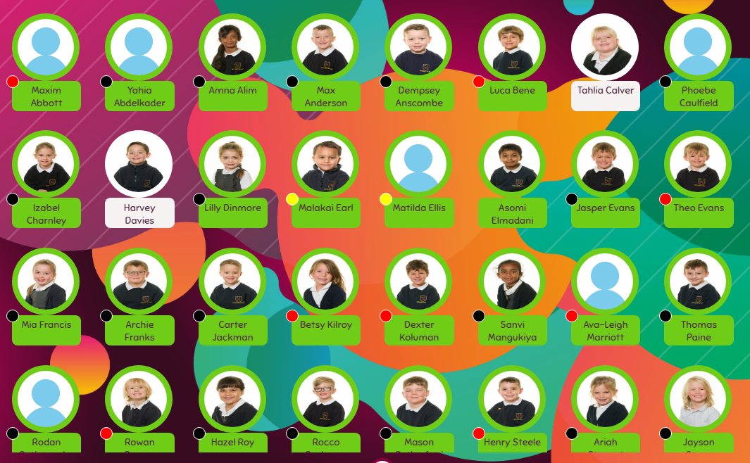

Meal Manager
Have a look at our menu for the Spring Term.
We suggest sitting down and highlighting the meals that you like, and then on the days that there’s nothing to take your fancy, bring in a packed lunch.
Don’t forget we are a nut-free school ☺

Slide 9
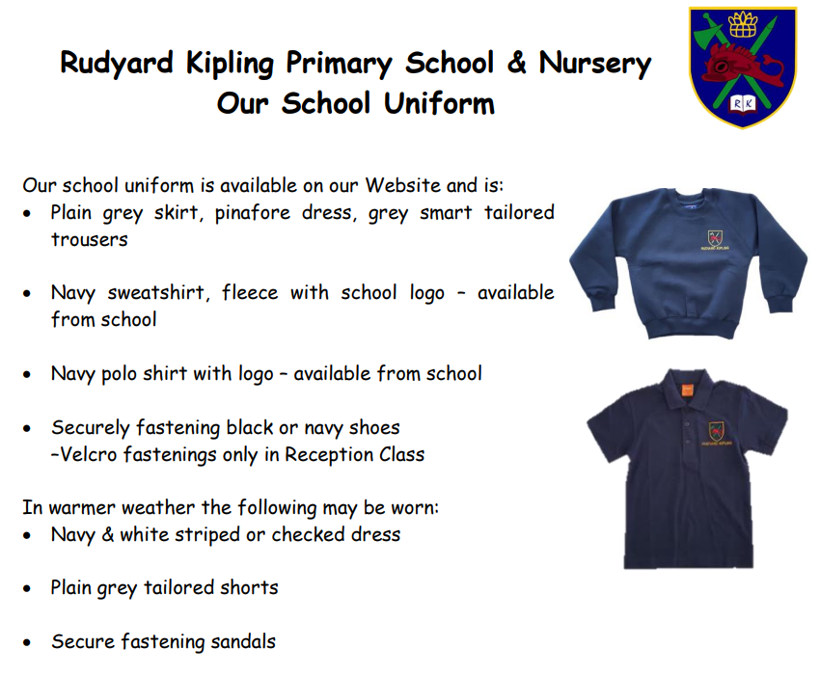
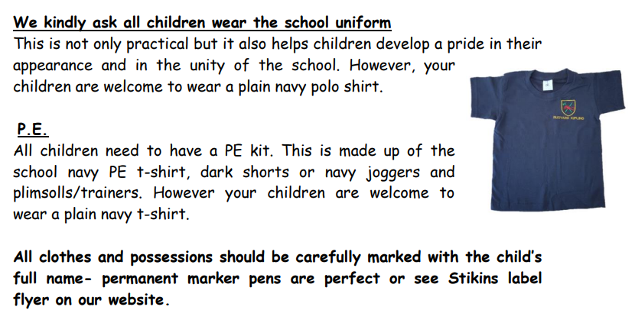
https://www.rudyardkiplingprimary.co.uk/assets/Documents/Attachments/School-Uniform-Code-2024-v3.pdf

Slide 10

Rock up and Read & Special Mentions Assembly
Friday morning 0840-0900
Special Mentions: Text sent out a week in advance to invite you along to the following Friday.
Star Badges and Maths Mission certificates also given on Friday

Slide 11

Reading - Home
Reading for pleasure. ☺
Read at home 3 times a week
Record this in your reading record.
Raffle ticket drawn in special mentions assembly every Friday.
Reading suggestions on home support sheet ☺

Slide 12

Times Tables
When children can recall their times tables, they become more confident, which can help them tackle more challenging math problems.
Please continue to practise these at home to secure them

Slide 13

Spelling Shed
You can download the app (for a small cost).
Your child will have a login (paid for by the school)
Fun interactive ways of learning tricky spellings.

Slide 14

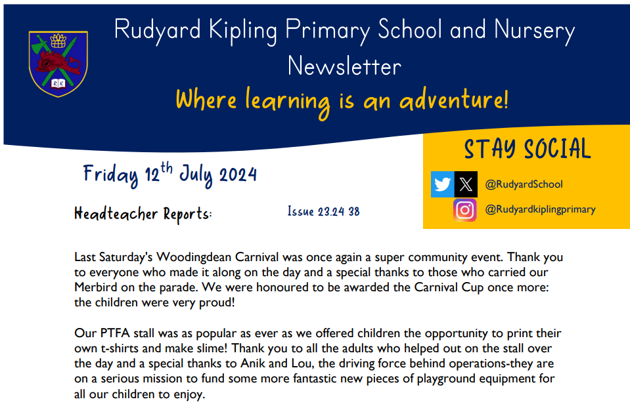
Communication
Rudyard Kipling Primary School and Nursery Newsletter.
School PING – Please download the app and sign in.
Details are available from the office.
Catchup at the end of the day.

Slide 15
Dates for the Diaries
PE Days: Monday and Friday
Computing Day: Thursdays PM
School Trip: TBC
Forest School: Parent helpers
Gladiator Steel Day: 09.05.2025
World Bee Day - Tues 20th May - Bee/nature dress up and book activities
Inset - report writing day - Fri 23rd May
Saturday 5th July - Woodingdean Carnival at Rudyard

Slide 16






Home Learning apps
TTRS; Spelling Shed; Google Classroom:
Logins: surnam:@rkps.me
Password: words123
Duolingo; White Rose 1minute maths: Free Apps

Slide 17
AOB
Meet the teacher TBC
Secondary Schools

