Slide 1


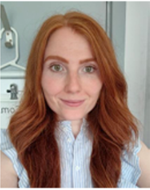
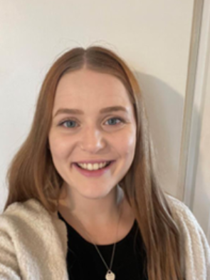
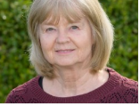
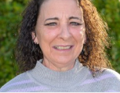
Year 4 Meet the Teacher 2024/25
Mrs Newbold & Mrs Draper| Miss Walsh | Mrs Borg | Mrs Vernon
https://www.rudyardkiplingprimary.co.uk/

Slide 2
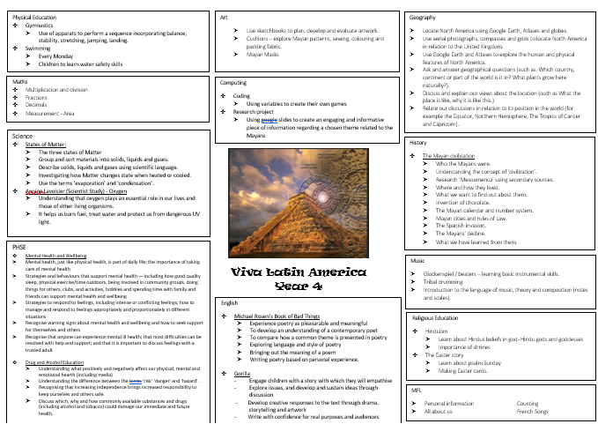

Slide 3

PE
Monday & Tuesday: Franklin
Monday & Friday: Mandela
Gymnastics
Swimming

Slide 4

Reading
Reading for Pleasure
Exciting texts
Understanding different characteristics of the text using VIPERS.

Slide 5

Reading - Home
Reading for pleasure ☺
Read at home 3 times a week
Record this in your reading record.
Hand in every few days
Raffle ticket drawn in special mentions assembly every Friday.

Slide 6

Times Tables
When children can recall their times tables, they become more confident, which can help them tackle more challenging math problems.
Please continue to practise these at home to secure them

Slide 7
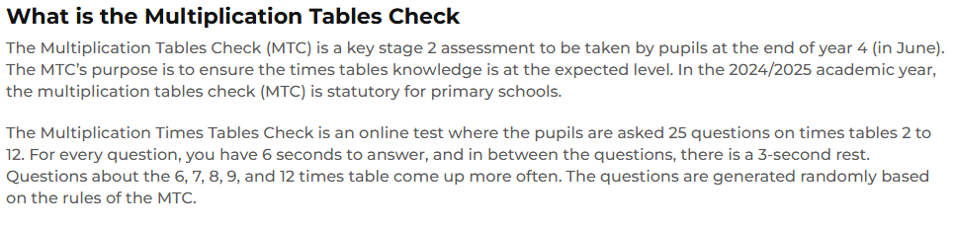
Multiplication Tables Check

Slide 8

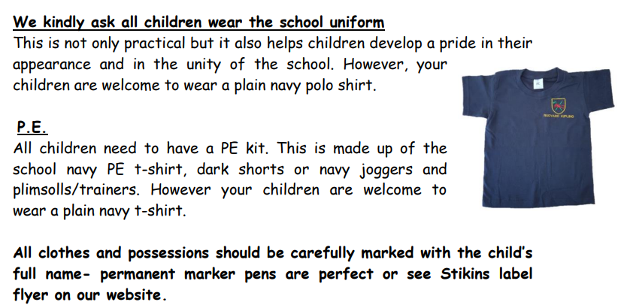
https://www.rudyardkiplingprimary.co.uk/assets/Documents/Attachments/School-Uniform-Code-2024-v3.pdf

Slide 9

Rock up and Read & Special Mentions Assembly
Friday morning 08:40-09:00
Special Mentions: Text sent out a week in advance to invite you along to the following Friday.
Star Badges and Maths Mission certificates also given on Friday

Slide 10
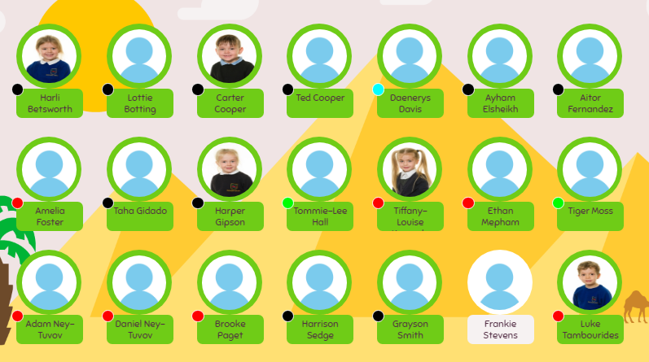
Meal Manager
Please look through this with your child and plan accordingly

Slide 11

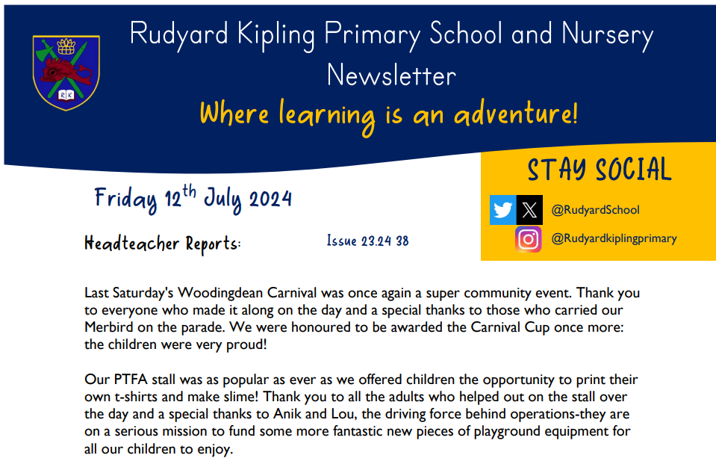
Communication
Rudyard Kipling Primary School and Nursery Newsletter.
School PING – Please download the app and sign in.
Details are available from the office.
Catchup at the end of the day.

Slide 12
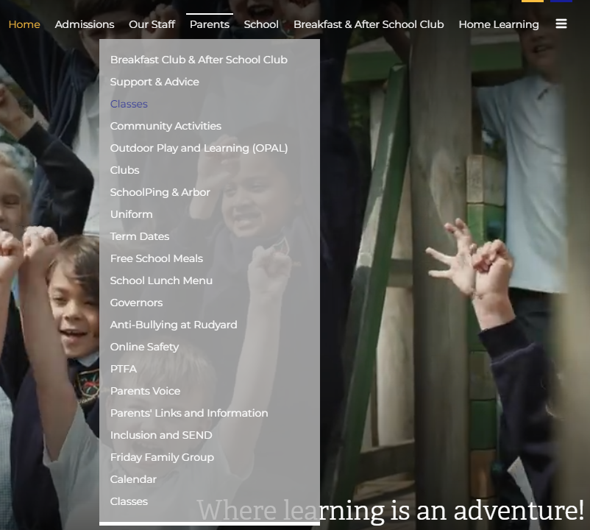
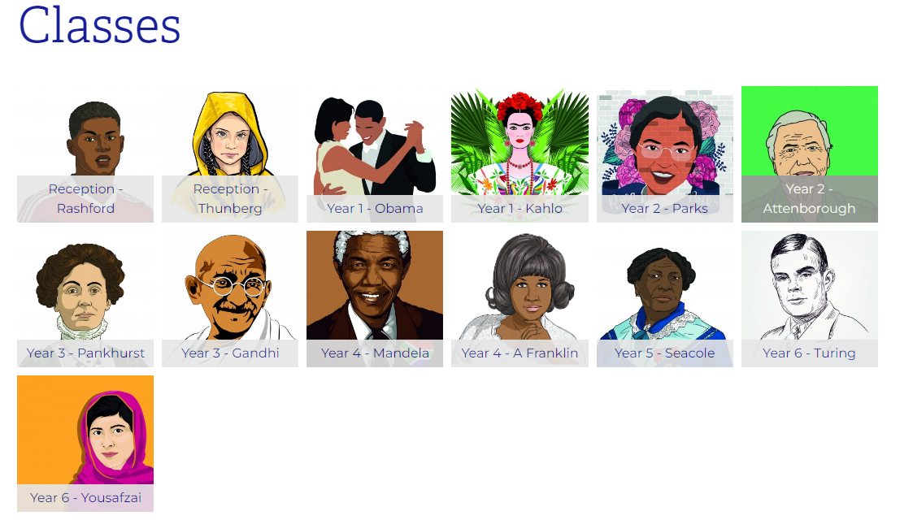
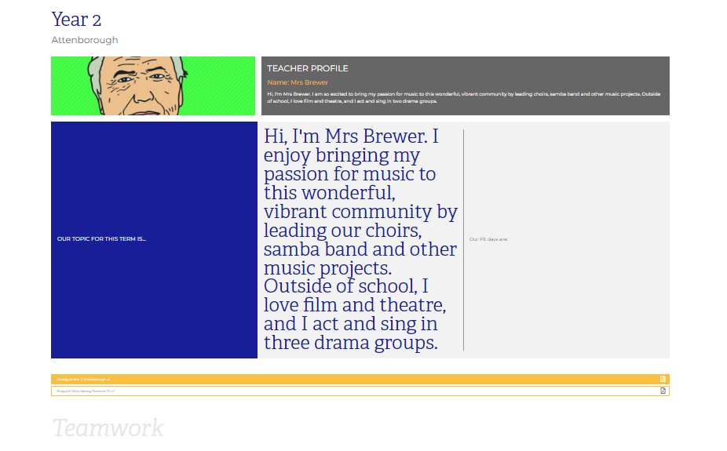
Class Page

Slide 13





Home Learning apps
TTRS; Spelling Shed; Google Classroom:
Logins: surnam:@rkps.me
Password: words123
Duolingo; White Rose 1minute maths: Free Apps

Slide 14
Any questions?

