Slide 1

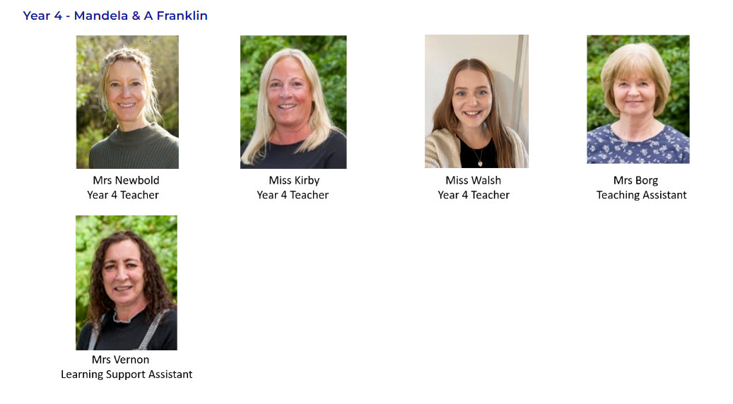
Year 4 Meet the Teacher (Summer term) 2025
Miss Kirby| Mrs Newbold| Miss Walsh| Mrs Borg | Mrs Vernon |
https://www.rudyardkiplingprimary.co.uk/

Slide 3


English
The Great Kapok Tree
The Boy at the Back of the Class

Slide 4
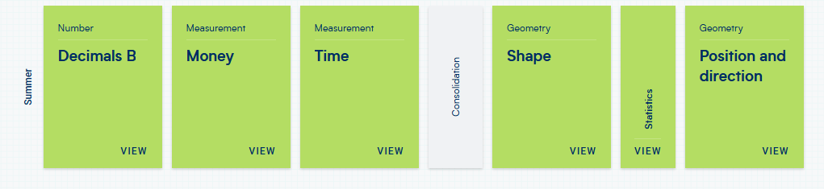
Maths
Maths Mission & TTRS - Friday

Slide 5

Reading
Reading for Pleasure
Exciting texts
Understanding different characteristics of the text using VIPERS.

Slide 6
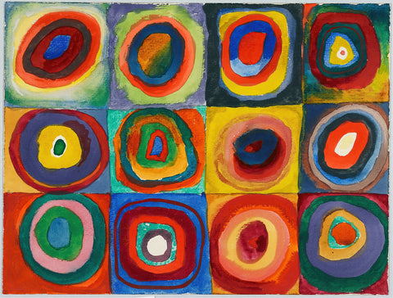

Art
Exploring patterns
Focus artist: Kandinsky
Rainforest patterns

Slide 7
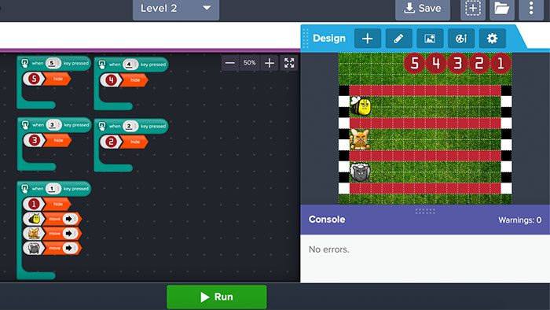
Computing
Times Tables practice
Coding
E-Safety

Slide 8


RE
Buddhism
Identity and Belonging

Slide 9

PSHE
Dealing with change
Global citizenship
Relationships
Good to be me

Slide 10


Music
Exploring pulse, rhythm and pitch
Creating soundscapes

Slide 11


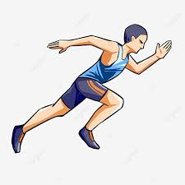
PE
Franklin: Monday and Tuesday
Mandela: Monday and Friday
Summer 1 – cricket and athletics
Summer 2 – OAA and rounders
Sensible clothing
Weather appropriate
Footwear is vital

Slide 12
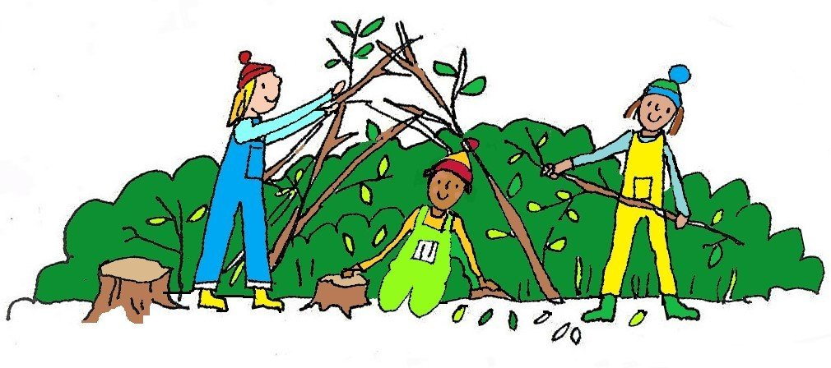
Forest School
Days are in the weekly newsletter and you will receive a PING reminder.
Sensible clothing
Weather appropriate
Footwear is vital
We really need volunteers
especially for afternoon
Sessions!

Slide 13
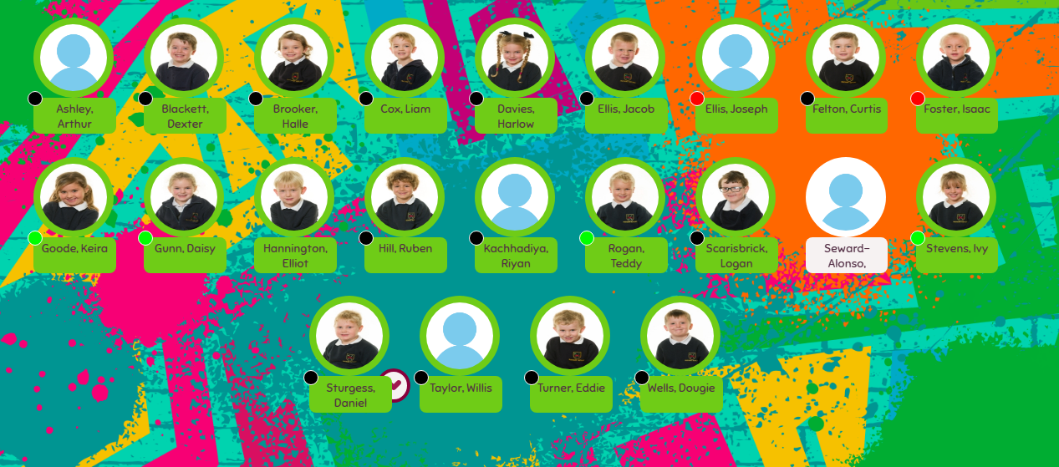
Meal Manager
Please look through this with your child and plan accordingly

Slide 14
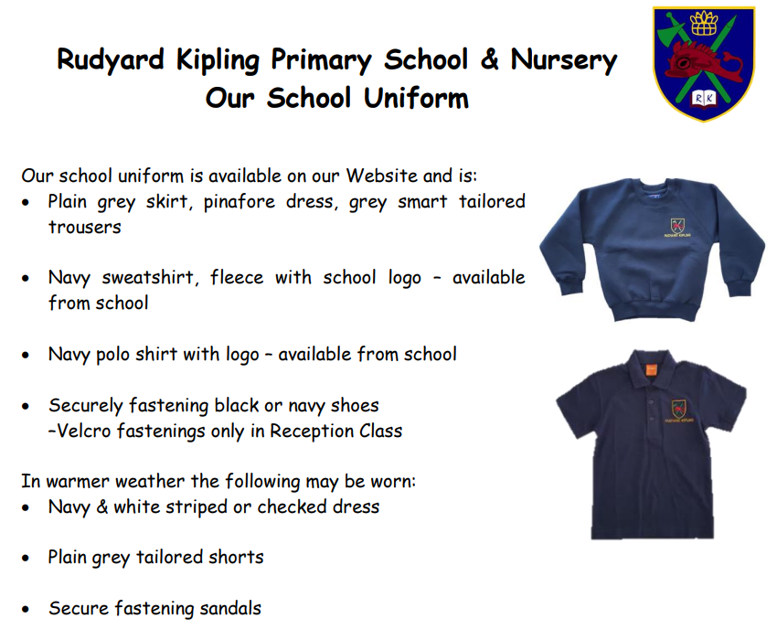
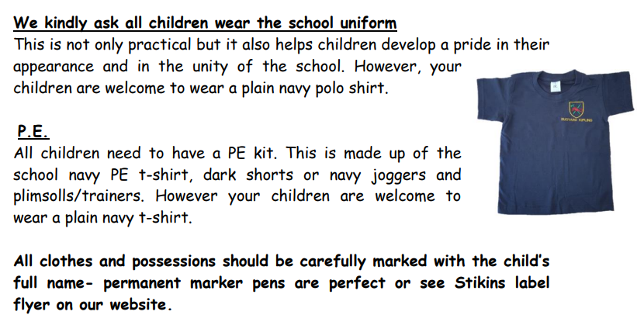
https://www.rudyardkiplingprimary.co.uk/assets/Documents/Attachments/School-Uniform-Code-2024-v3.pdf

Slide 15

Rock up and Read & Special Mentions Assembly
Friday morning 08:40-09:00
Special Mentions: Text sent out a week in advance to invite you along to the following Friday.
Star Badges and Maths Mission certificates also given on Friday

Slide 16

Reading - Home
Reading for pleasure ☺
Read at home 3 times a week
Record this in your reading record.
Hand in every few days
Raffle ticket drawn in special mentions assembly every Friday.

Slide 17

Times Tables
When children can recall their times tables, they become more confident, which can help them tackle more challenging maths problems.
Please continue to practise these at home to secure them
The Y4 DfE times table test will be in the week beginning 2nd and 13th June. We can disapply some children, but most will have to do it.
Recall facts up to 12x tables. There are 25 questions. There are 6 seconds to answer each question.

Slide 18

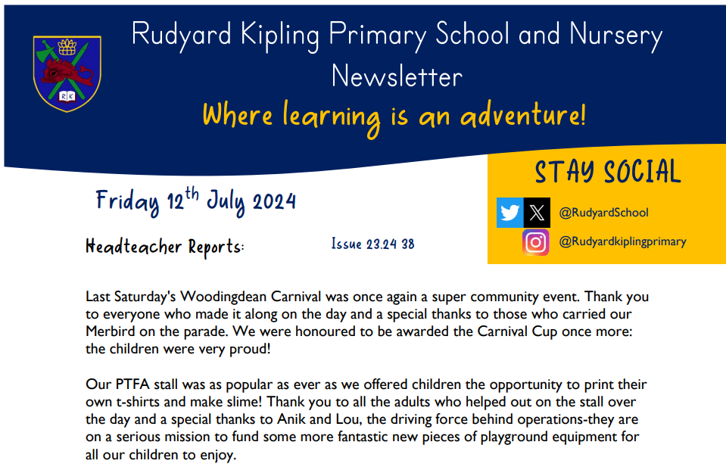
Communication
Rudyard Kipling Primary School and Nursery Newsletter.
School PING – Please download the app and sign in.
Details are available from the office.
Catch up at the end of the day.

Slide 19
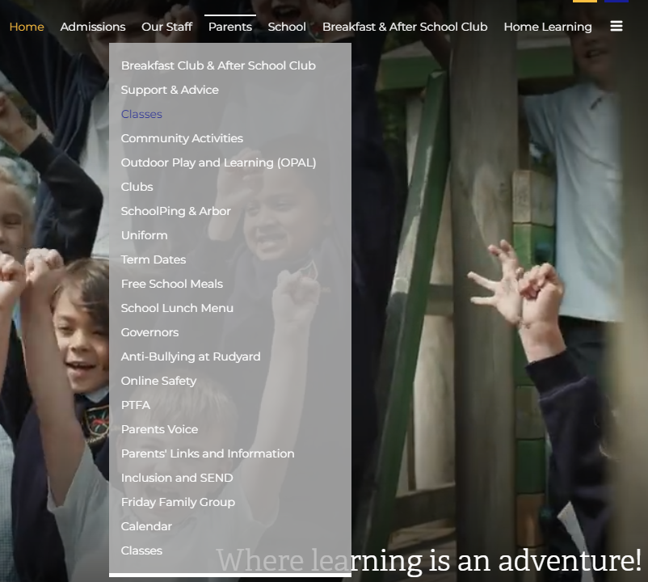
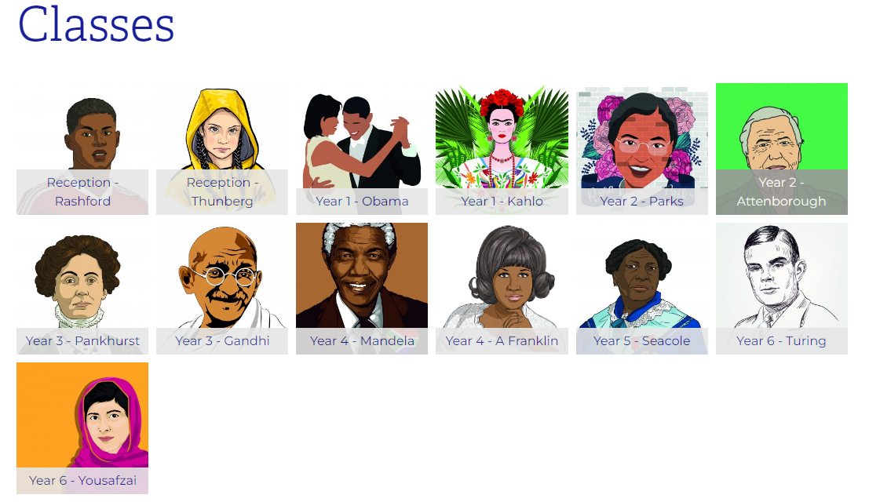
Class Page

Slide 20





Home Learning apps
TTRS; Spelling Shed; Google Classroom:
Logins: surnam:@rkps.me
Password: words123
Duolingo; White Rose 1minute maths: Free Apps

Slide 21
Trips
We have a electricity science day planned on Monday 9th June, with a company coming in to do an electricity work shop in the morning. The PTFA have kindly donated £150 towards this.
We will then be doing experiments and challenges around electricity for the rest of the day. We have sent a Ping asking for a donation of £6.50 to help to pay for this.
We will also be going on a local walk to look at the physical and human features of our local area and thinking how it has changed over the years.

Slide 22
Any questions?

