Slide 1

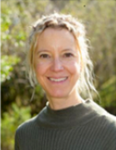
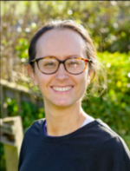
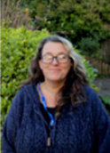
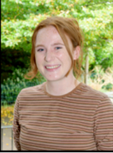
Year 3 Meet the Teacher 2024/25
Mrs Newbold & Mrs Jensen | Mr Nicholson | Mrs Hollingsworth | Mrs McCormack | Mrs Goode
https://www.rudyardkiplingprimary.co.uk/

Slide 2
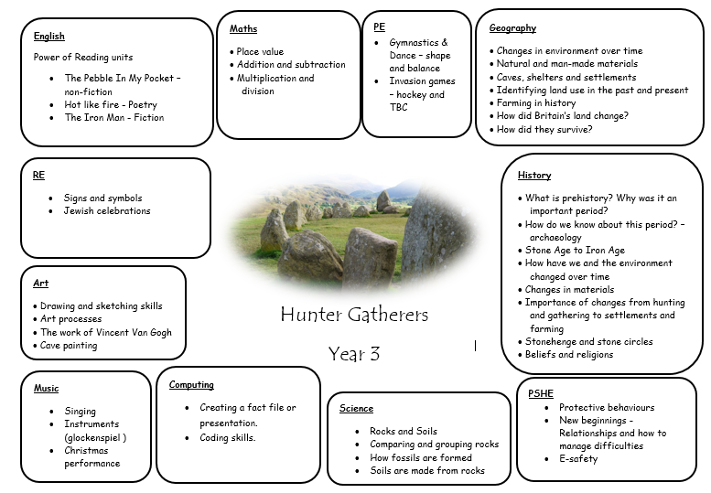

Slide 3



English
Main writing opportunity:
Poetry
Main writing opportunity:
Non-chronological report on Saber-tooth tigers
Main writing opportunity:
Newspaper report

Slide 4
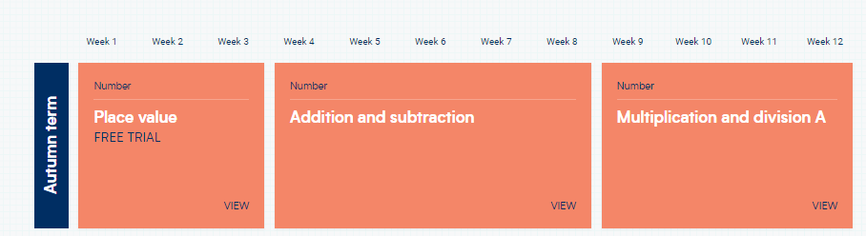
Maths

Slide 5

Reading
Reading for Pleasure
Exciting texts
Understanding different characteristics of the text using VIPERS.

Slide 6
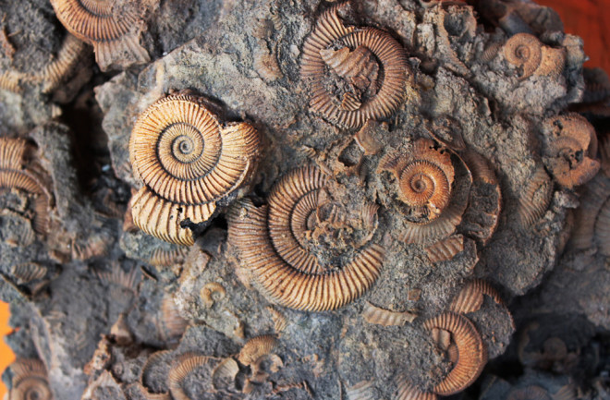
Science
Rocks and Soils
Comparing and grouping rocks
How fossils are formed
Soils are made from rocks

Slide 7
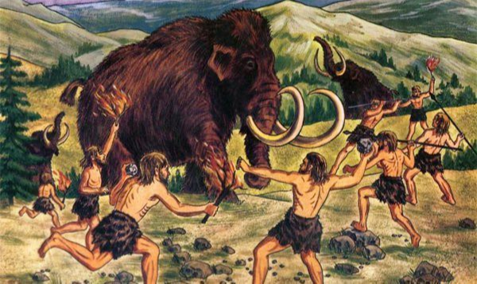
History – Stone Age – Hunter Gatherers
What is prehistory? Why was it an important period?
How do we know about this period? – archaeology
Stone Age to Iron Age
How have we and the environment changed over time
Changes in materials
Importance of changes from hunting and gathering to settlements and farming
Stonehenge and stone circles
Beliefs and religions

Slide 8

Geography – Stone age
Changes in environment over time
Natural and man-made materials
Caves, shelters and settlements
Identifying land use in the past and present
Farming in history
How did Britain’s land change?
How did they survive?

Slide 9
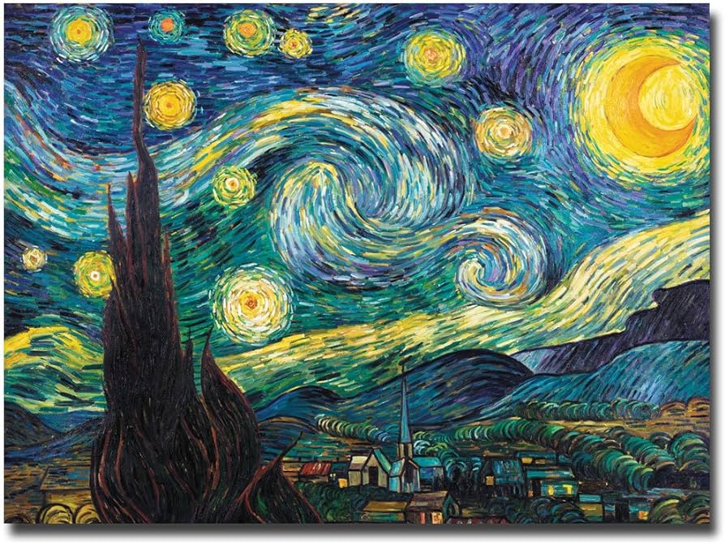
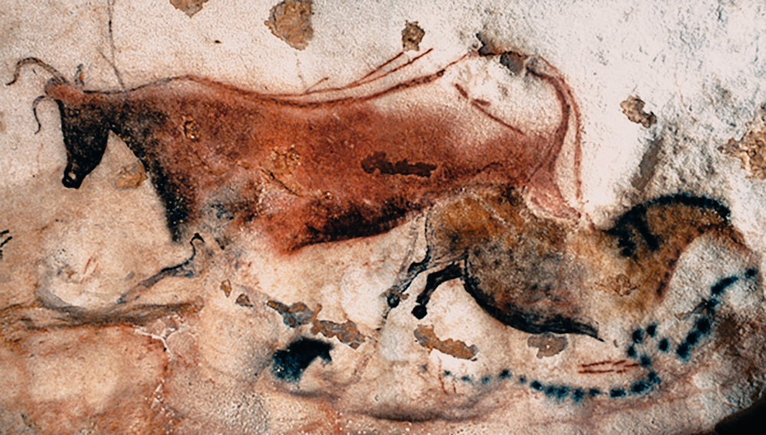
Art
Drawing and sketching skills
Art processes
The work of Vincent Van Gogh
Cave painting

Slide 10

Computing
Creating a presentation based on their likes.
Coding skills
E-safety
Times table rockstars home + school

Slide 11


RE
Signs and symbols
Jewish celebrations

Slide 12

PSHE
Protective Behaviours
New Beginnings
E-safety
A chance for children to ask questions and explore themselves.
Worry box available for those who want to ask questions/raise concerns.

Slide 13

Music
Singing (Charanga)
Instruments (glockenspiel)
Christmas performance
Singing assemblies
Club

Slide 14
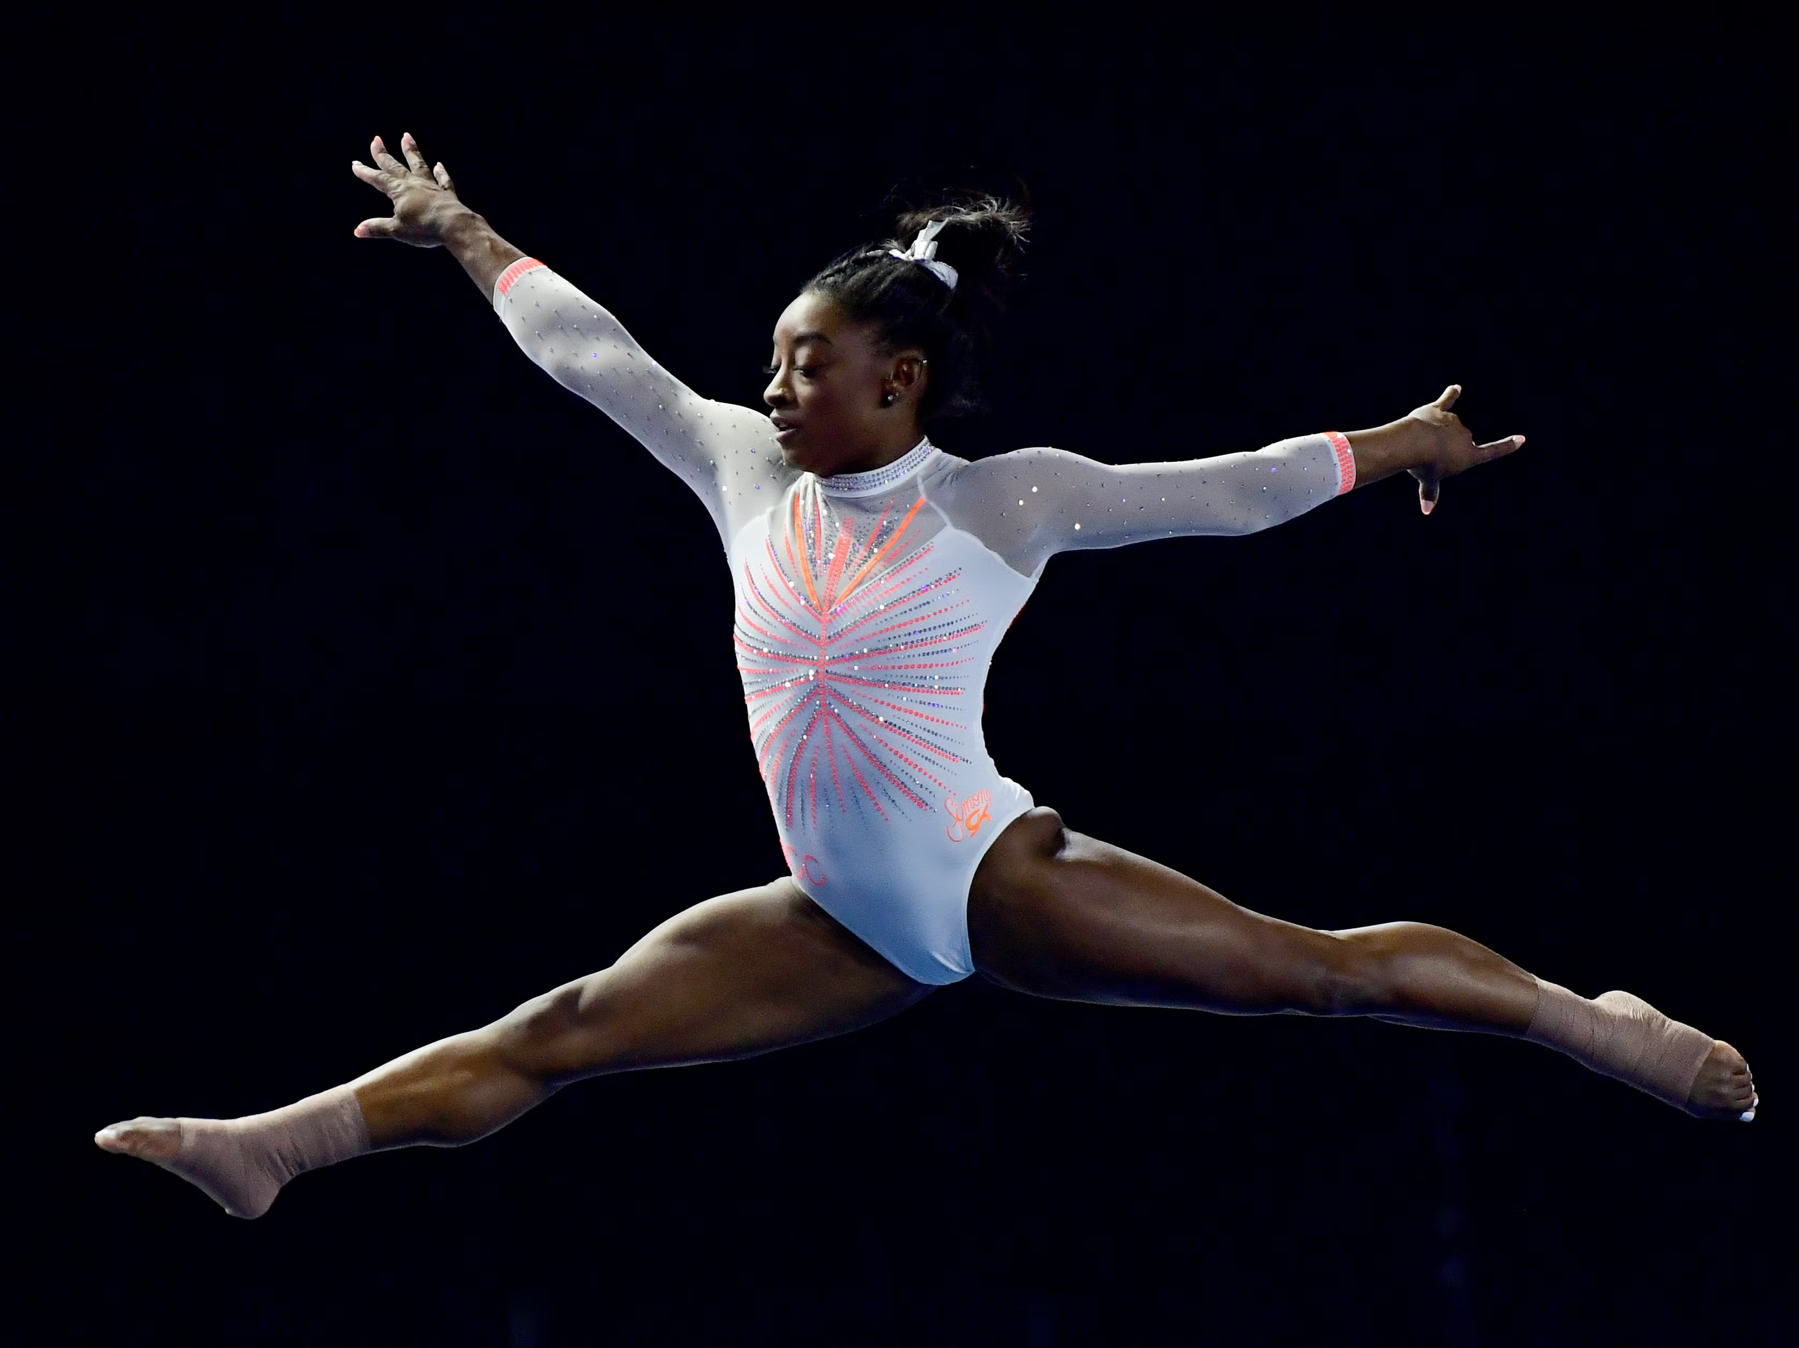
PE for both classes
Monday
Sensible clothing
Weather appropriate
Footwear is vital

Slide 15
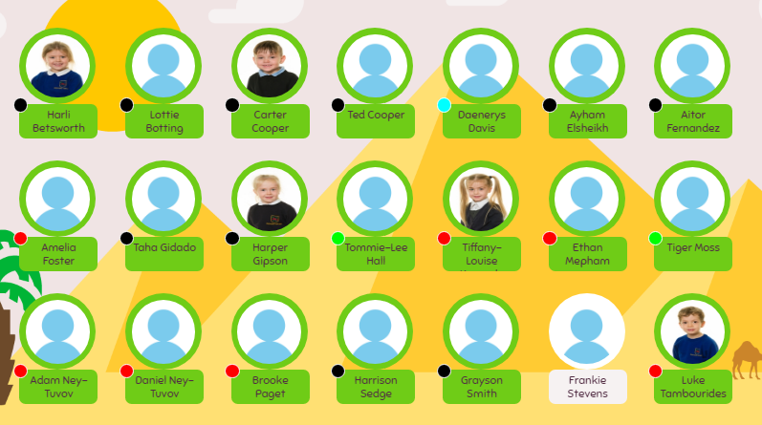
Meal Manager
Please look through this with your child and plan accordingly

Slide 16
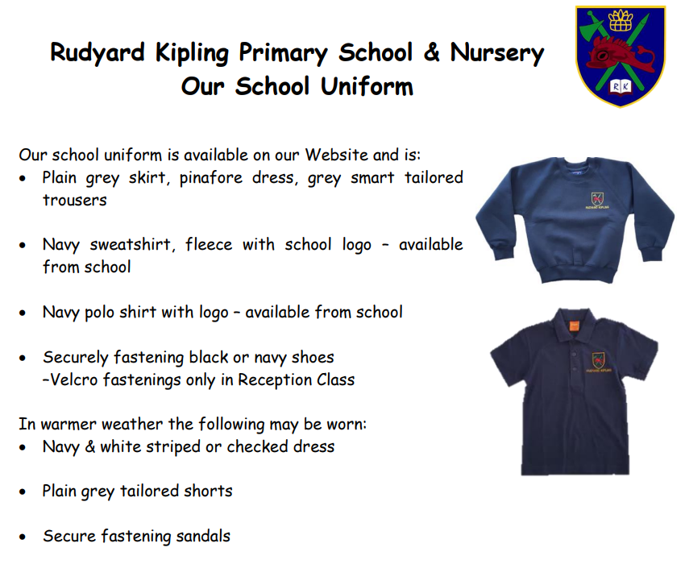
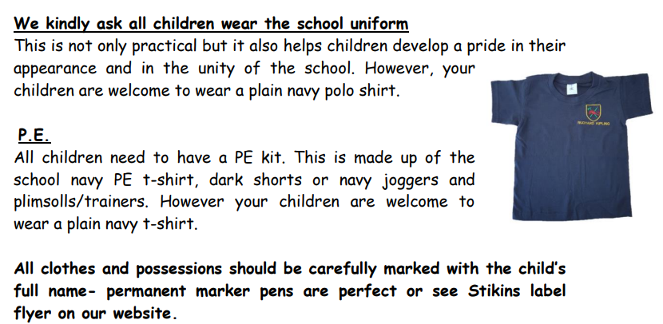
https://www.rudyardkiplingprimary.co.uk/assets/Documents/Attachments/School-Uniform-Code-2024-v3.pdf

Slide 17

Rock up and Read & Special Mentions Assembly
Friday morning 08:40-09:00
Special Mentions: Text sent out a week in advance to invite you along to the following Friday.
Star Badges and Maths Mission certificates also given on Friday

Slide 18

Reading - Home
Reading for pleasure ☺
Read at home 3 times a week
Record this in your reading record.
Hand in every few days
Raffle ticket drawn in special mentions assembly every Friday.

Slide 19

Times Tables
When children can recall their times tables, they become more confident, which can help them tackle more challenging math problems.
Please continue to practise these at home to secure them

Slide 20
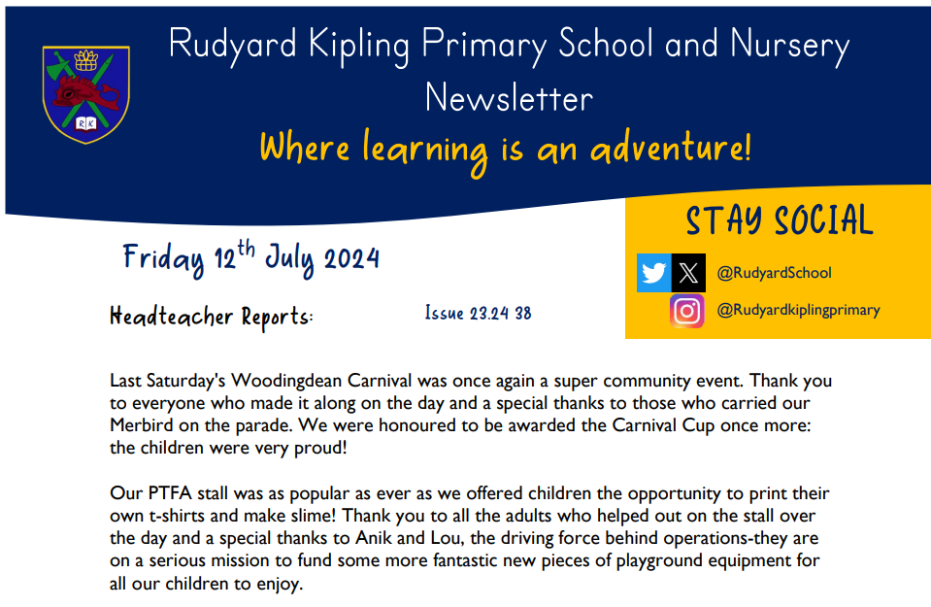
Communication
Rudyard Kipling Primary School and Nursery Newsletter.
Details are available from the office.
Catchup at the end of the day.

Slide 21
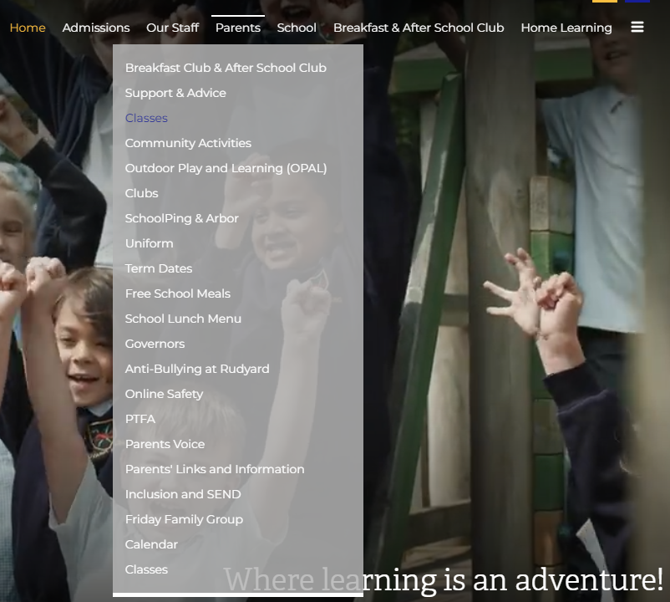
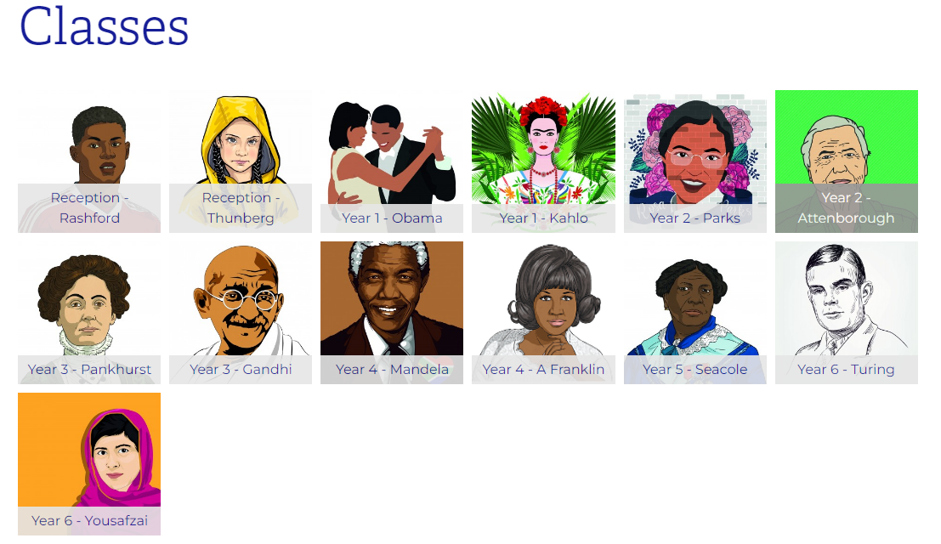
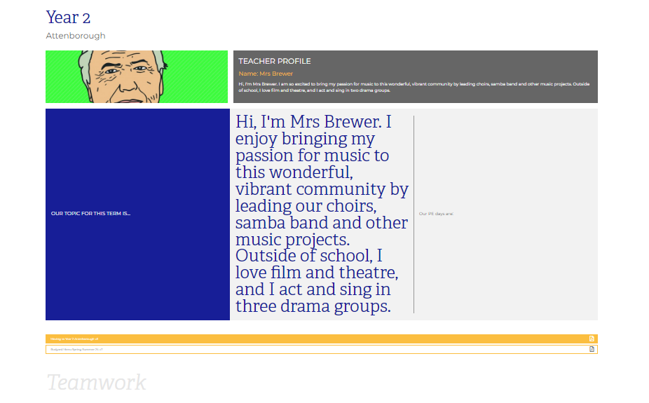
Class Page

Slide 22





Home Learning apps
TTRS; Spelling Shed; Google Classroom:
Logins: surnam:@rkps.me
Password: words123
Duolingo; White Rose 1minute maths: Free Apps

Slide 23
Any questions?

