Slide 1

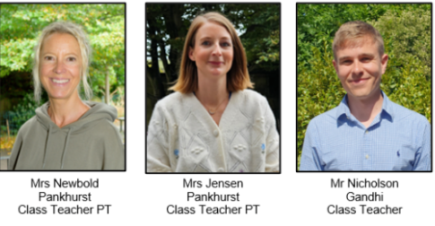
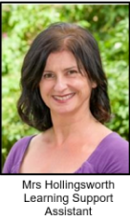
Year 3 Meet the Teacher (Summer term) 2026
Mr Nicholson | Mrs Newbold | Miss Goode | Mrs Hollingsworth |
https://www.rudyardkiplingprimary.co.uk/

Slide 2
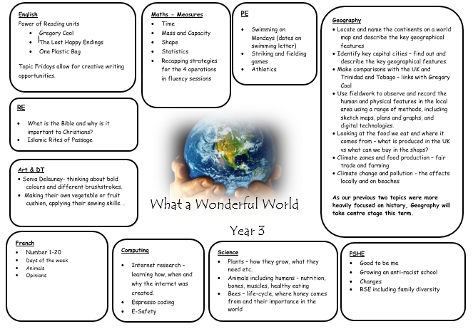

Slide 3



English
Gregory Cool
The Lost Happy Endings
One Plastic Bag

Slide 4
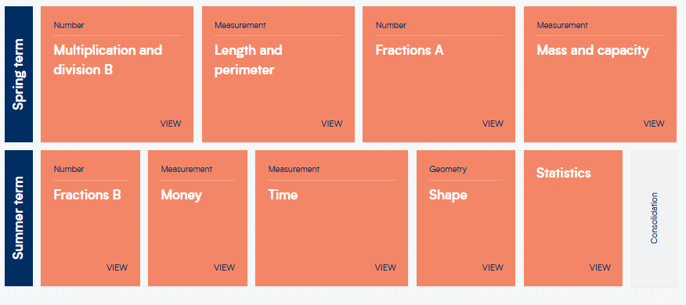
Maths

Slide 5
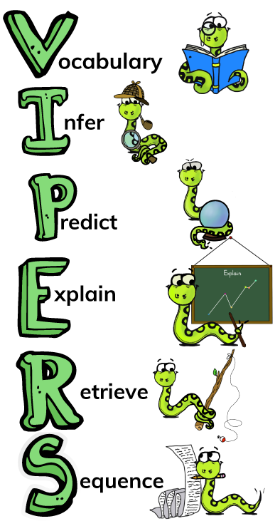
Reading
Reading for Pleasure
Exciting texts
Understanding different characteristics of the text using VIPERS.

Slide 6
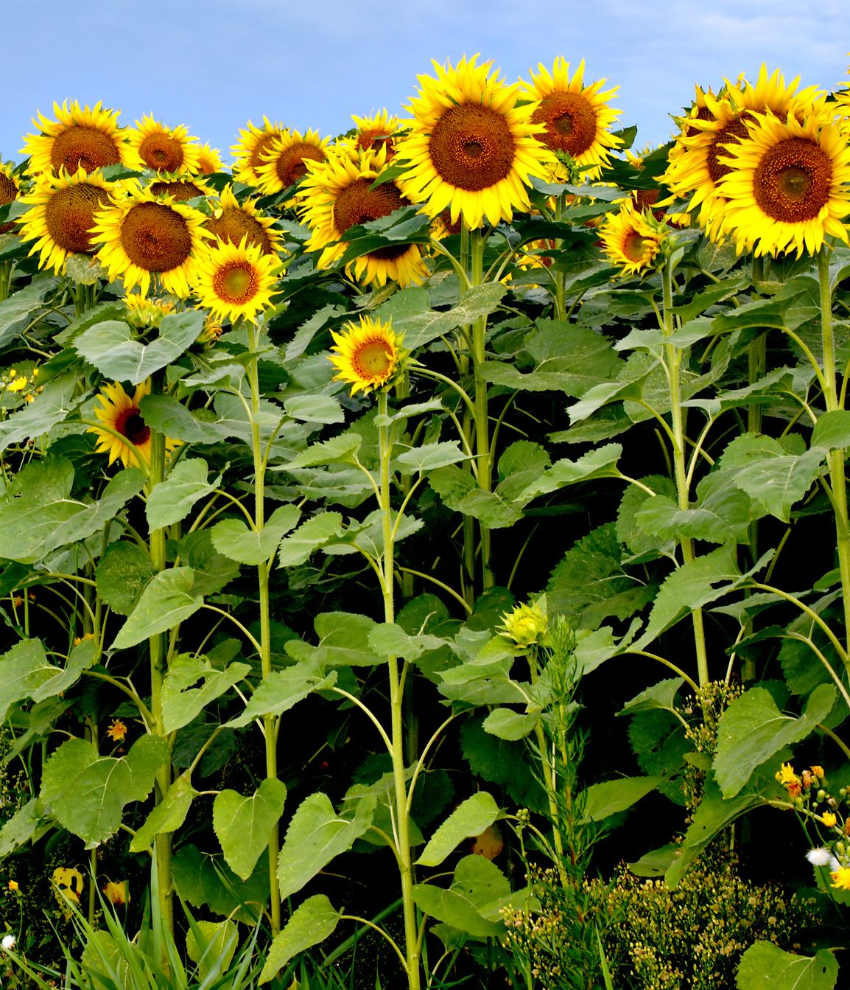
Science
Plants – how they grow, what they need etc.
Animals including humans – nutrition, bones, muscles, healthy eating
Bees – life-cycle, where honey comes from and their importance in the world

Slide 7
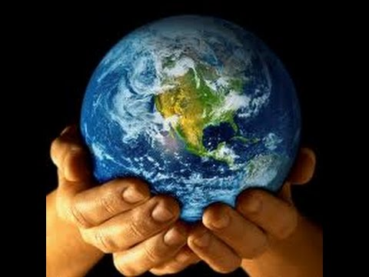
Geography
Locate and name the continents on a world map and describe the key geographical features
Identify key capital cities – find out and describe the key geographical features.
Make comparisons with the UK and Trinidad and Tobago – links with Gregory Cool
Use fieldwork to observe and record the human and physical features in the local area using a range of methods, including sketch maps, plans and graphs, and digital technologies.
Looking at the food we eat and where it comes from – what is produced in the UK vs what can we buy in the shops?
Climate zones and food production – fair trade and farming
Climate change and pollution - the affects locally and on beaches

Slide 8
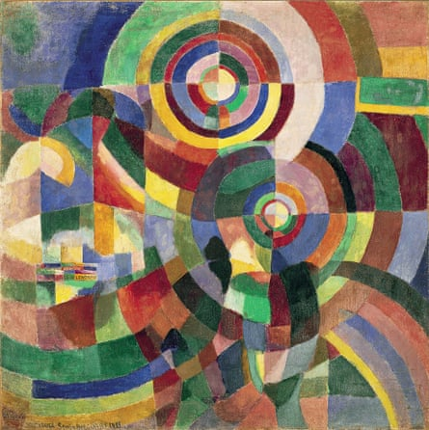
Art
Sonia Delaunay- thinking about bold colours and different brushstrokes.
Making their own vegetable or fruit cushion, applying their sewing skills.

Slide 9


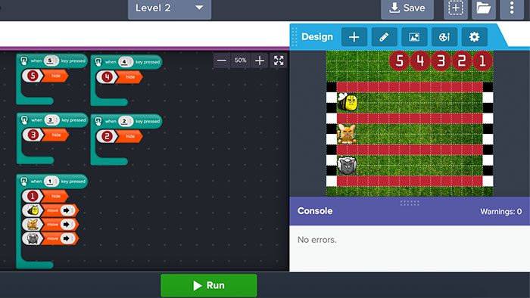
Computing
Google classroom projects
Espresso coding
E-Safety

Slide 10
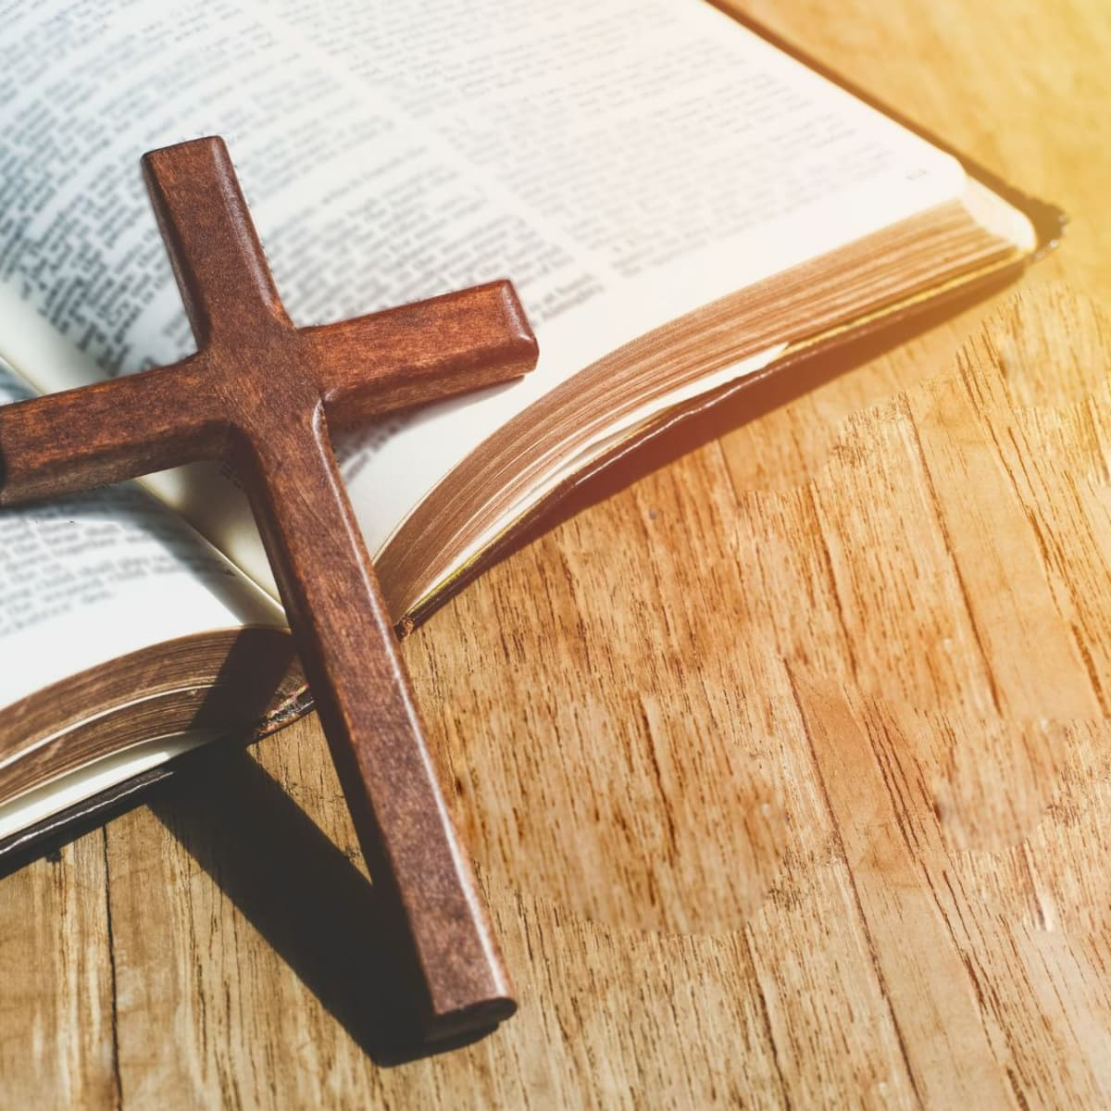

RE
What is the Bible and why is it important to Christians?
Islamic Rites of Passage

Slide 11

PSHE
Changes
RSE including family diversity
Good to be me
Growing an anti-racist-school

Slide 12
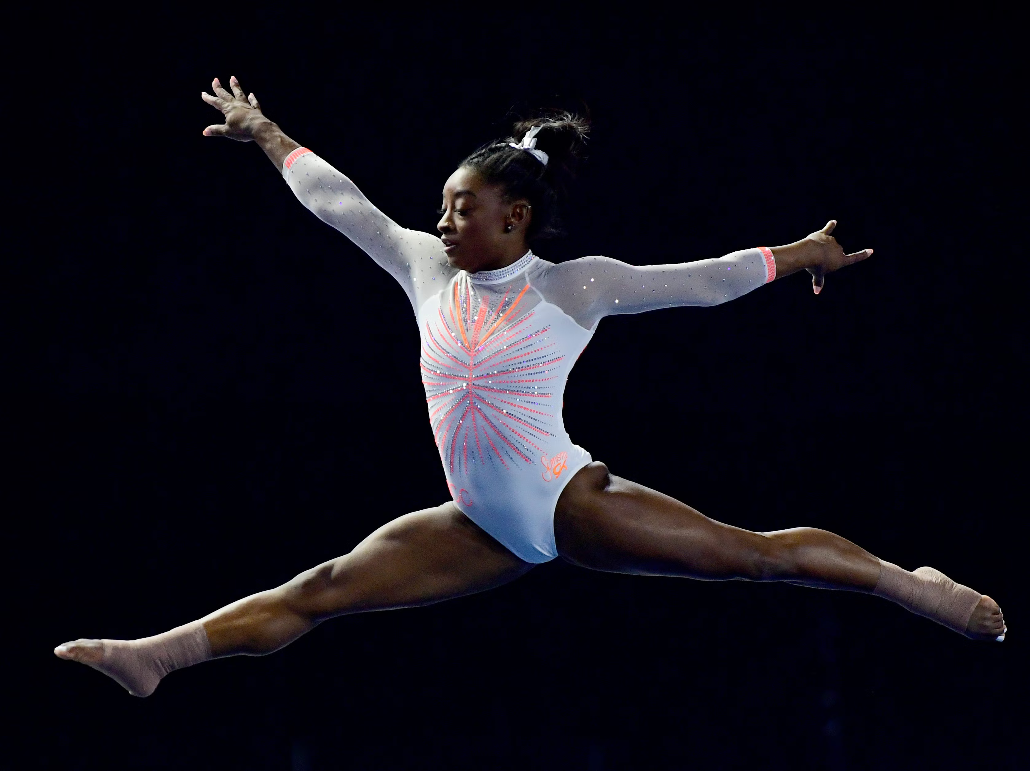
PE
Monday – Coach
Friday – Swimming
Sensible clothing
Weather appropriate
Footwear is vital

Slide 13
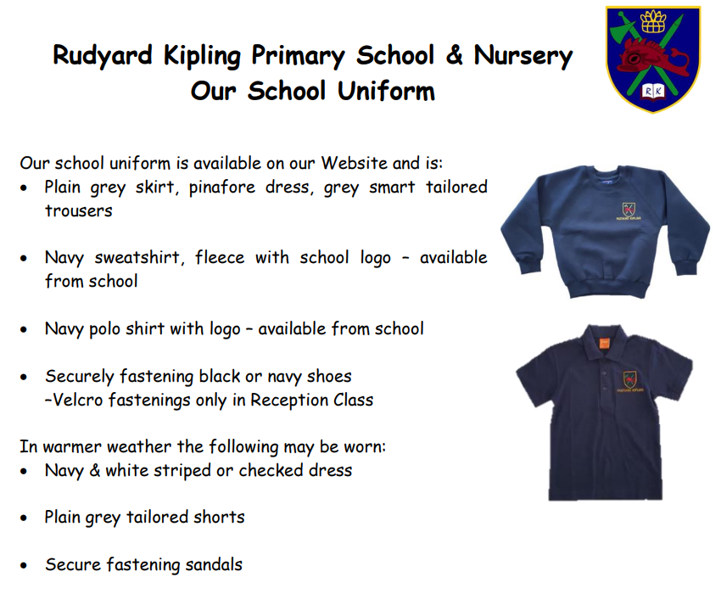
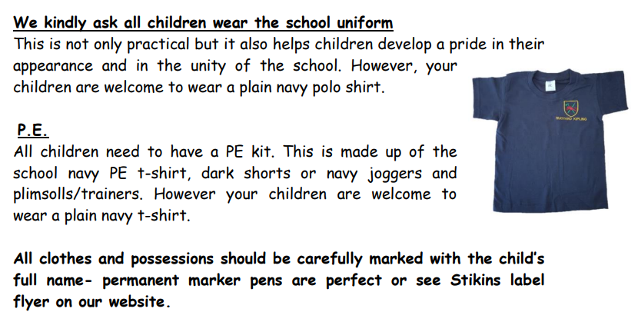
https://www.rudyardkiplingprimary.co.uk/assets/Documents/Attachments/School-Uniform-Code-2024-v3.pdf

Slide 14

Reading - Home
Reading for pleasure ☺
Read at home 3 times a week
Record this in your reading record.
Hand in every few days
Raffle ticket drawn in special mentions assembly every Friday.

Slide 15

Times Tables
When children can recall their times tables, they become more confident, which can help them tackle more challenging math problems.
Please continue to practise these at home to secure them

Slide 16

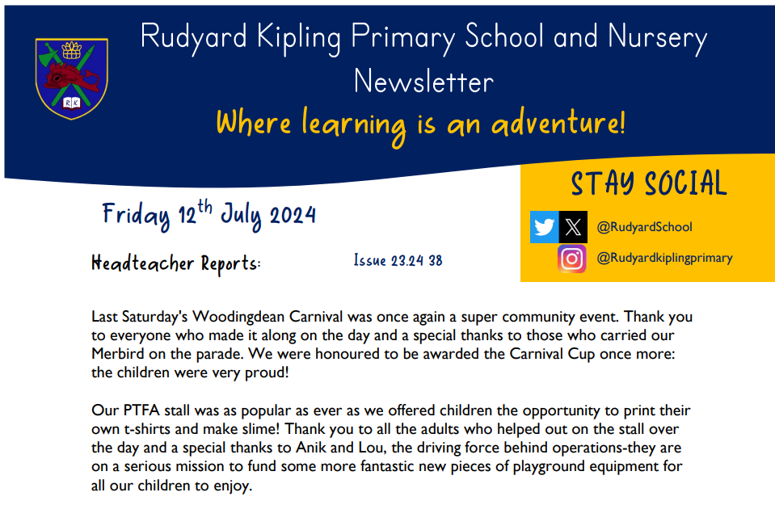
Communication
Rudyard Kipling Primary School and Nursery Newsletter.
School PING – Please download the app and sign in.
Details are available from the office.
Catch up at the end of the day.

Slide 17
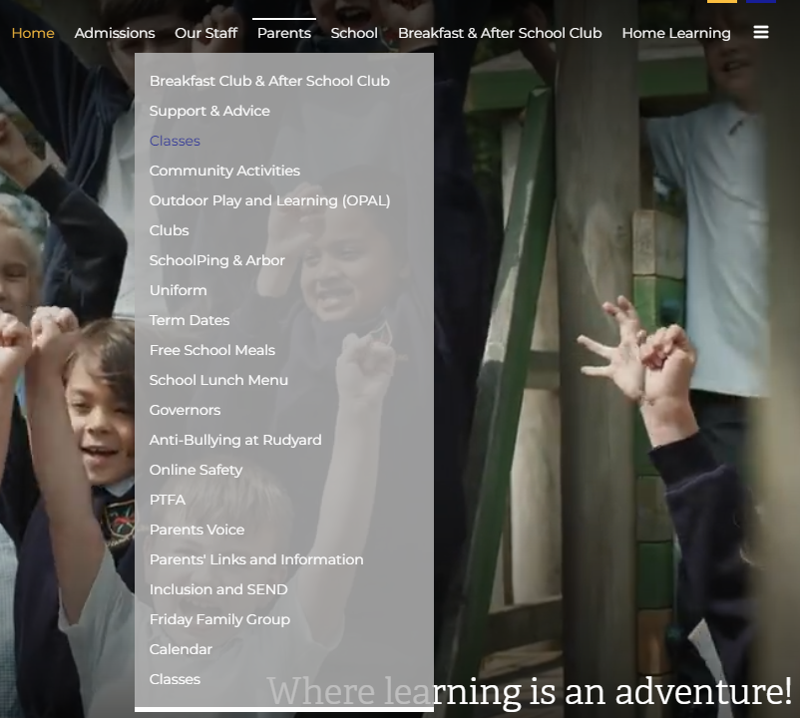
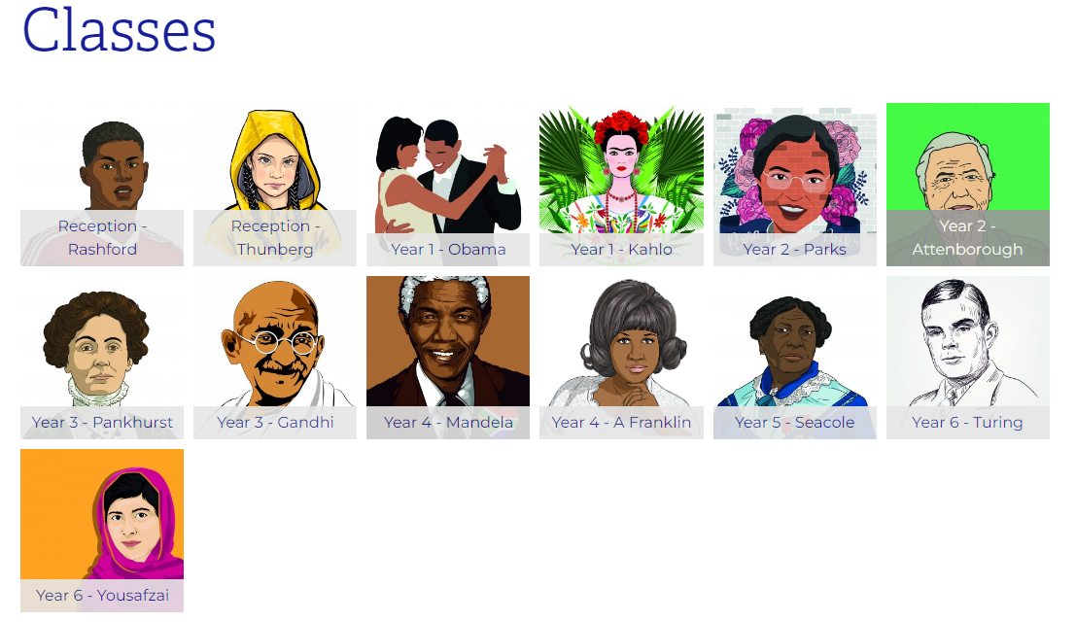
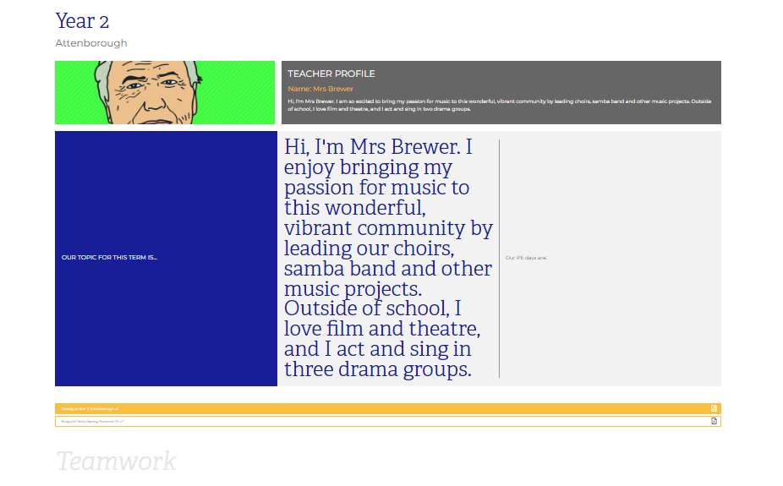
Class Page

Slide 18





Home Learning apps
TTRS; Spelling Shed; Google Classroom:
Logins: surnam:@rkps.me
Password: words123
Duolingo; White Rose 1minute maths: Free Apps

Slide 19
Any questions?

