Slide 1

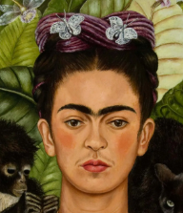

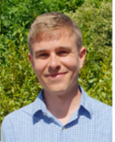

TOPIC TALK!
Summer Term
Mr Nicholson

Slide 2
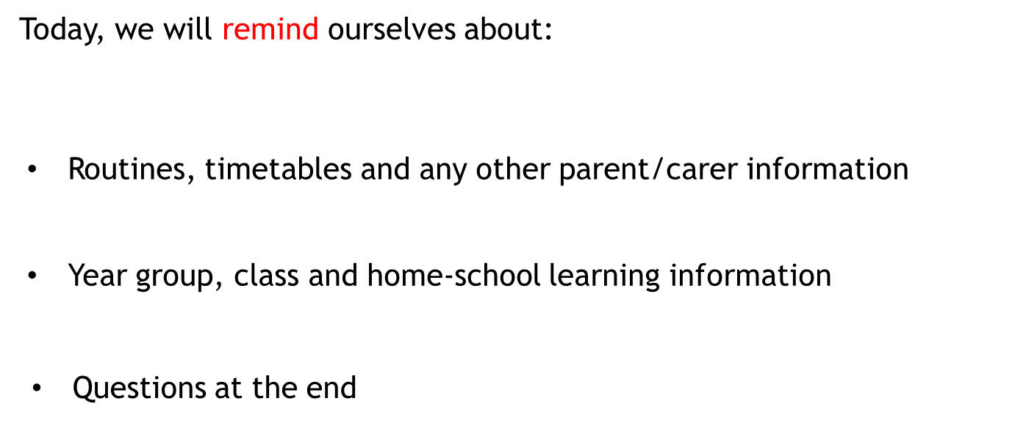


Slide 3
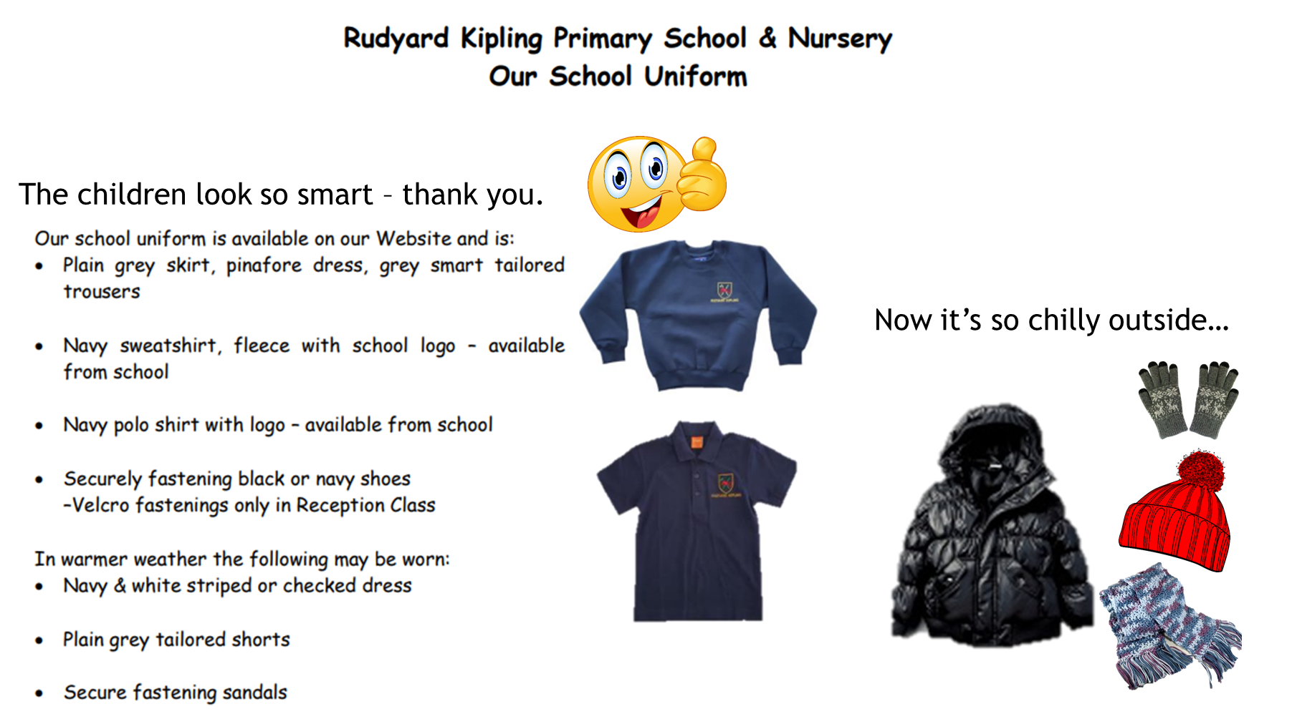

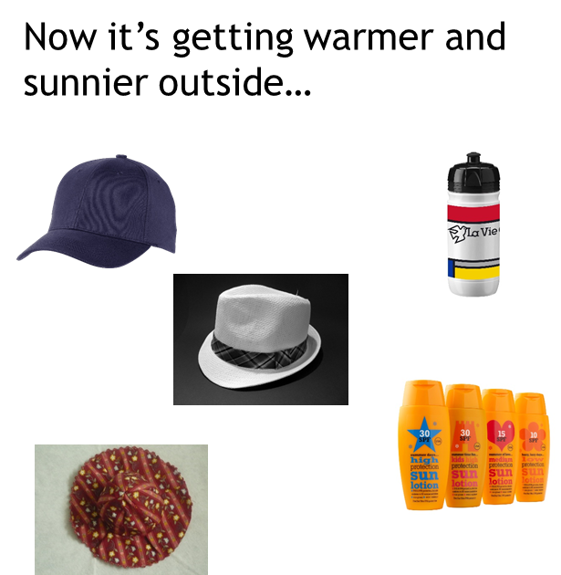

Slide 4
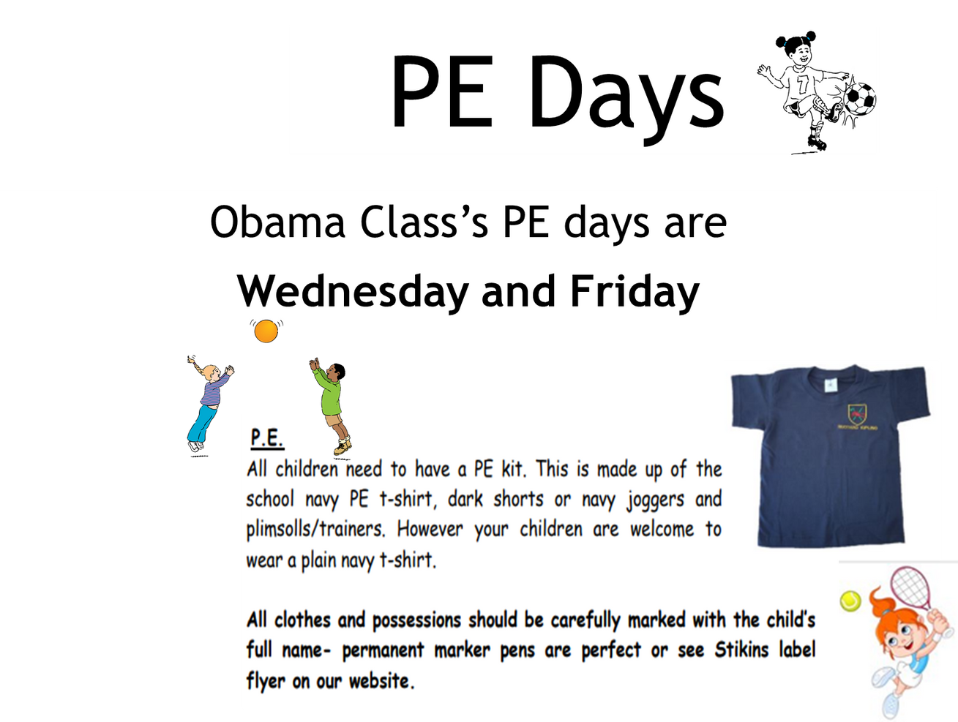



Slide 5




Slide 6


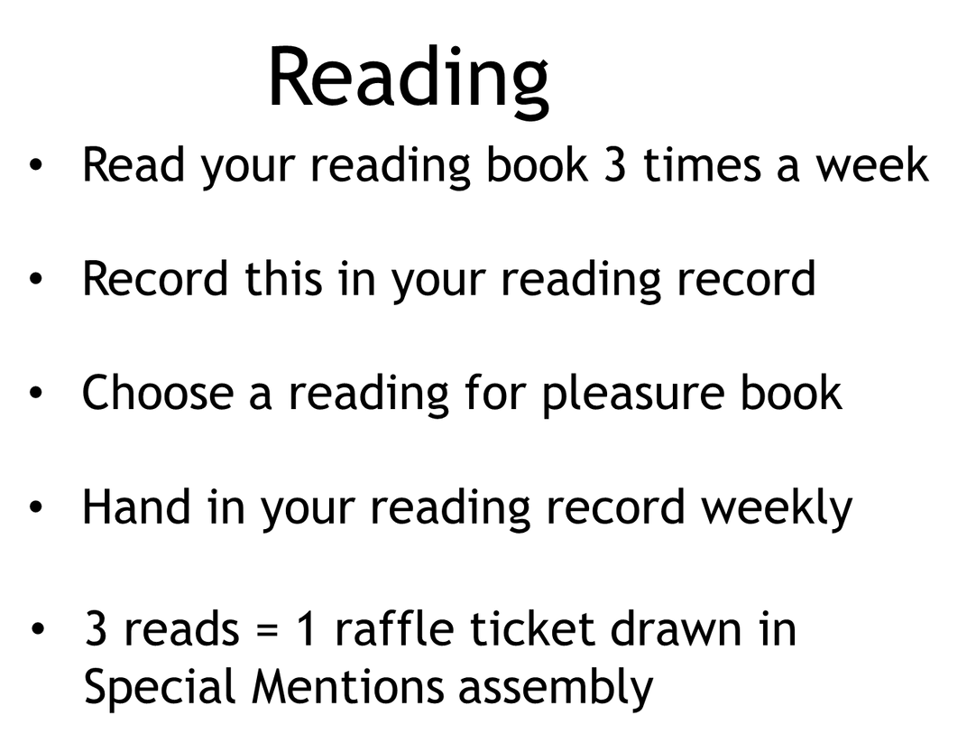
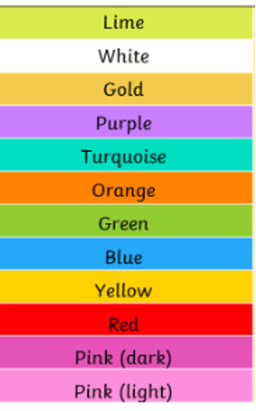

Slide 7
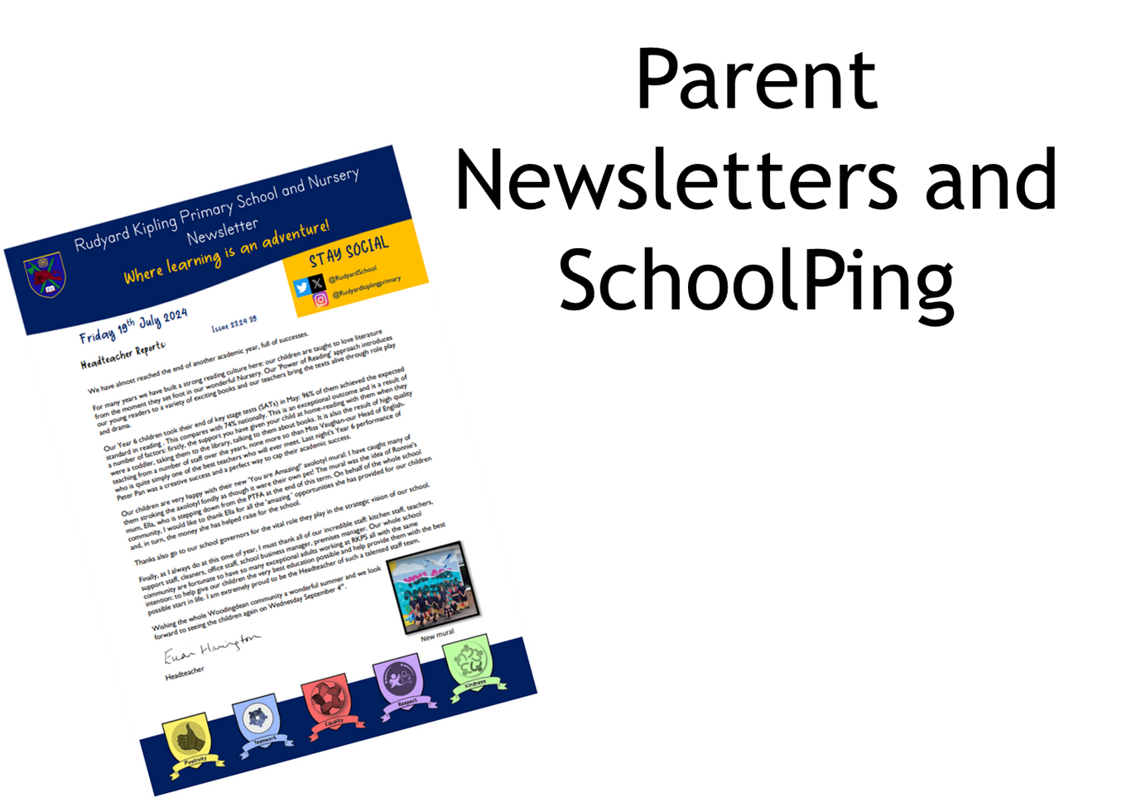



Slide 8


https://www.rudyardkiplingprimary.co.uk

Slide 9



Slide 10
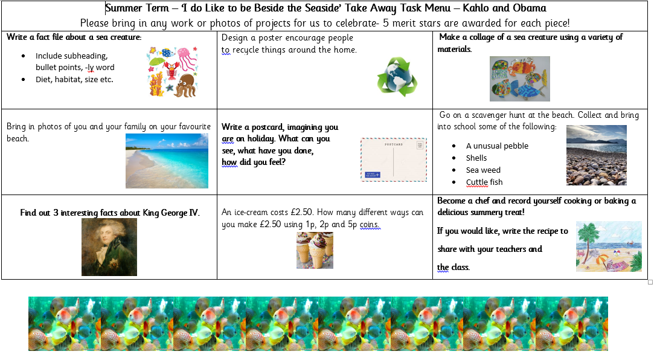

Slide 11
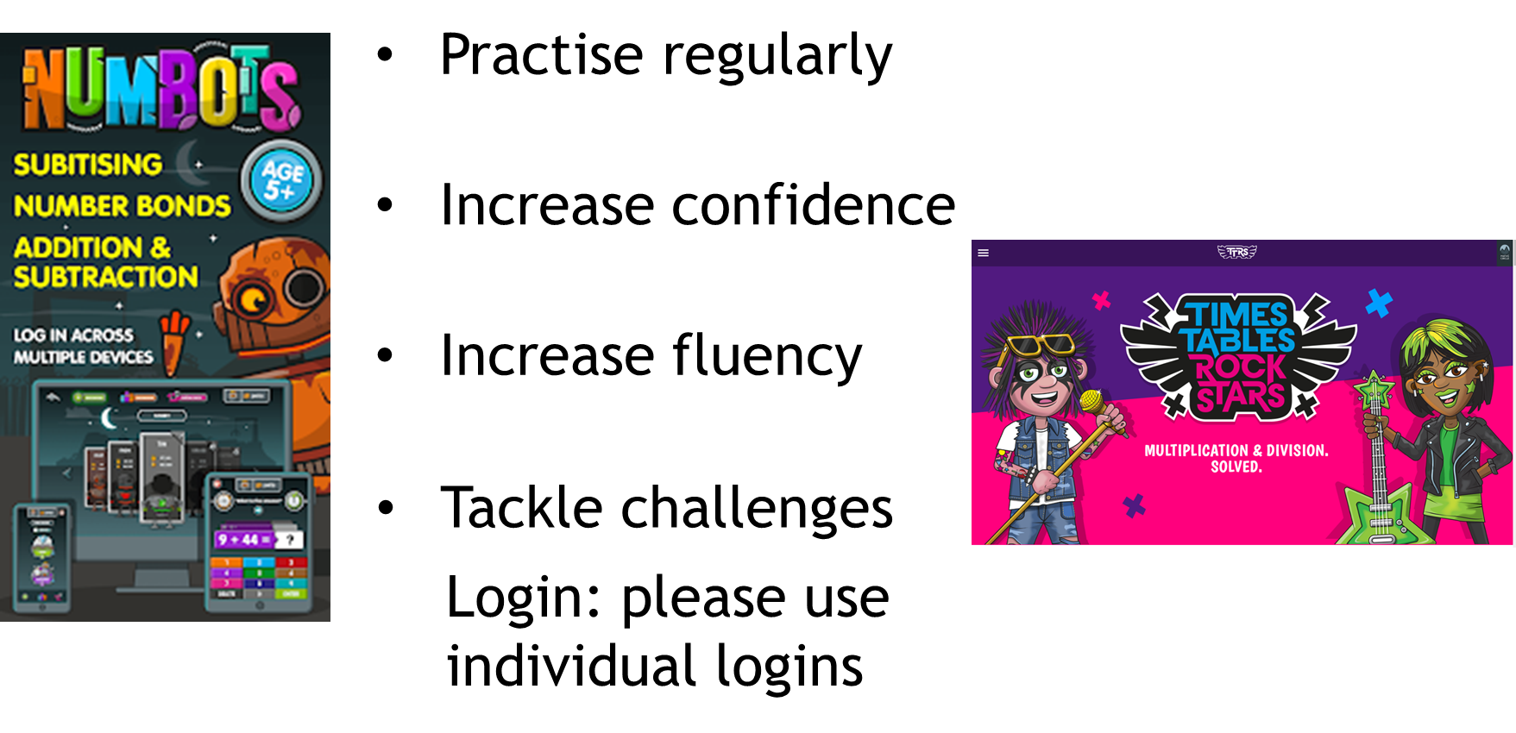


Slide 12
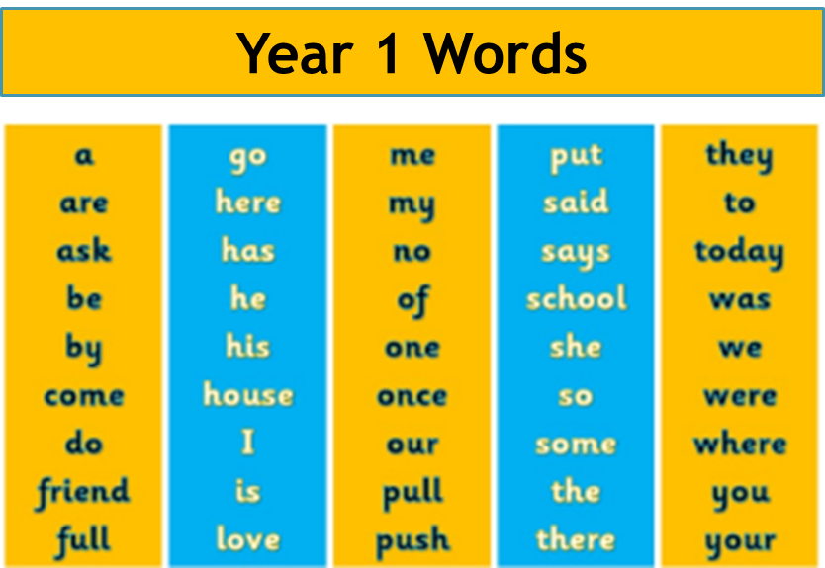
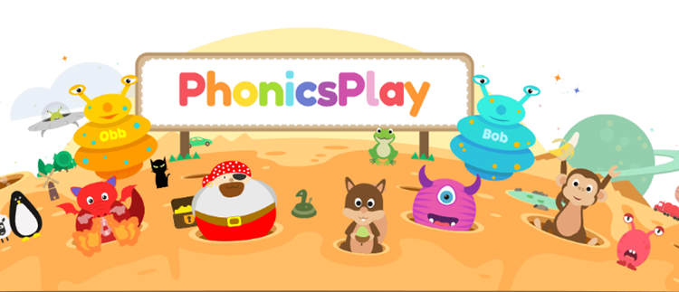
How can I support my child with spelling?
There are lots of amazing free games that help with spelling and phonics.

Slide 13
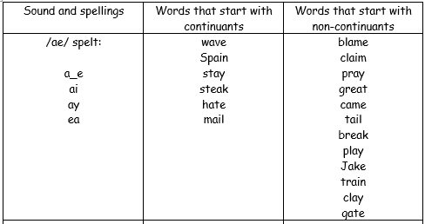
How can I support my child with spelling?

Slide 14
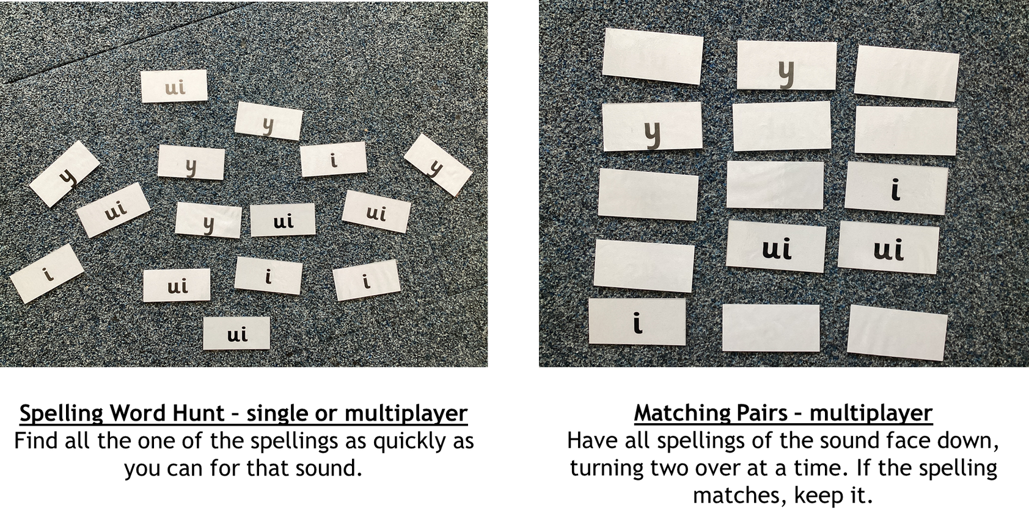
How can I support my child with spelling?
Phonics Screening – WB 9th June

Slide 15
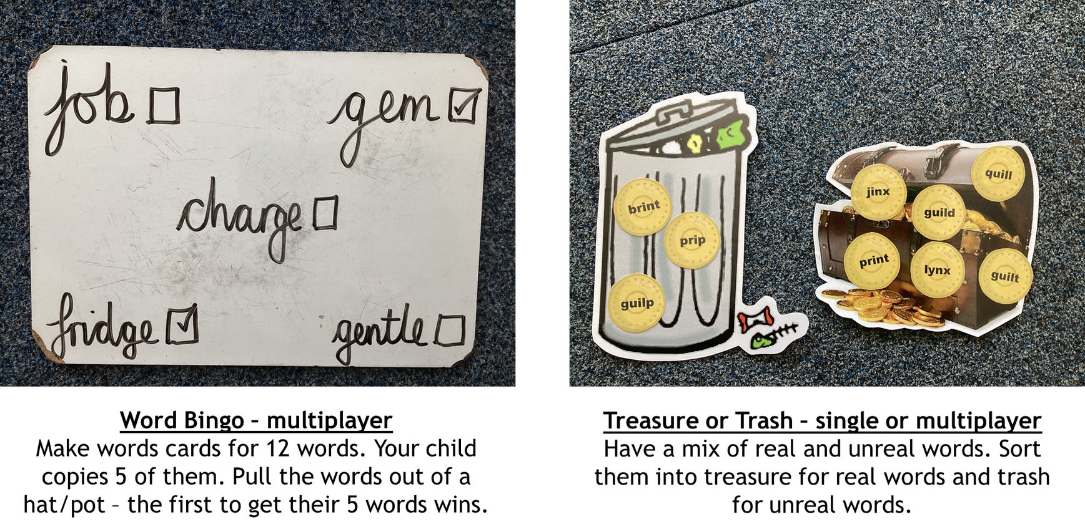

Slide 16

Reminders
Nut free school/allergy aware:
Please read ingredients before sending in a snack!
Teacher’s allergies:
Raw apples and carrots, nuts...have a conversation about washing hands after a snack!
Also any help in forest school and school trips is massively appreciated!

Slide 17



