Slide 1
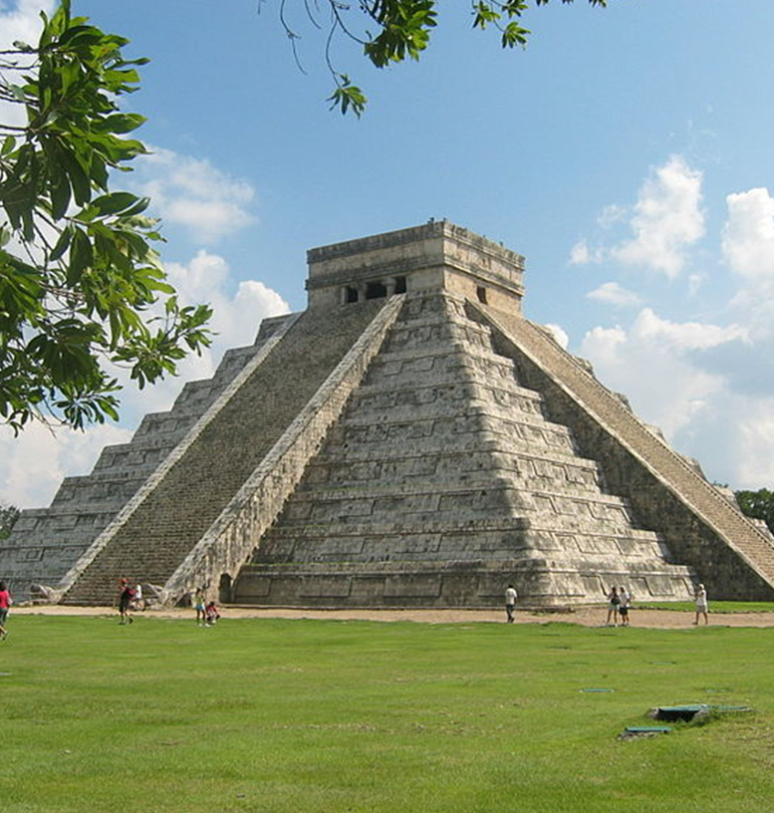
Year 4 Topic Chat Spring 2024
Viva Latina America

Slide 3
Stunning Start – Chocolate Drink Making
Marvellous Middle – School Trip (to La Choza, currently being organised)
Fabulous Finish – Create a temple for D&T and create Mayan headdresses

Slide 4
Homework
Homework is still applicable, the expectation is for children to practice:
Reading - Reading diaries need to be filled out for children to progress on the blast off scale and to be entered into the raffle.
Spellings - Children are to practice common exception and spelling words.
Times tables - Each child has a Times Table Rockstars account and login.
There is a times tables test for year 4 children, so it is vital they are practicing. (Times tables underpin so much of learning in Maths, so please do encourage children to become fluent).
Take home tasks

Slide 5
Uniform
Staff will be checking uniform regularly, please ensure your child has the correct school uniform daily.
PE
Please ensure your child has their PE kit in school. PE days are: Mandela Class - Monday – swimming/ gymnastics
Toys
Please discourage your child from bringing in toys. Children who require fiddle toys for reasons discussed with school is different.

