Slide 1





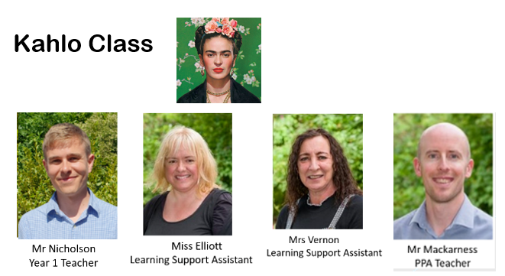
Meet the Teacher
Autumn Term

Slide 2
Today, we will talk about:
Routines, timetable and any other parent/carer information
Year group, class and home-school learning information
Questions at the end

Slide 3


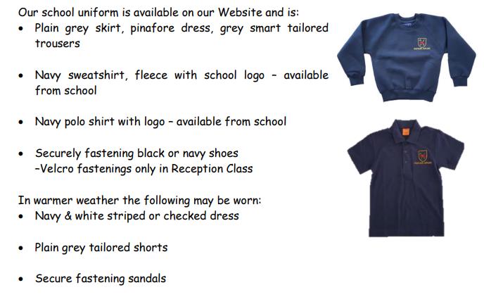
The children look so smart – thank you.

Slide 4
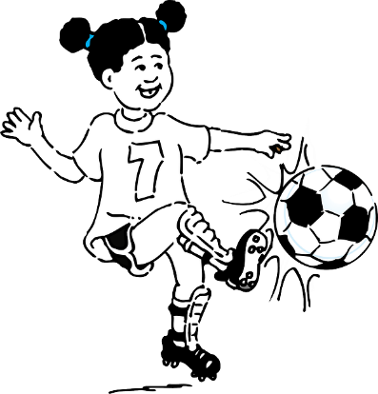
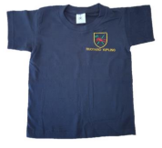
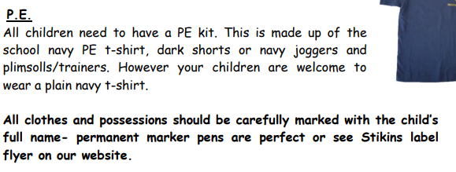

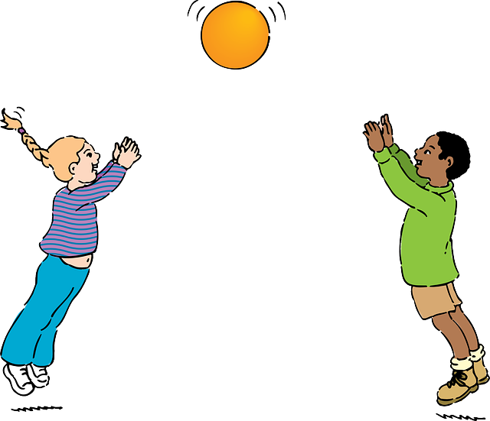
PE Days
Kahlo’s Class’s PE days are
Monday and Wednesday

Slide 5



Special Mentions
Special Mentions assemblies are every Friday after Rock Up and Read.
You will receive a Ping on the Friday before. Your child will also get a sticker.
You will also receive a Ping for Merit Star chart completion the Friday prior to the award.

Slide 6


Rock Up And Read
Every Friday at 8:40-9:00
I will sign any reading records on the Friday and give out raffle tickets. During rock up and read change your child’s book. They need 1 colour book and 1 phonics book per week.

Slide 7
Reading
Read your reading book 3 times a week
Record this in your reading record
Choose a reading for pleasure book
Hand in your reading record weekly
3 reads = 1 raffle ticket drawn in Special Mentions assembly

Slide 8
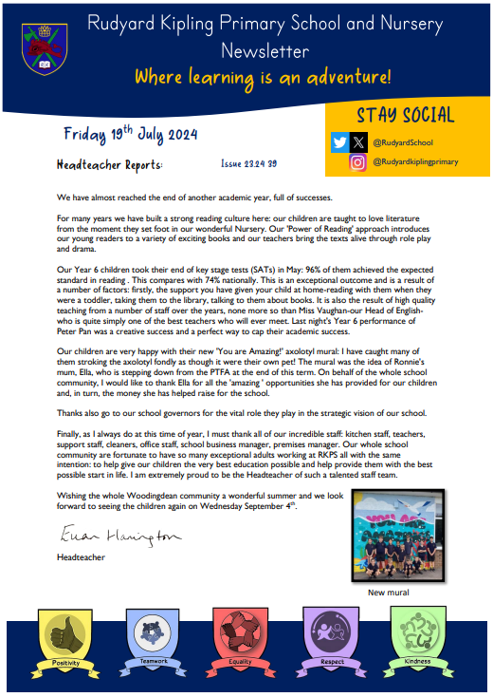

Parent Newsletters and SchoolPing
Use your SchoolPing account to receive important messages.

Slide 9
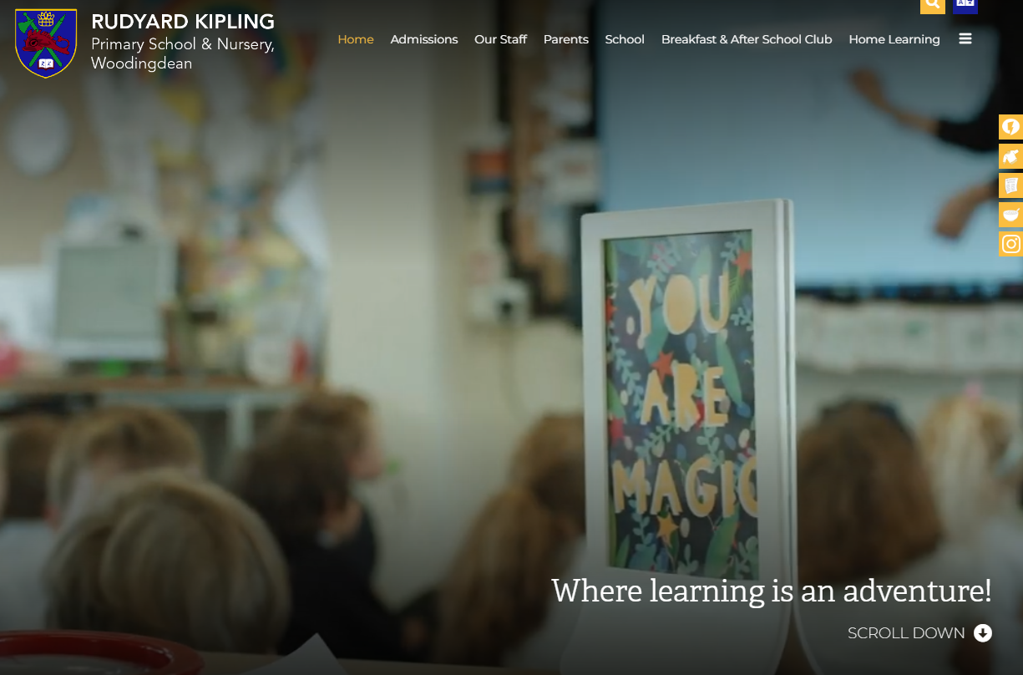
School Website
https://www.rudyardkiplingprimary.co.uk/

Slide 10

Home learning
I will often send work home for the children, usually phonics. It is optional work that you can choose to complete if your child would like to. Other than this Numbots, reading and spelling are things that your child can do at home. I will cover these in the next few slides.

Slide 11

Practise regularly
Increase confidence
Increase fluency
Tackle challenges
Login: surnam:@rkps.me
Password: words123

Slide 12

How can I support my child with reading?
It is amazing to read to your children! However it is even more important if they can read to you. Let your child “sound out” words instead of saying it for them. At least 3 times of a week makes a huge difference.

Slide 13
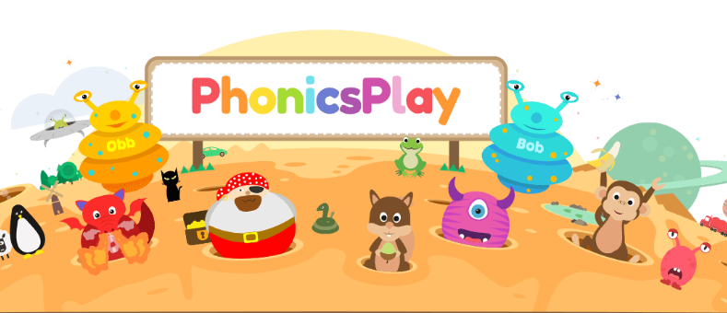

How can I support my child with spelling?
Year 1 Words
There are lots of amazing free games that help with spelling and phonics.

Slide 14
Any questions?

