Slide 1





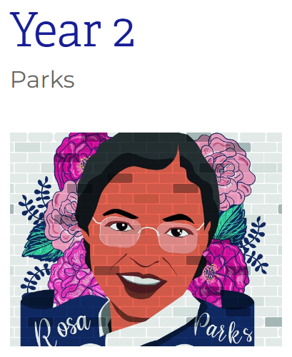
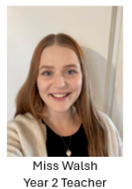
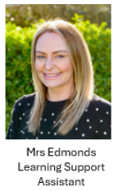
Meet the Teacher
Autumn Term
Meet the adults in Parks Class:

Slide 2
Today we will discuss:
Routines, timetables and other parent/ carer information
Year group/ class and home-school learning information
Questions (at the end)

Slide 3
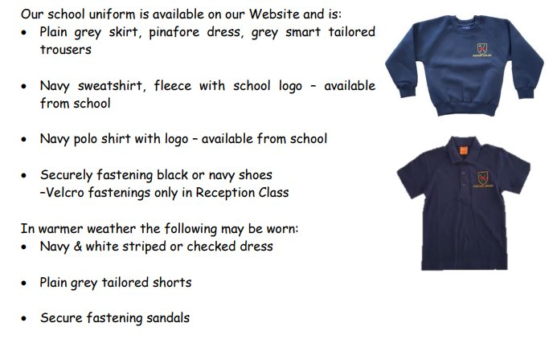
Our school uniform
The children look so smart already - thank you!

Slide 4
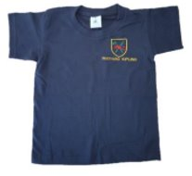
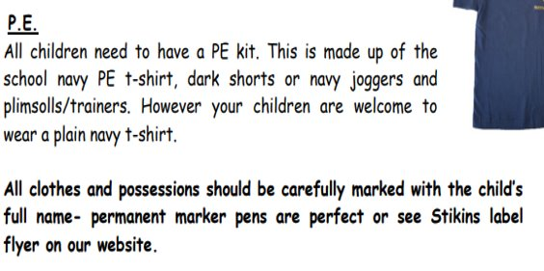


Our PE Day:
Monday
With Mr Hoad

Slide 5
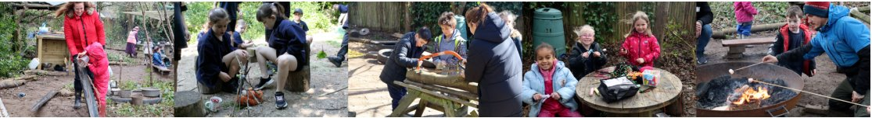
Forest school:
Autumn 1 - Tuesdays
With Mr Westcott
For Autumn 1 we will have Forest School once a week for a full afternoon.
Please ensure children have spare clothes and that clothing covers their arms and legs.
Parent helpers are warmly welcomed!

Slide 6



Special mentions assemblies
Special Mentions assemblies are every Friday morning straight after Rock Up and Read.
You will receive an Arbor notification the Friday before.
You will also receive a notification if your child will be awarded a merit star badge, a Maths Mission certificate or Pen License the Friday before.

Slide 7

Rock up and read: every Friday from 8:40-9:00

Slide 8
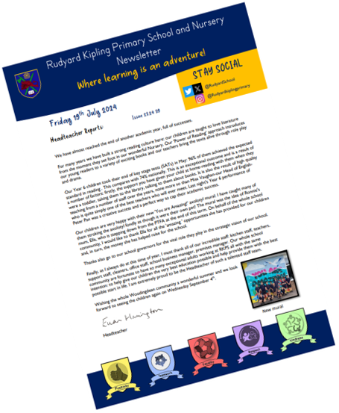
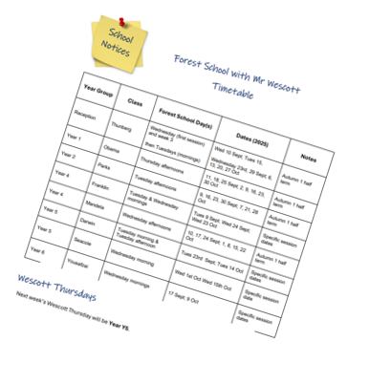
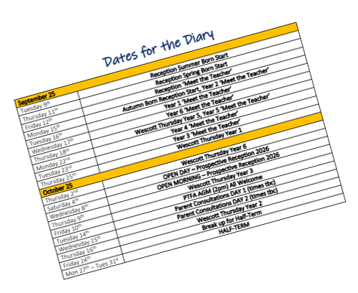
Parents newsletter

Slide 9

notifications
Letters and admin
Bookings
Special Mentions
We no longer use PING!

Slide 10
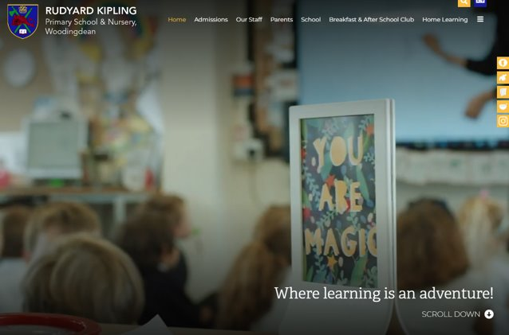
School website
www.rudyardkiplingprimary.co.uk

Slide 11
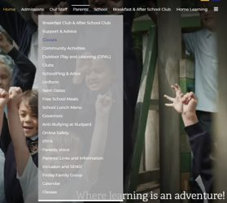
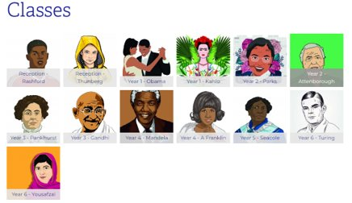
Class page

Slide 12
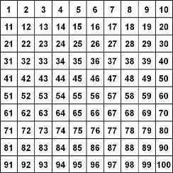
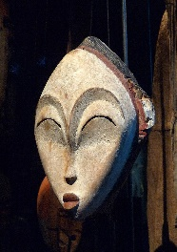

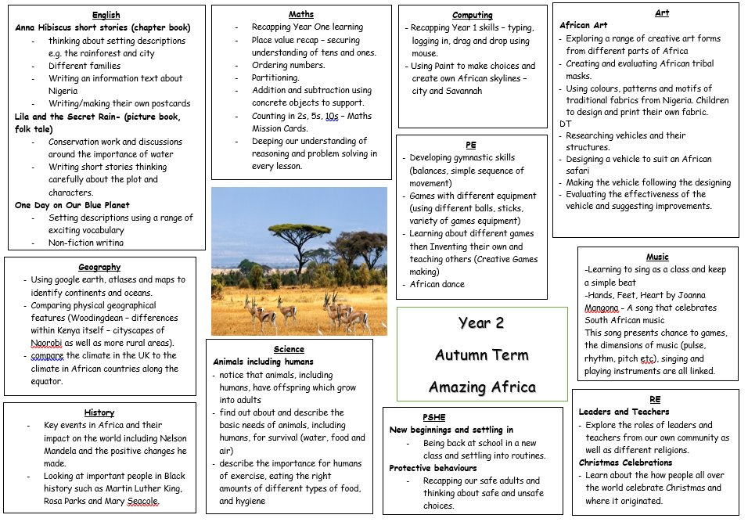





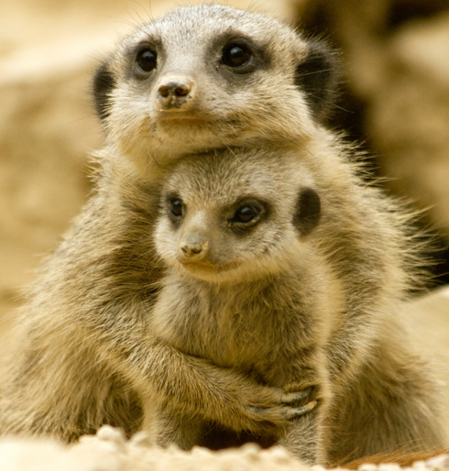


Curriculum map

Slide 13
Parks days for:
Computing - Wednesday
Library:
Key dates:
Christmas show – Dress rehearsal on 8th December, performances on 9th and 10th December at 9:15am
Upcoming trips: local walk in Spring term, Drusillas in summer term

Slide 14
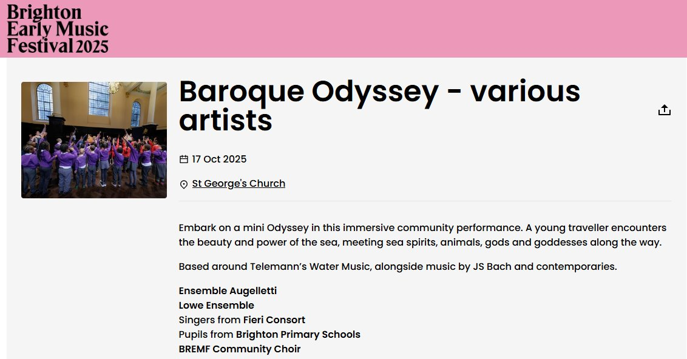
2025 Brighton and Hove early music festival – Year 2
Friday 17th October - lunchtime

Slide 15


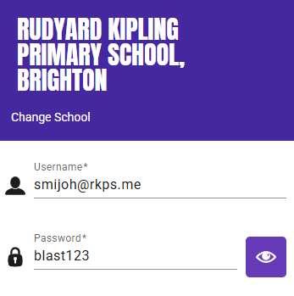
Times tables homework will start later this year
Practice regularly
Increase confidence
Increase fluency
Tackle challenges
Login details:
Username: surname@rkps.me
Password: words123
Can be printed late this week
Example: John Smith

Slide 16


reading
Pick up a new book weekly on a Friday morning.
Read your book 3 times a week and record in your reading record.
Choose a reading for pleasure book.
Hand in your reading record book weekly.
3 reads = 1 raffle ticket drawn in Special Mentions assembly

Slide 17
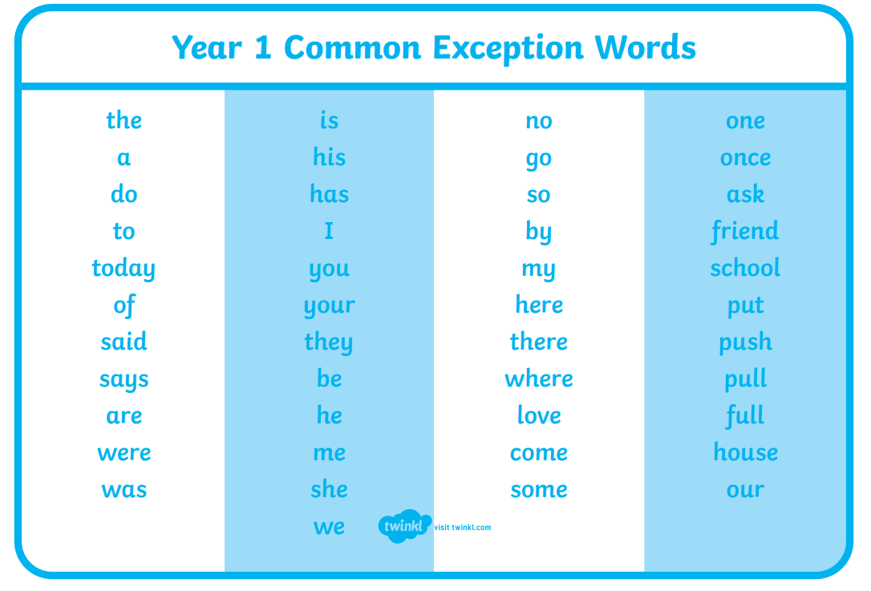
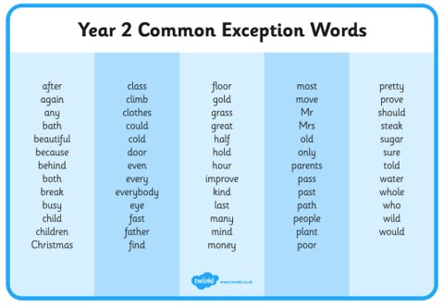
Supporting with spelling
Year 1 Words
Year 2 Words

Slide 18
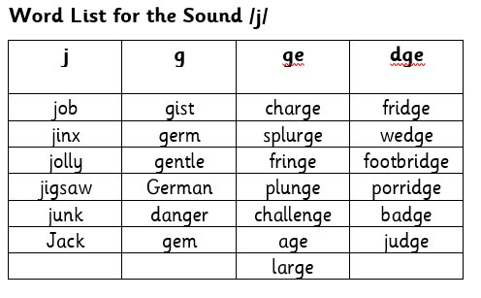

phonics
Every 2 weeks, your child will be given a list of words that have our fortnightly sound. This will show how that sound is represented by different spellings.

Slide 19
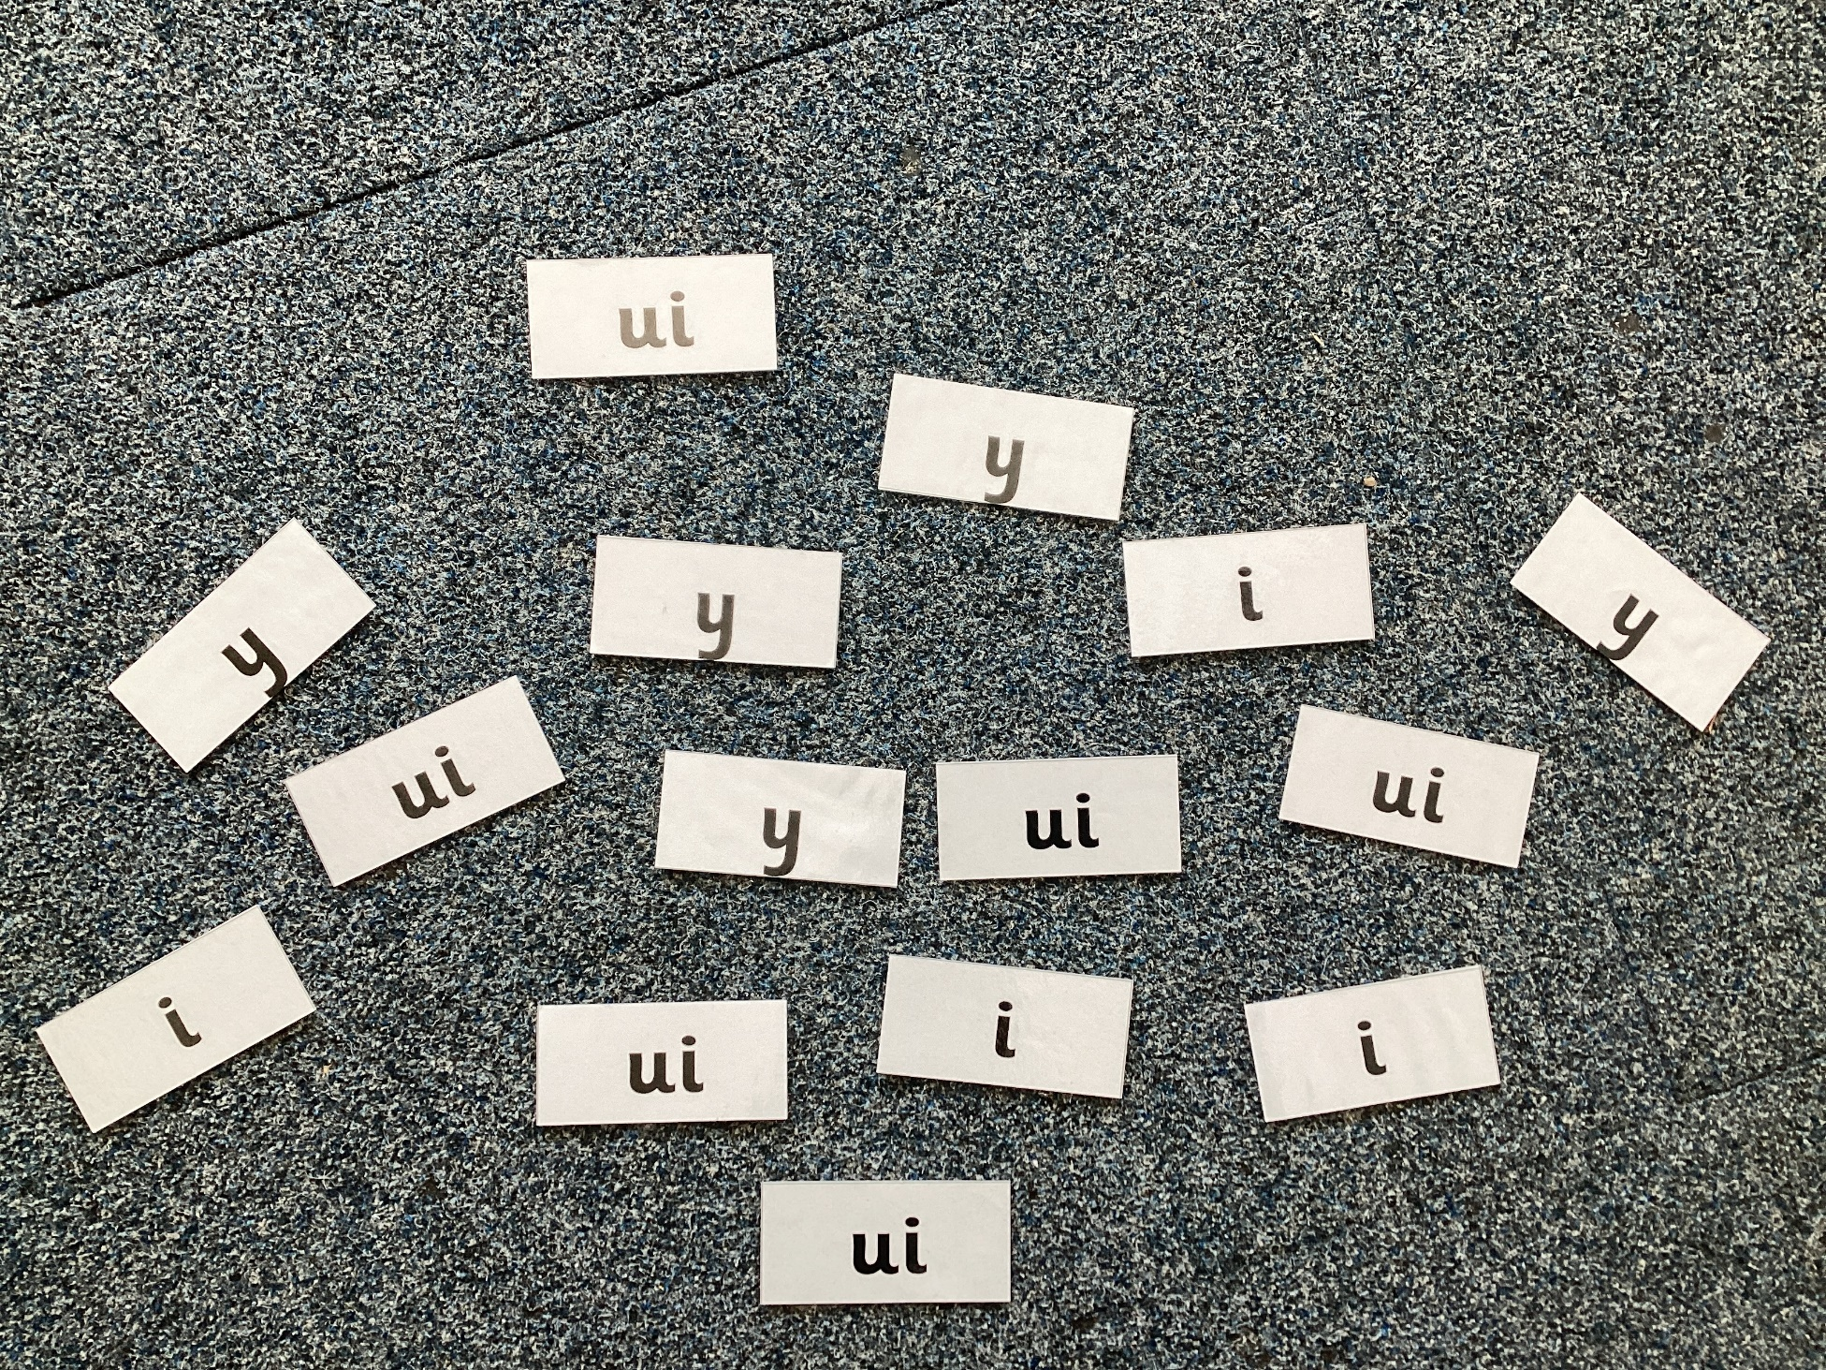
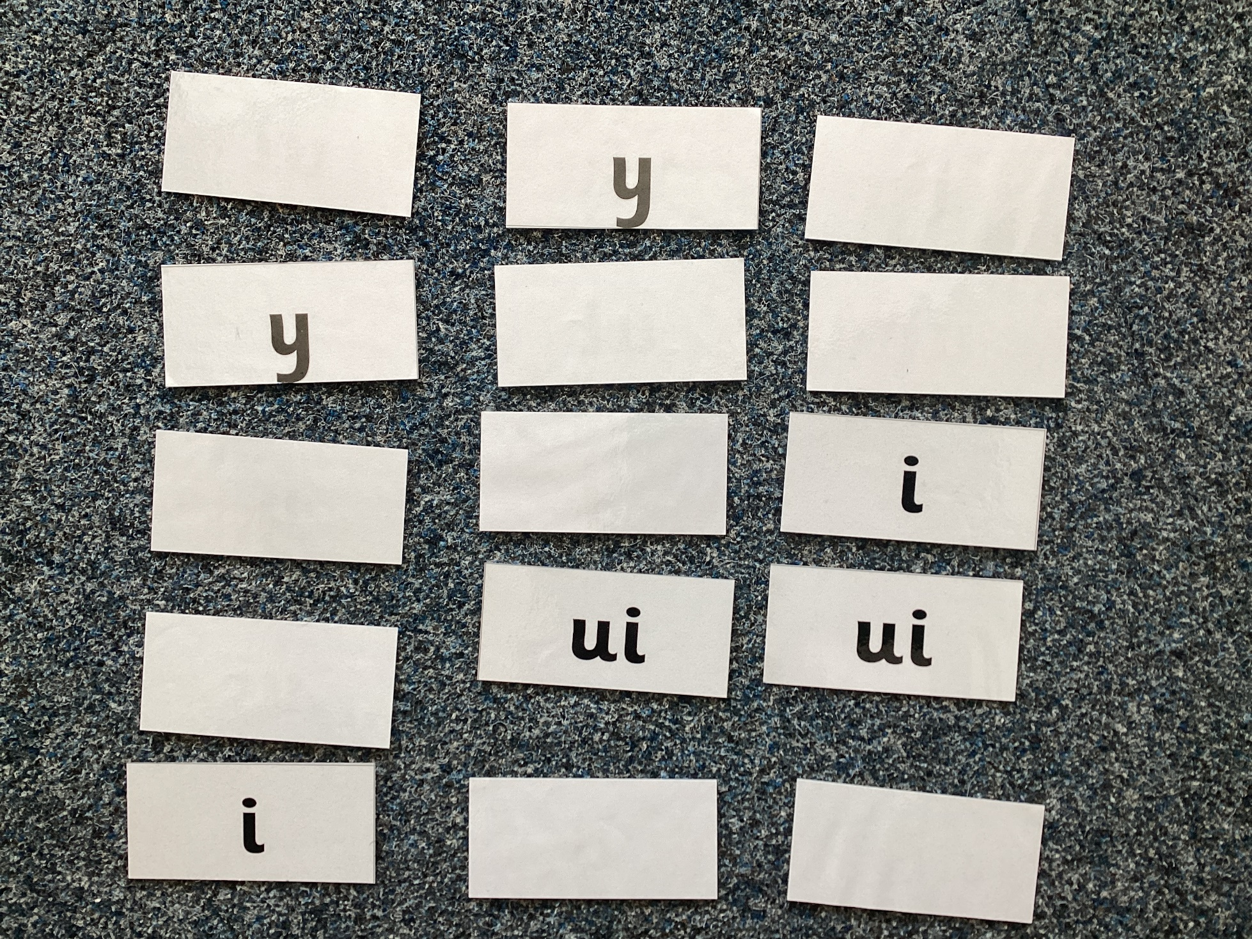
Phonics games
Spelling Word Hunt – single or multiplayer
Find all the one of the spellings as quickly as you can for that sound.
Matching Pairs – multiplayer
Have all spellings of the sound face down, turning two over at a time. If the spelling matches, keep it.

Slide 20
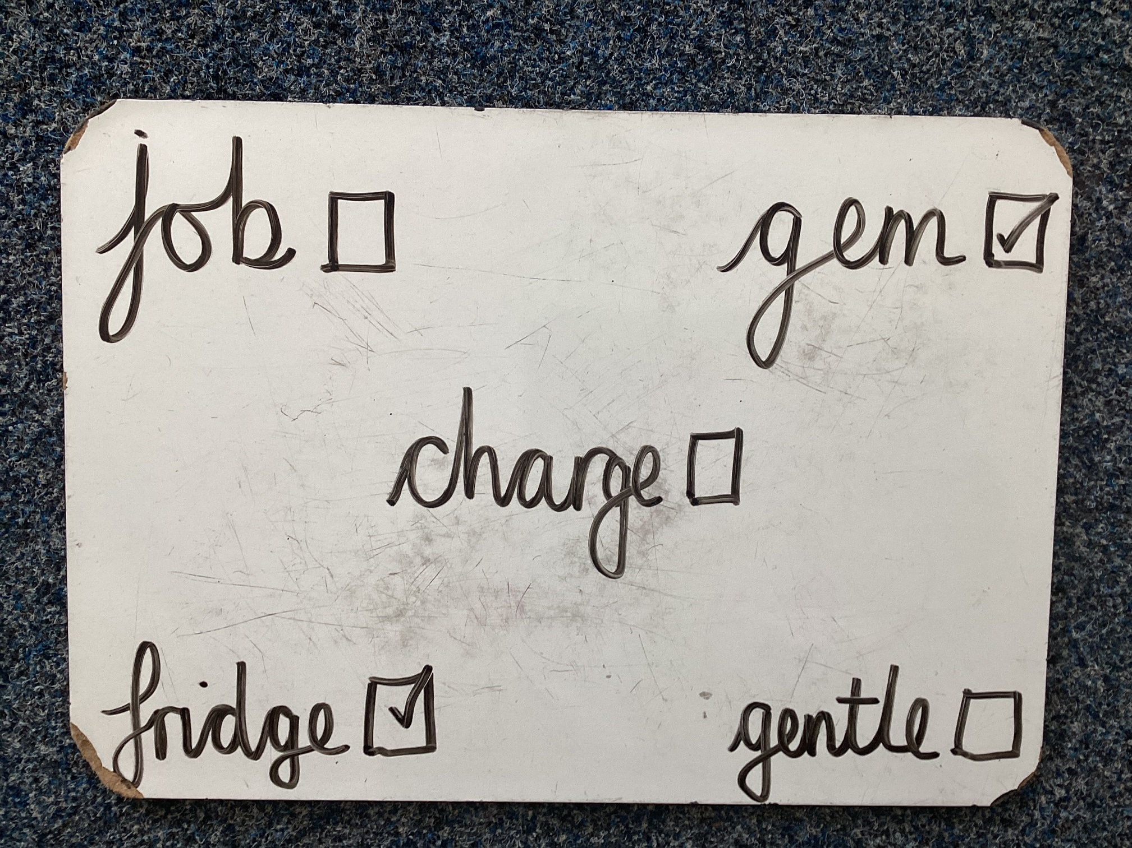
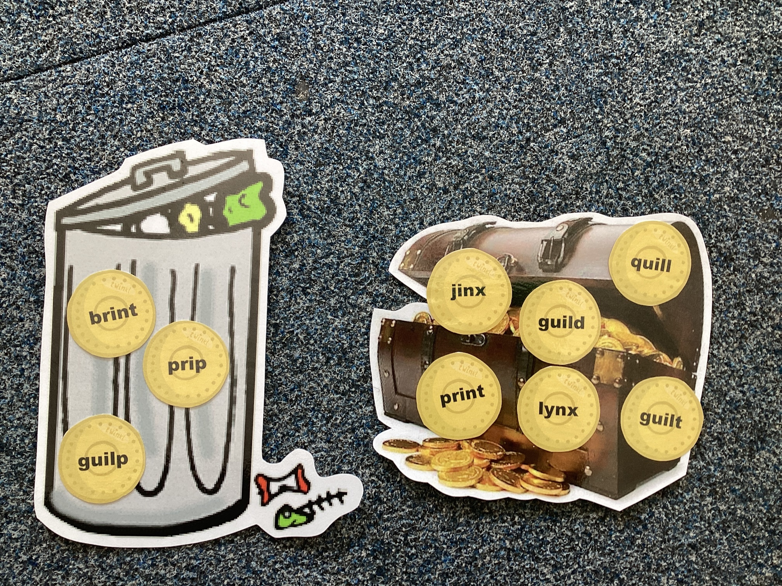
Phonics games
Word Bingo – multiplayer
Make words cards for 12 words. Your child copies 5 of them. Pull the words out of a hat/pot – the first to get their 5 words wins.
Treasure or Trash – single or multiplayer
Have a mix of real and unreal words. Sort them into treasure for real words and trash for unreal words.

Slide 21
Phonics games
There will be a phonics workshop for parents and carers later this term!
Word Bingo – multiplayer
Make words cards for 12 words. Your child copies 5 of them. Pull the words out of a hat/pot – the first to get their 5 words wins.
Treasure or Trash – single or multiplayer
Have a mix of real and unreal words. Sort them into treasure for real words and trash for unreal words.

Slide 22
Any questions? ☺

