Slide 1







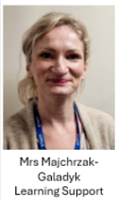

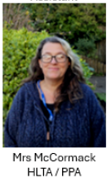
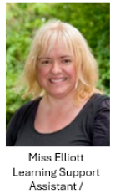
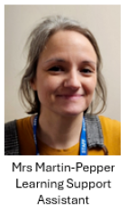
Meet the Teacher
Autumn Term
Attenborough Class
Meet the adults in Attenborough class

Slide 2
Today, we will talk about:
Routines, timetable and any other parent/carer information
Year group, class and home-school learning information
Questions at the end

Slide 3


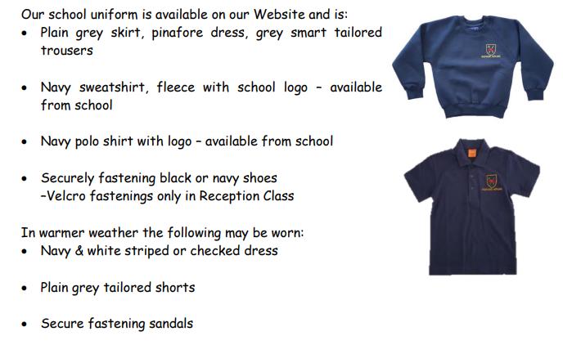
The children look so smart – thank you.

Slide 4

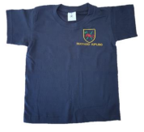
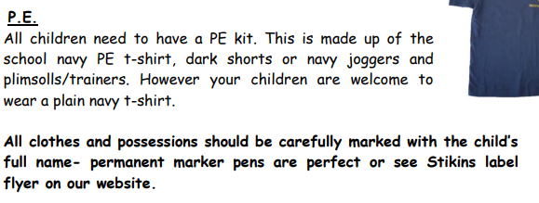


PE Days
Attenborough Class PE day is
Monday

Slide 5
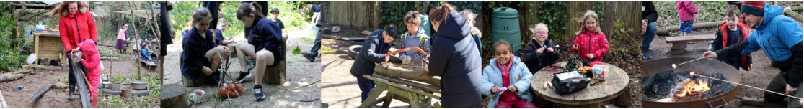
Forest School
Attenborough Forest School will be once a week next half term.

Slide 6




Special Mentions
Special Mentions assemblies are every Friday after Rock Up and Read.
You will receive an Arbor notification on the Friday before.
You will also receive an Arbor notification for Merit Star and Maths Mission Awards on the Friday before.

Slide 7


Rock Up And Read
Every Friday at 8:40-9:00

Slide 8
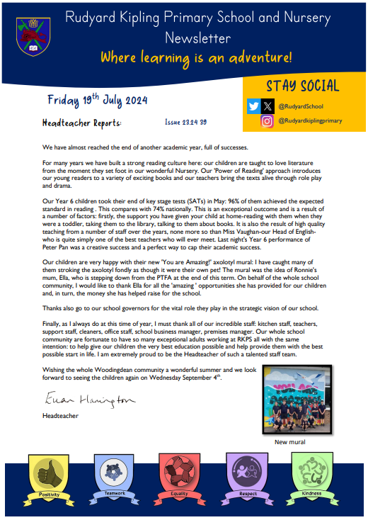
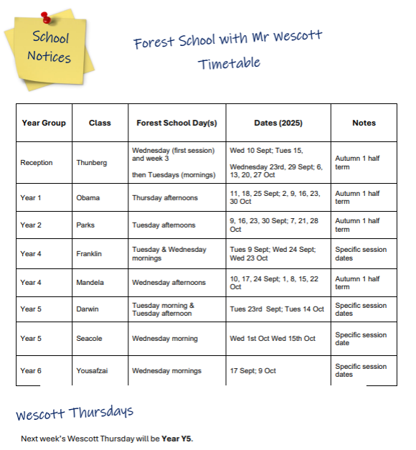
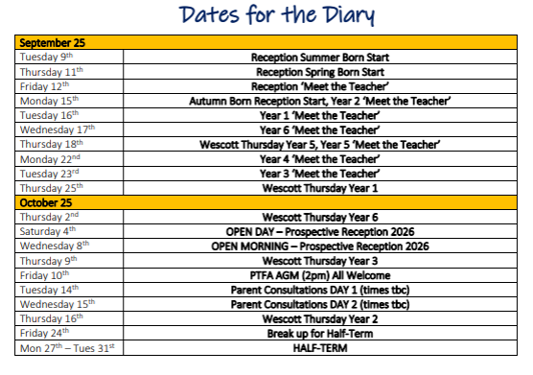
Parent Newsletters

Slide 9

Letters and admin
Bookings
We no longer use Ping!

Slide 10
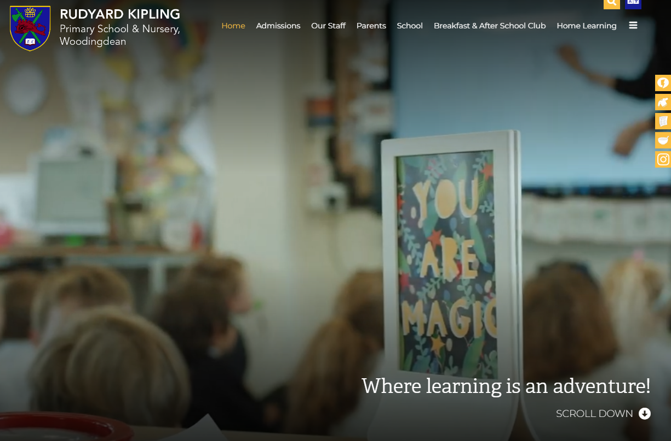
School Website
https://www.rudyardkiplingprimary.co.uk/

Slide 11
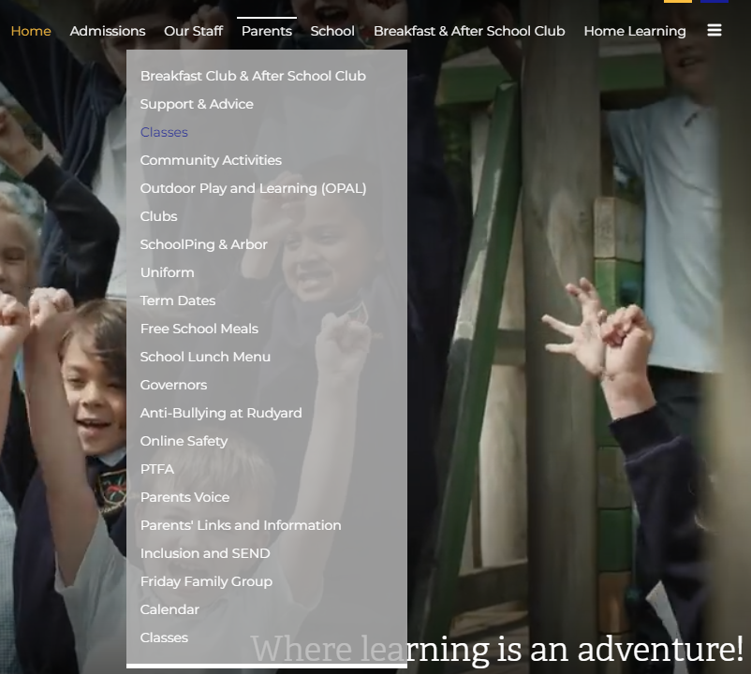
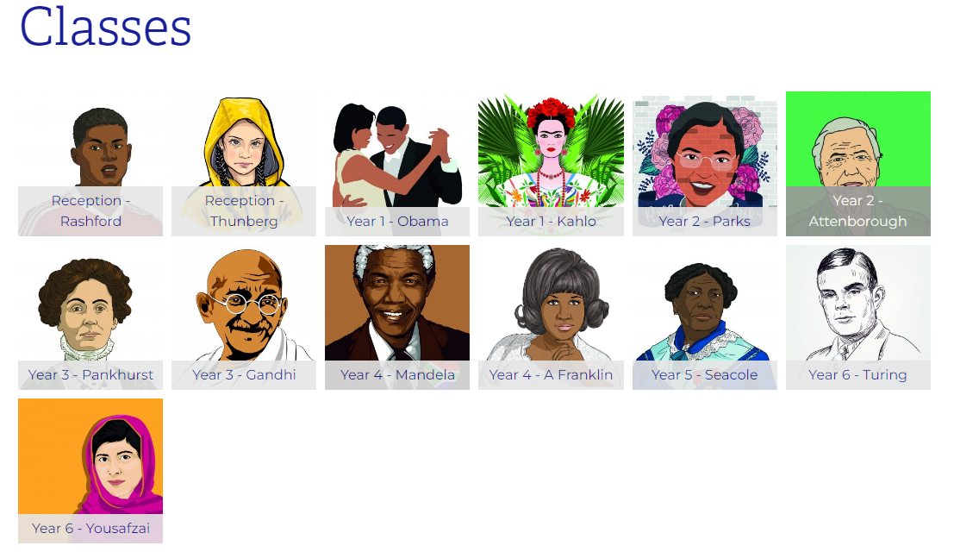
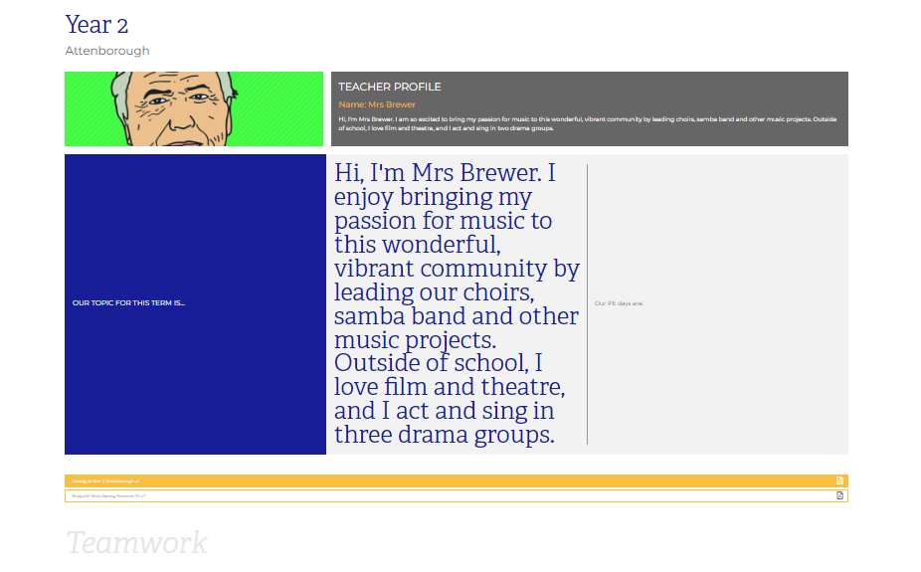
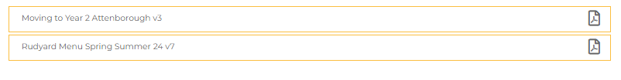
Class Page

Slide 12
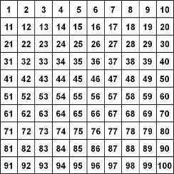
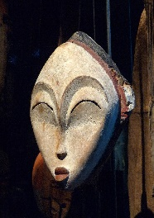
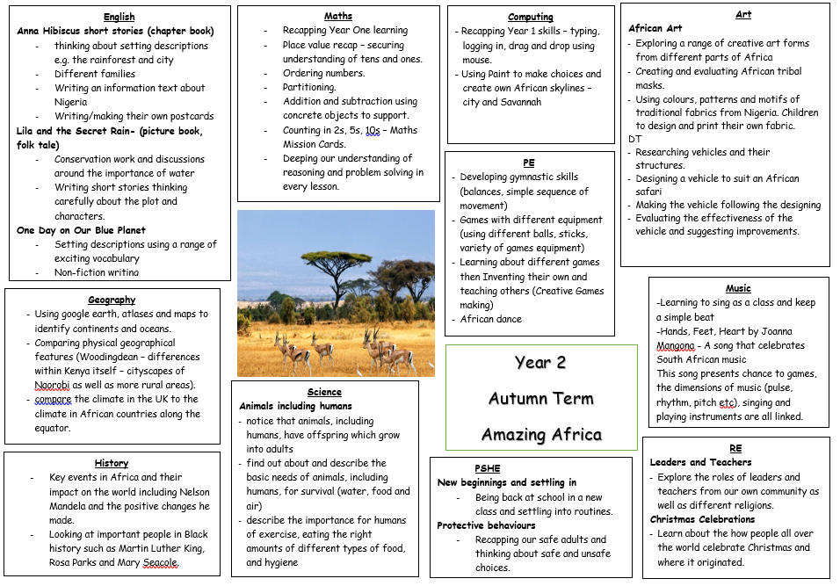






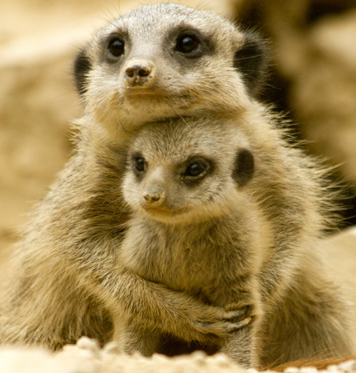


Curriculum Map

Slide 13
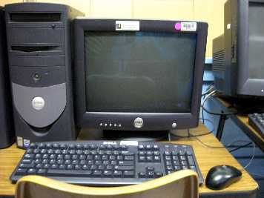



Attenborough Days for:
Computing: Wednesday
Library: Wednesday
Dates:
Christmas show – Dress on 8th and performances on 9th and 10th December at 9.15am
Upcoming trips – local walk in the spring, Drusillas in the summer

Slide 14
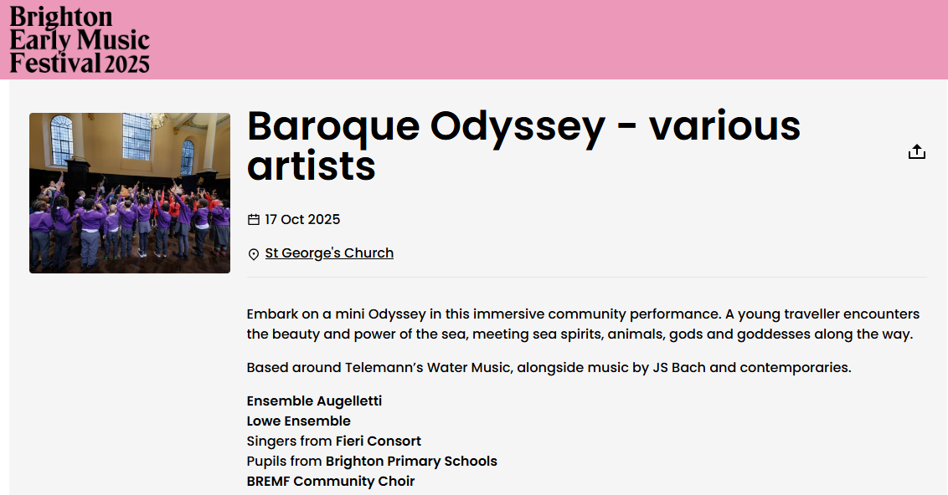
Year 2 - Brighton and Hove
Early Music Festival Collaboration
Friday 17th October, lunchtime

Slide 15


Practise regularly
Increase confidence
Increase fluency
Times Tables homework will be starting later this year.
Tackle challenges
Login: surnam:@rkps.me
Password: words123

Slide 16
Reading
Read your reading book 3 times a week
Record this in your reading record
Choose a reading for pleasure book
Hand in your reading record weekly
3 reads = 1 raffle ticket drawn in Special Mentions assembly

Slide 17

How can I support my child with reading?

Slide 18
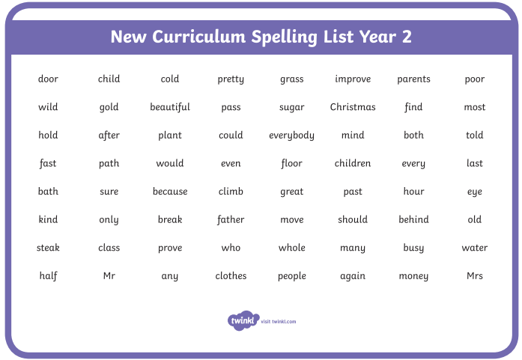
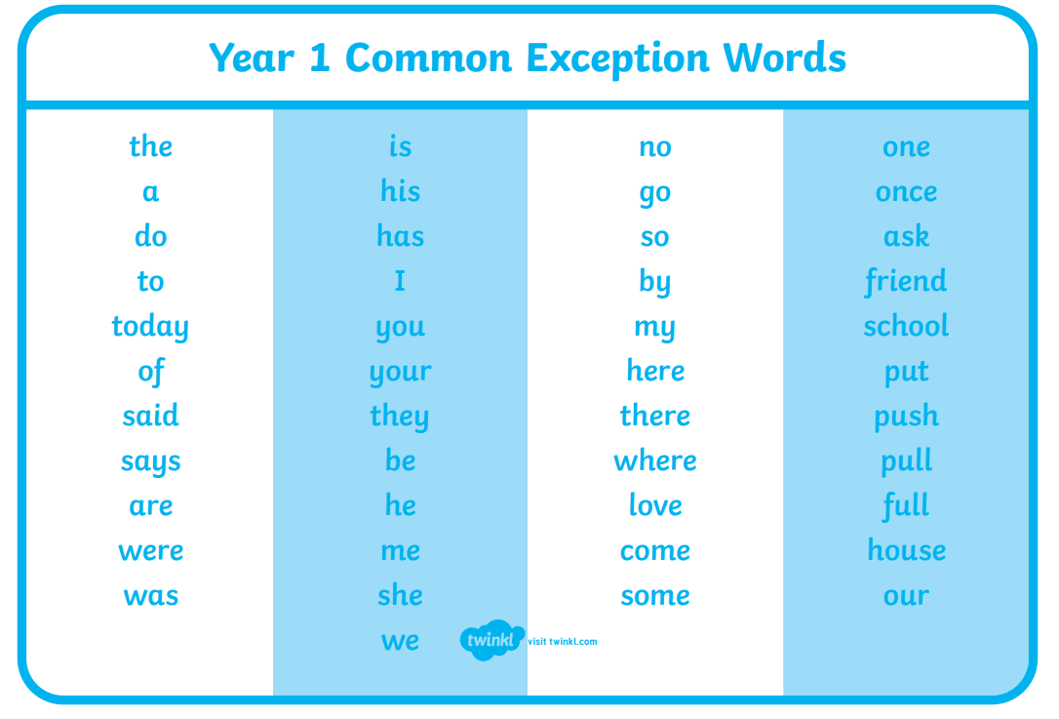
How can I support my child with spelling?
Year 2 Words
Year 1 Words

Slide 19
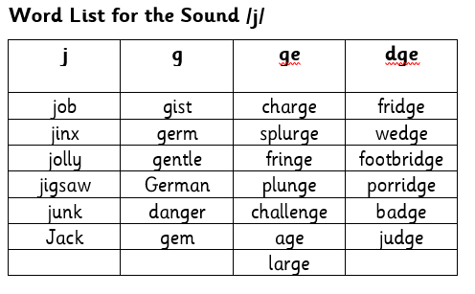
Phonics
Every 2 weeks, your child will be given a list of words that have our fortnightly sound. This will show how that sound is represented by different spellings.

Slide 20
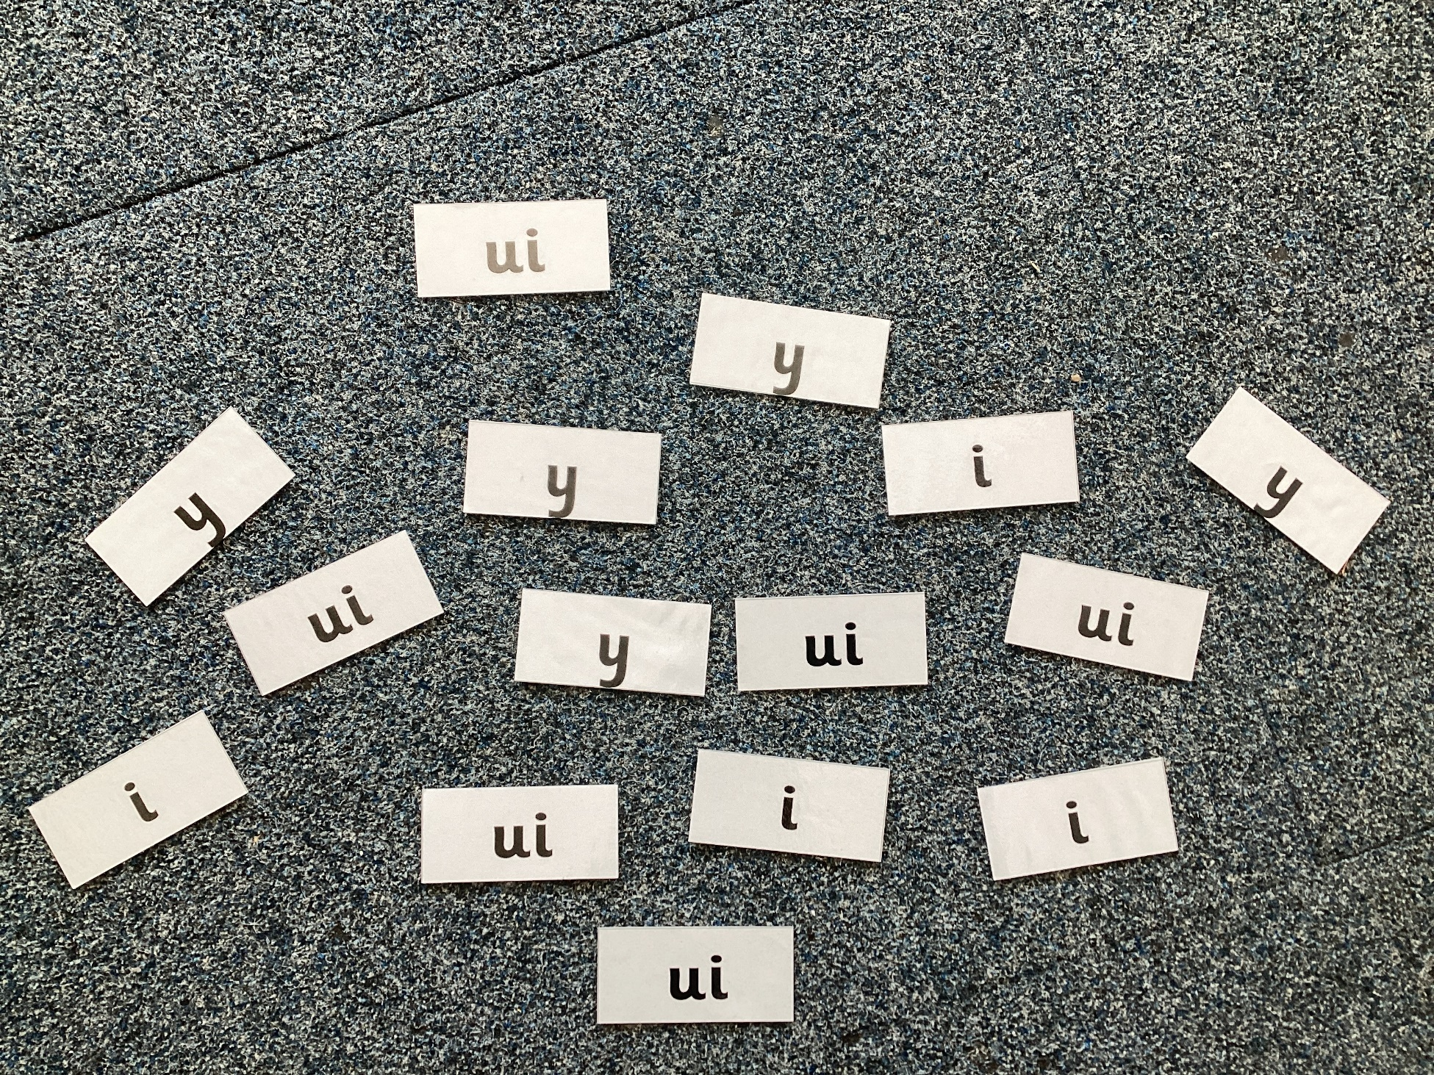
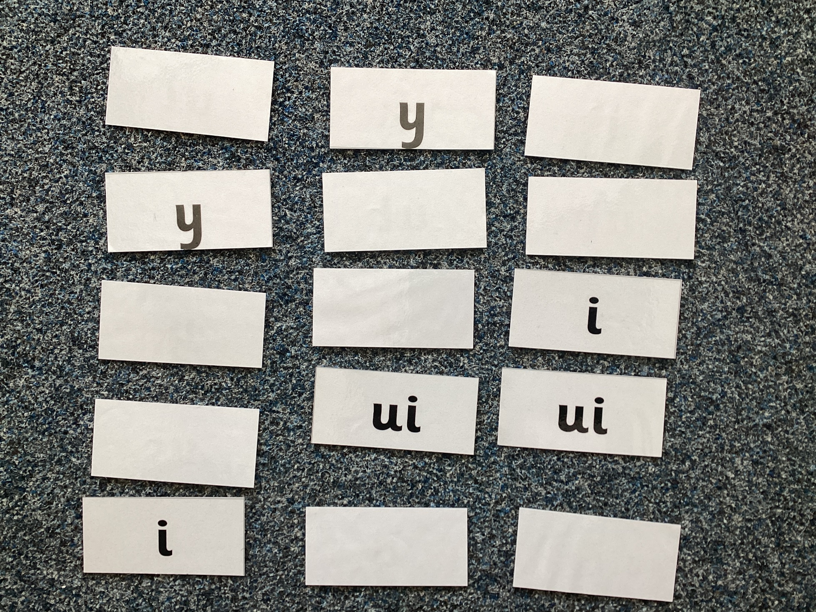
Examples of Phonics Games You Can Play
Spelling Word Hunt – single or multiplayer
Find all the one of the spellings as quickly as you can for that sound.
Matching Pairs – multiplayer
Have all spellings of the sound face down, turning two over at a time. If the spelling matches, keep it.

Slide 21
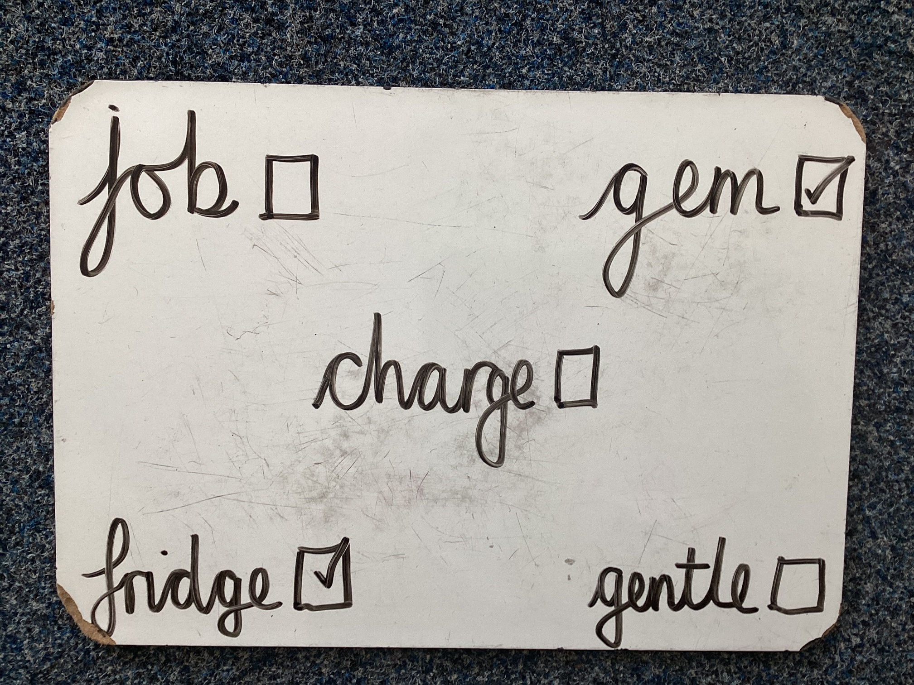
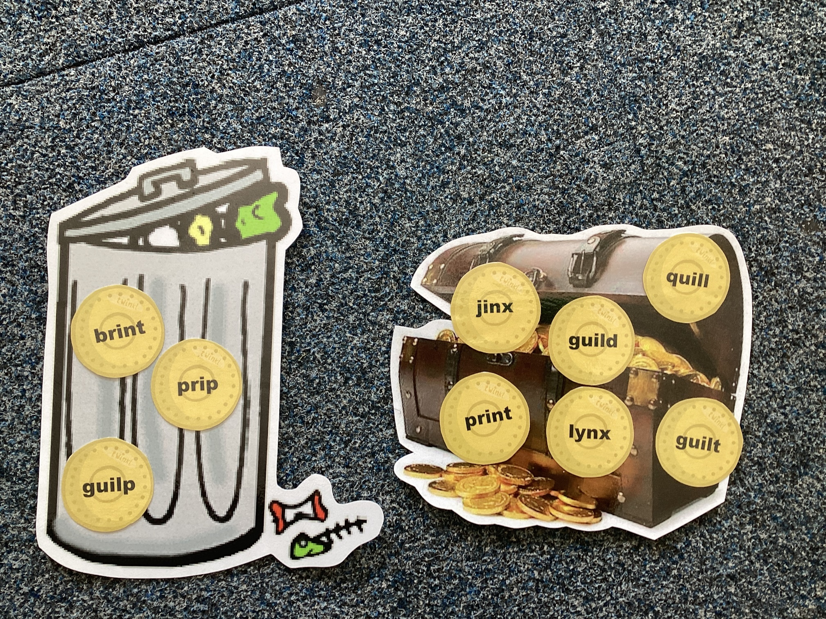
Examples of Phonics Games You Can Play
Word Bingo – multiplayer
Make words cards for 12 words. Your child copies 5 of them. Pull the words out of a hat/pot – the first to get their 5 words wins.
Treasure or Trash – single or multiplayer
Have a mix of real and unreal words. Sort them into treasure for real words and trash for unreal words.

Slide 22
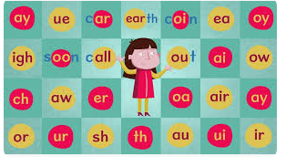
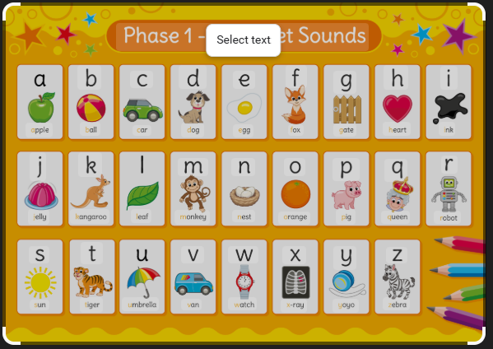
There will be a Phonics Workshop for parents and carers later this term.
The workshop will explain more about Phonics and how to play these and other games.

Slide 23

Any questions?

