Slide 1

Meet the teachers
Miss Davies, Miss Vaughan, Miss Goode and Miss Farrow

Slide 2
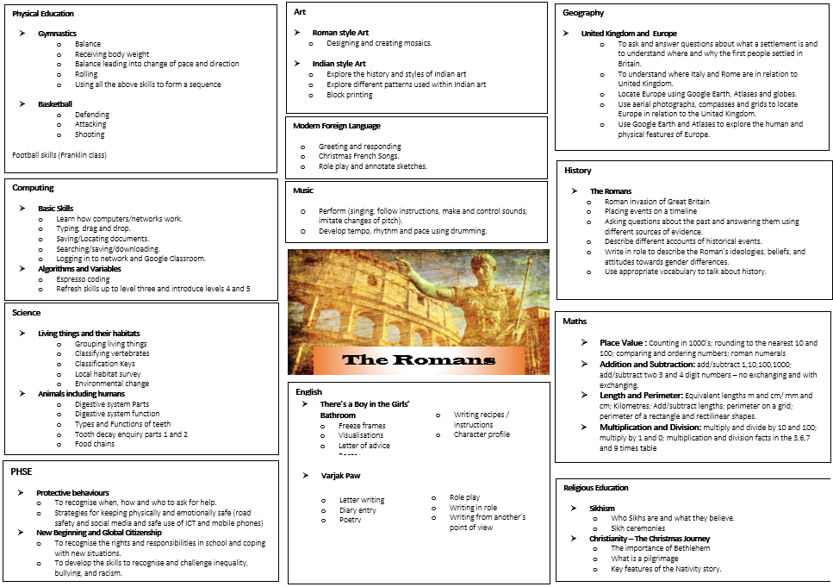
Curriculum Overview

Slide 3


English Overview
What will my child be doing in their English lessons?
Poetry
Letter writing
Diary entries
Visualisations
Role play
Freeze frames
Writing from new perspectives
Making predications
Understanding characters feelings and emotions

Slide 4
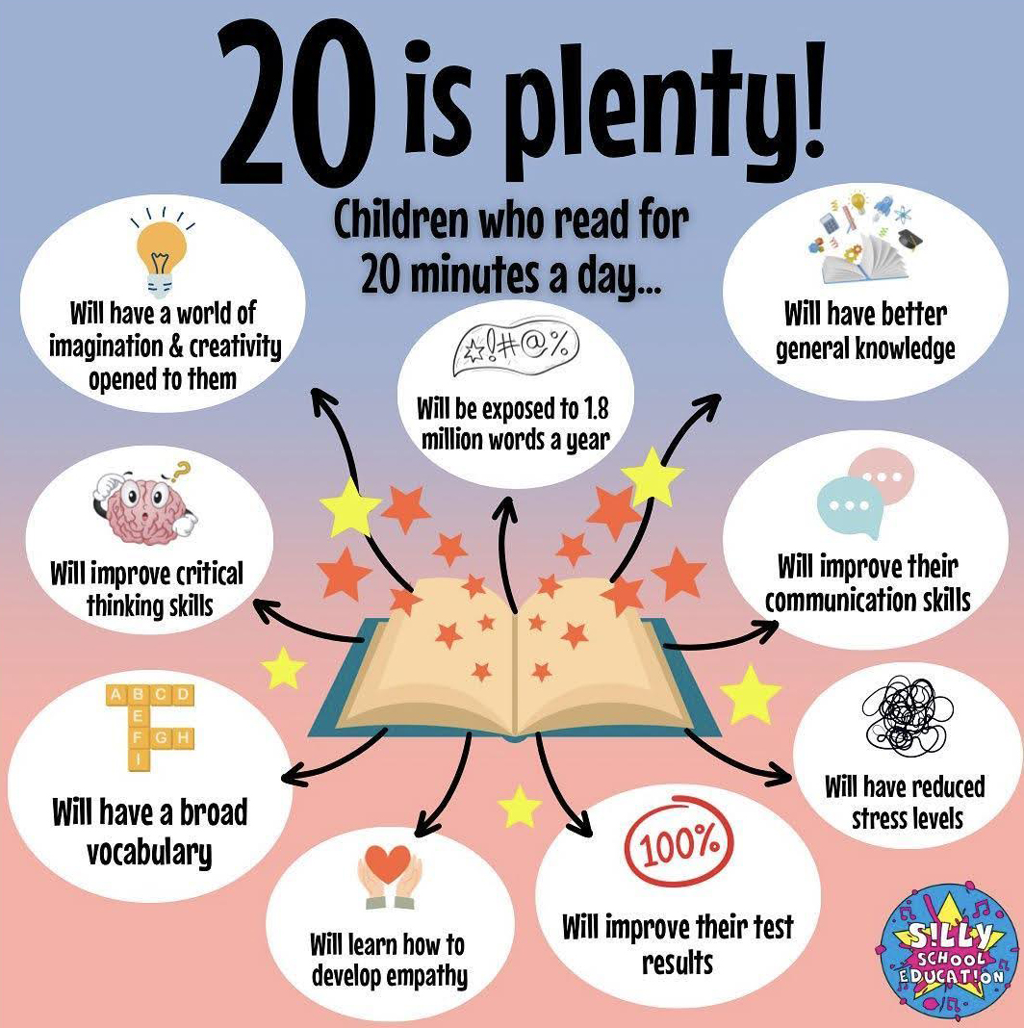
Reading at home

Slide 5

Reading records
We like the children to read at least 3 times a week and this should be recorded in their reading records.
3 reads = 1 raffle ticket drawn in Special Mentions assembly

Slide 6
Rock up and Read & Special Mentions Assembly
Rock up and Read is every Friday morning 08:40 - 09:00
Special Mentions starts at 09:00

Slide 7
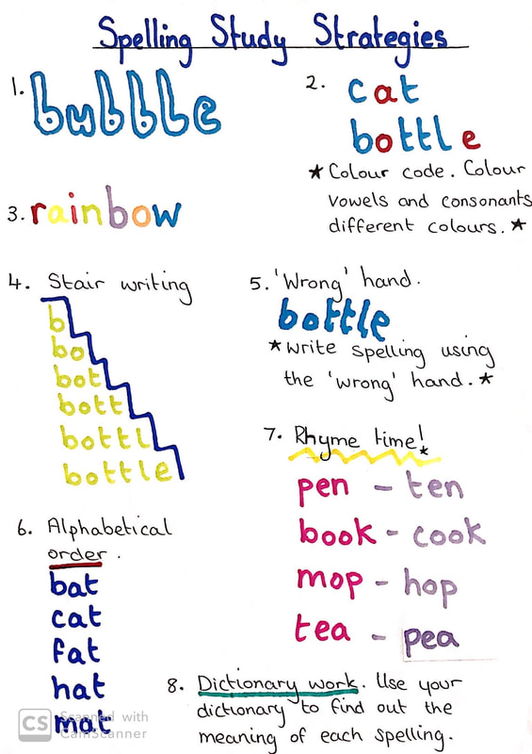
Spelling homework
Spellings will be sent home each week on a Friday and we will test the children through a quizzes the following week.

Slide 8
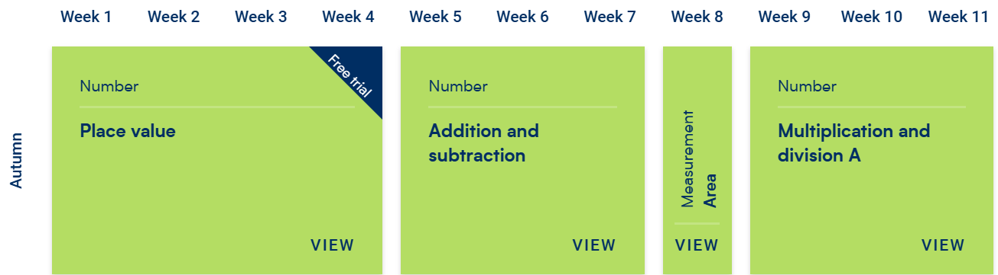
Maths

Slide 9
This year’s Maths focus…
The statutory Multiplication Tables Check (MTC) for Year 4 pupils in England takes place within a two-week window starting on Monday 7 June 2027.
The purpose of the MTC is to determine whether pupils can rapidly recall their times tables fluently up to 12, through a set of 25 timed questions (6 seconds per question). ​

Slide 10
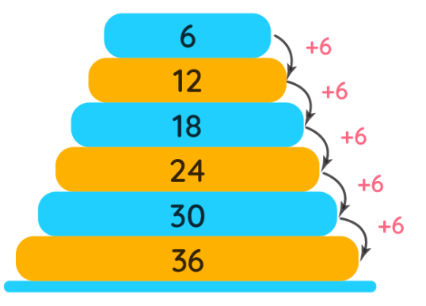
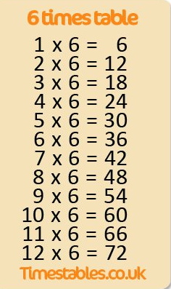
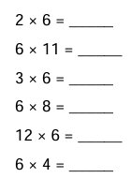
How to help at home
First chant the multiples. Once secure…
Next, say the whole number sentence in order. Once secure…
Finally, answer questions in a random order.

Slide 11
Round the world
Times table showdown
I have, who has…
Times Table Bingo
Sheets - https://www.timestables.me.uk/printable-pdf-quiz-generator.htm
Hit the button - https://www.topmarks.co.uk/maths-games/hit-the-button
Songs BBC Bitesize - https://www.bbc.co.uk/bitesize/articles/z97rdnb#z3r3xg8

Slide 12

TTRS
Practise regularly
Increase confidence
Tackle challenges
Login: surname:@rkps.me
Password: words123

Slide 13
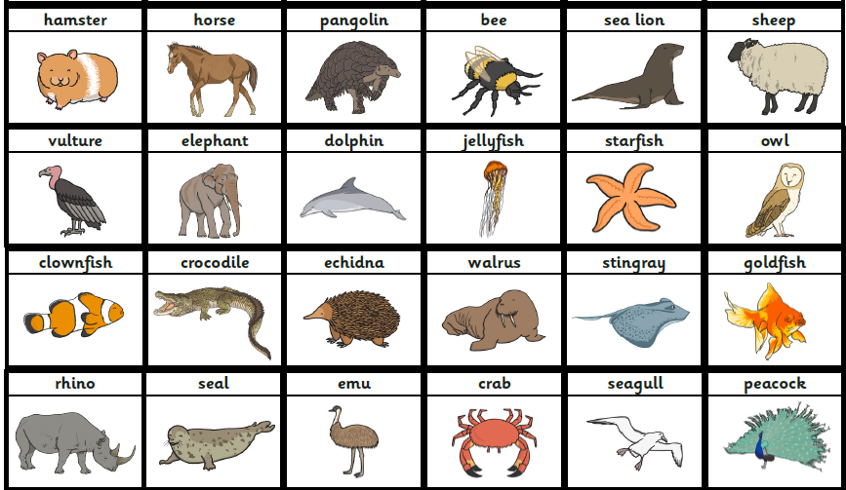

Science
Living things and their habitats
Grouping living things
Classifying vertebrates
Classification keys
Local habitat survey
Environmental change
Animals including humans
Digestive system parts
Digestive system function
Types and functions of teeth
Tooth decay
Food chains

Slide 14
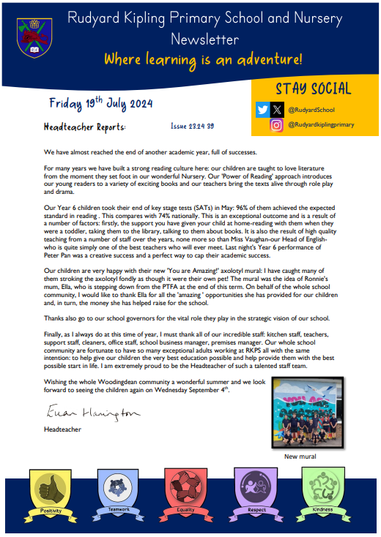

Important Dates
PE this half term: Tuesday
Forest School this half term: Wednesday mornings
Any other dates including trips, school events, Forest School will be sent out on Arbor.

Slide 15
Volunteers
We would LOVE to have volunteers in Year 4
Forest School
School Readers
Please email admin@kipling.brighton-hove.sch.uk or speak with a member of the office staff

Slide 16
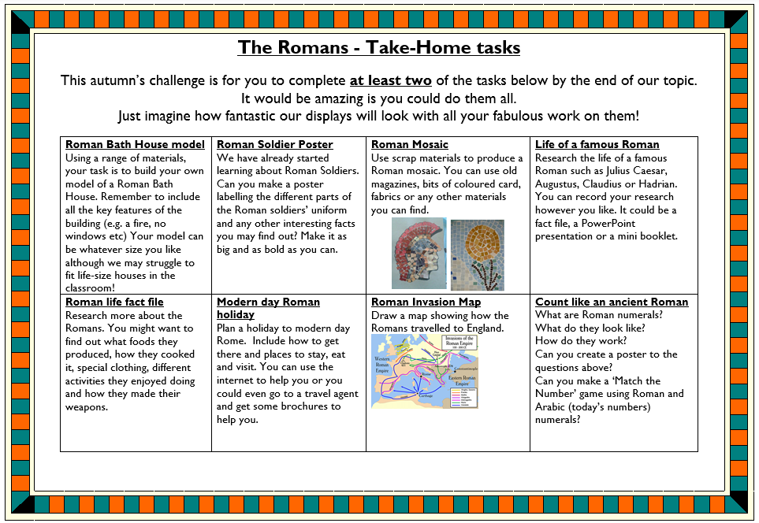
Take home tasks

