Slide 1

Meet the teachers:
Miss Dolan-Parry, Mrs Hollingsworth, Mrs Farrow

Slide 2
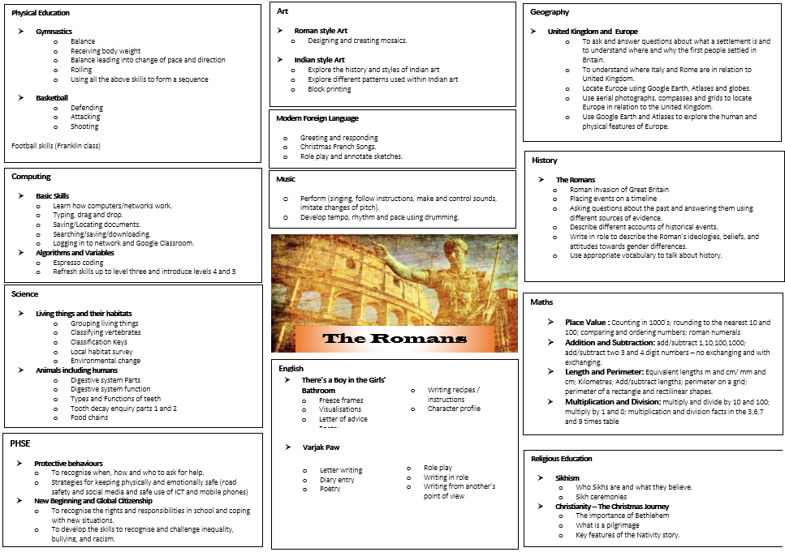
Curriculum Overview

Slide 3


English Overview
Reading the books as class.
Dictionary work to search for meaning of new words.
Make and adapt predictions.
What will my child be doing in their English lessons?
Poetry
Letter writing
Diary entries
Visualisations
Role play
Freeze frames
Character profiles
Writing from new perspectives
We tend to reveal our books to pupils slowly so although we love the enthusiasm, please don’t rush home and buy these books as the children need to read them with the class. This will help the pupils build predicting skills as well as get them excited about their English lessons!

Slide 4
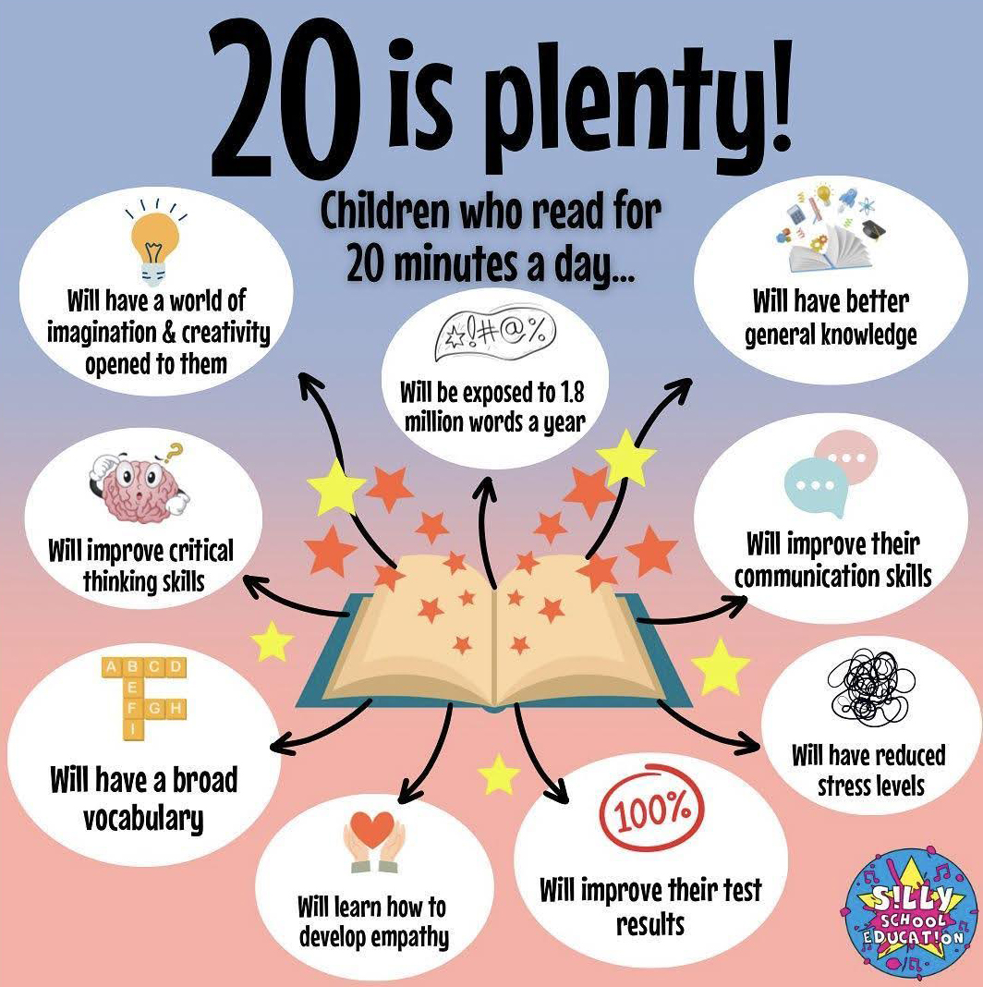
Reading at home

Slide 5

Reading records
Read your reading book 3 times a week and record this in your reading record.Your child should be reading every day.
3 reads = 1 raffle ticket drawn in Special Mentions assembly

Slide 6
Rock up and Read & Special Mentions Assembly
Rock up and Read is every Friday morning 08:40 - 09:00
Special Mentions starts at 09:00

Slide 7
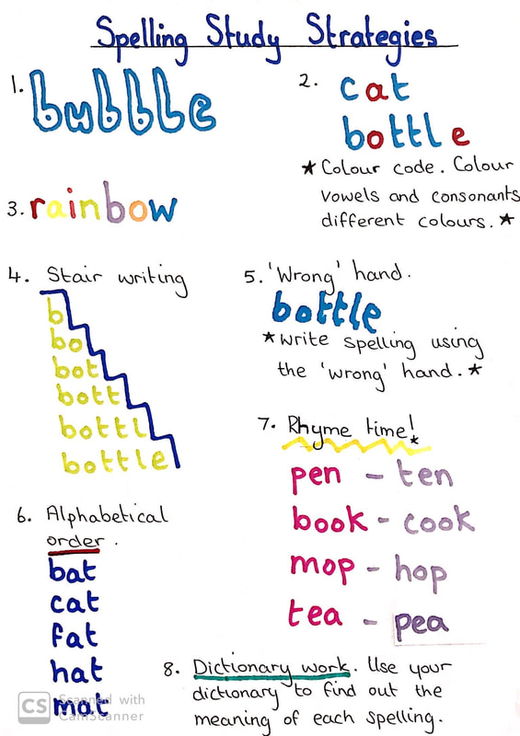
Spelling Homework
Spellings will be sent home each week on a Friday and we will test the children through quizzes the following week.

Slide 8
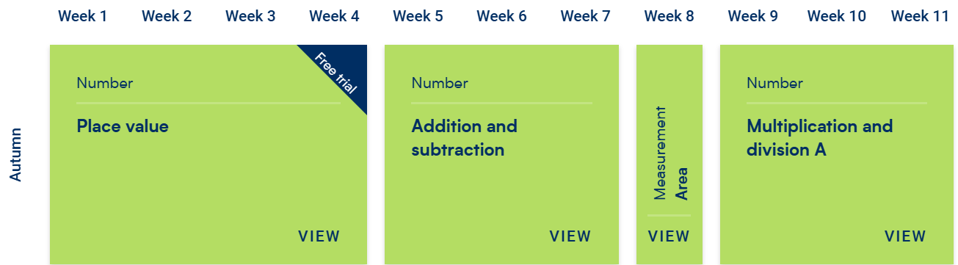
Maths

Slide 9
This year’s Maths focus…
The statutory Multiplication Tables Check (MTC) for Year 4 pupils in England takes place within a two-week window starting on Monday 7 June 2027.
The purpose of the MTC is to determine whether pupils can rapidly recall their times tables fluently up to 12, through a set of 25 timed questions (6 seconds per question). ​

Slide 10
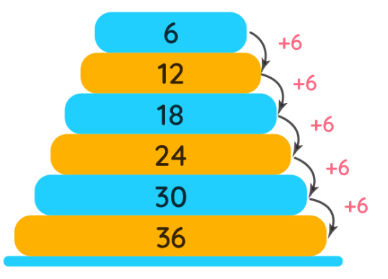
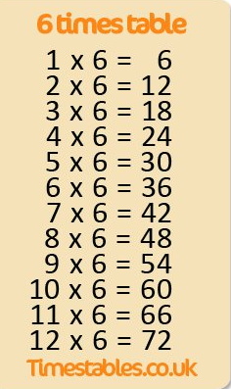
How to help at home
First chant the multiples. Once secure…
Next, say the whole number sentence in order. Once secure…
Finally, answer questions in a random order.
2 x 6 =
8 x 6 =
0 x 6 =
5 x 6 =
3 x 6 =

Slide 11
Making Maths fun
Round the world
Times table showdown in assemblies
I have, who has…
Times Table Bingo
Sheets - https://www.timestables.me.uk/printable-pdf-quiz-generator.htm
Hit the button - https://www.topmarks.co.uk/maths-games/hit-the-button
Songs – BBC - https://www.bbc.co.uk/bitesize/articles/z97rdnb#z3r3xg8

Slide 12

TTRS:
Practise regularly
Increase confidence
Tackle challenges
Login: surname:@rkps.me
Password: words123

Slide 13
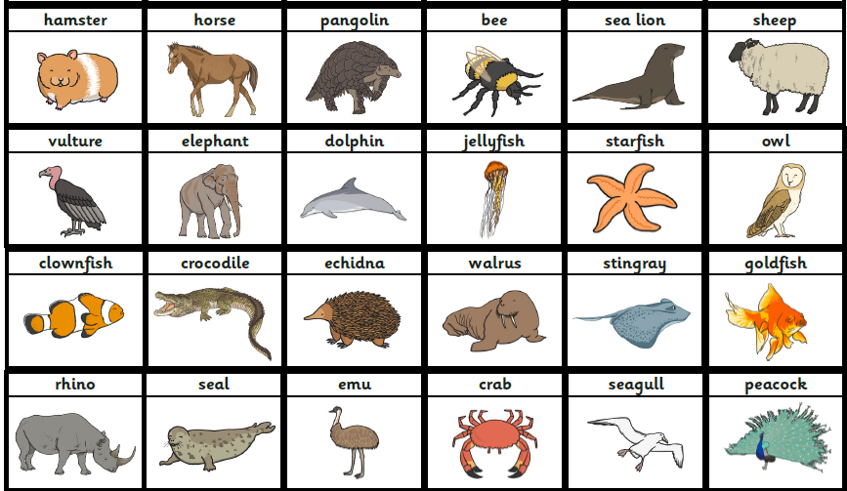

Science
Living things and their habitats
Grouping living things
Classifying vertebrates
Classification keys
Local habitat survey
Environmental change
Animals including humans
Digestive system parts
Digestive system function
Types and functions of teeth
Tooth decay
Food chains

Slide 14
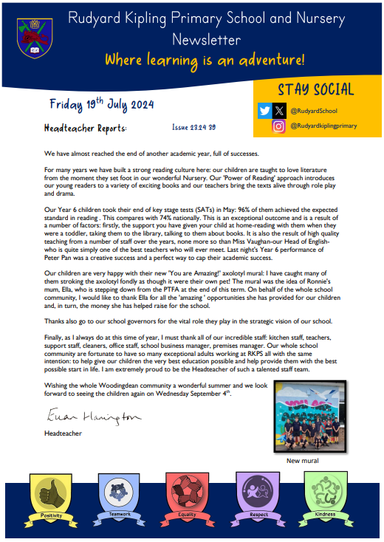

Important Dates
PE this half term: Wednesday mornings
Any other dates including trips, school events, Forest School will be sent out on Arbor.

Slide 15
We would LOVE to have volunteers in Year 4
Forest School
School Readers
Please email admin@kipling.brighton-hove.sch.uk if you are interested ☺

Slide 16
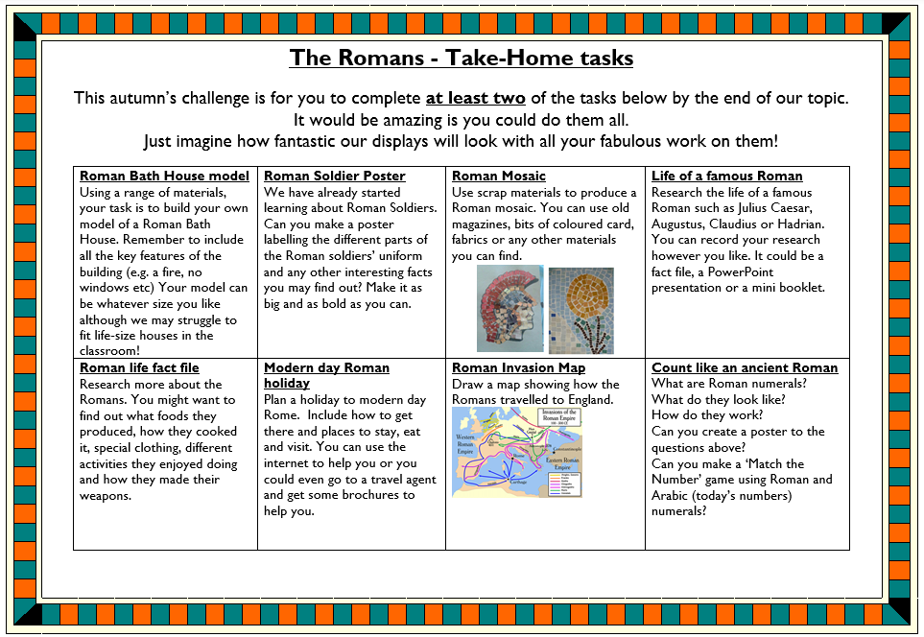
Take home tasks

