Slide 1

Year 6 Classroom Connect (Autumn term) 2026
Mr Wynne & Mr Campbell
Morning support: Woolven & Miss Farrow
Afternoon reading support: Mrs Borg

Slide 2
Curriculum overview
Important Day/dates
Spellings
Reading at home
Maths at home
Expectations
Aims
Notes:
Explain importance of communication. Encourage staff to email or visit your office. Mention that Sarah managed things differently, but you prefer structure to stay organised.

Slide 3
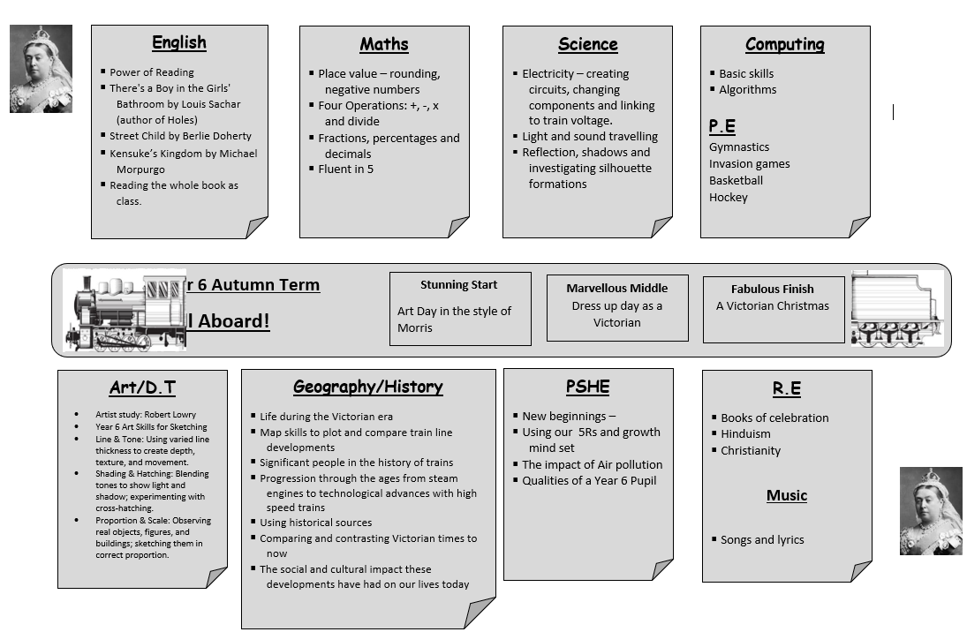
Curriculum Overview:

Slide 4
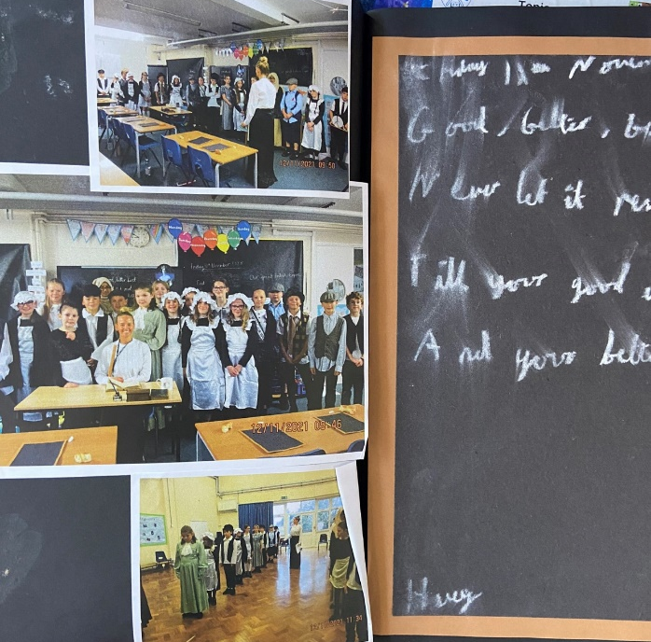
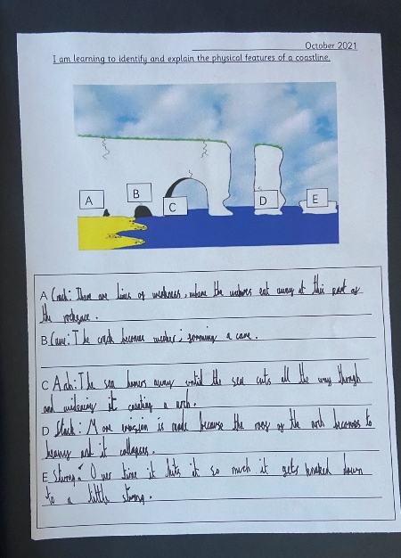
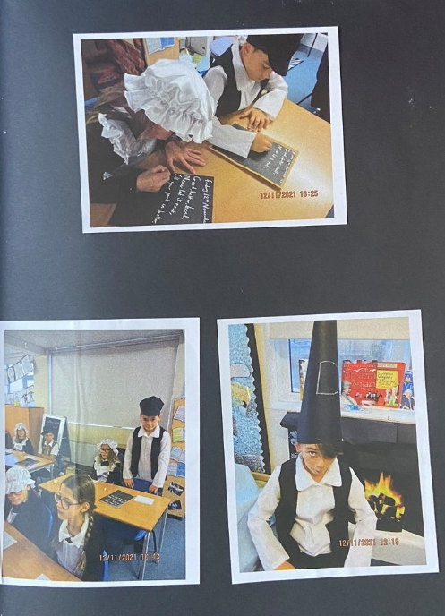
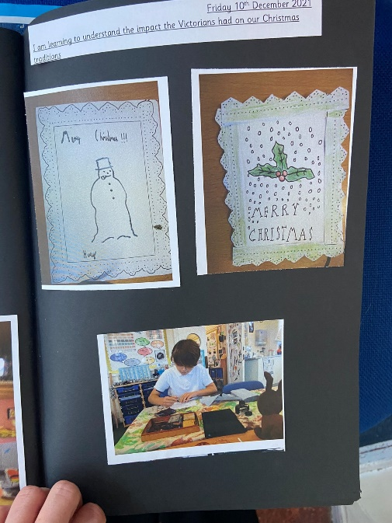
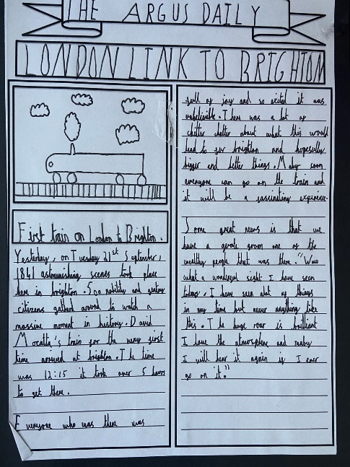
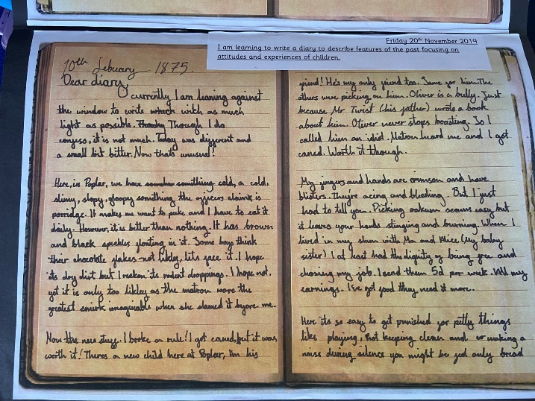
Curriculum Overview:

Slide 5
Studying the famous artist Robert Lowry
What do you think the Victorians invented?
Focusing on railways and understanding the impact they had on Britain, focusing on Brighton.
Identifying the changes of Brighton from Brighthelmstone (a fishing village) to the city it is today.
Who Queen Victoria was:
Life in the workhouse for children
Victorian school day (will be asked to dress up – this will be after half term)
Creating a Victorian house with electricity
Victorian Christmas
Curriculum Overview:
Notes:
Briefly share vision: enhance teaching and learning, foster a positive school culture, support staff wellbeing, and encourage professional development.

Slide 6

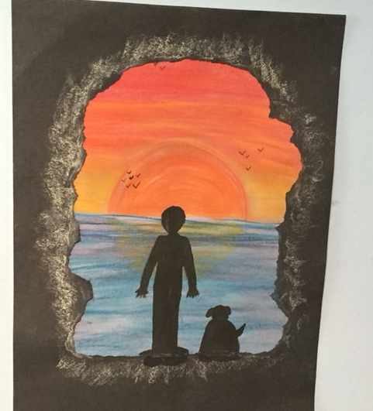


English Overview:
Reading the book as class.
Dictionary work to search for meaning of new words e.g. exhilarating
Make and adapt predictions
Drama:
Role play telephone conversations
Role play being journalists
Writing opportunities fiction and non fiction:
Discussion writing – arguments for and against
News report
Jungle setting description
Diary entries
Letter writing
Write an alternative ending

Slide 7
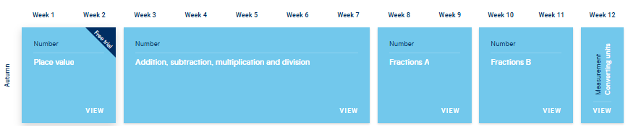
Maths overview:

Slide 8
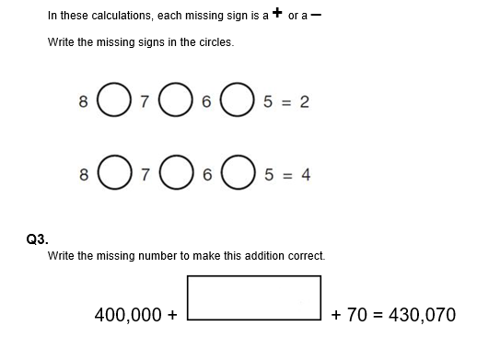
Maths:
Recap and consolidating place value/written methods
New Year 6 written methods – compact multiplication and long division
Comprehension skills – reading and understanding the questions e.g. SATS style
Applying to different problems and proving how they know

Slide 9
Fluent in Five :
745,245 + 64,154
74,989 – 54,362
324 x 8
856 ÷ 4
5²
Once they have learnt a concept, we don’t want them to forget it. Like everything practise is key.

Slide 10
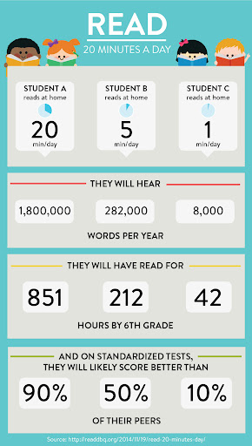

Reading at home:

Slide 11



Reading at home:
Book Recommendations
Read your reading book 3 times a week
Record this in your reading record
Choose a reading for pleasure book
Reluctant Readers
Hand in your reading record weekly
3 reads = 1 raffle ticket drawn in Special Mentions assembly

Slide 12
Reading at home:
Book Recommendations
There is a growing body of evidence which illustrates the importance of reading for pleasure for both educational purposes as well as personal development (cited in Clark and Rumbold, 2006).
Reading increases a person’s understanding of their own identity, improves empathy and gives them an insight into the world view of others (The Reading Agency 2015).
Reluctant Readers

Slide 13
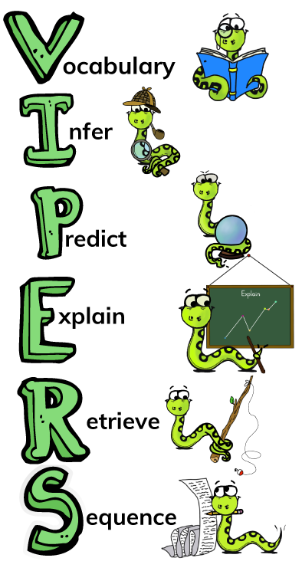
Reading

Slide 14


Rock up and Read & Special Mentions Assembly:
Friday morning: ROCK UP AND READ 08:40-09:00
Friday morning: SPECIAL MENTIONS ASSEMBLY: 9:00 (Arbor message a week in advance)

Slide 15

TTRS:
Practise regularly
Increase confidence
Tackle challenges
Login: surname:@rkps.me
Password: words123

Slide 16
Science:
Electricity
Light and sound travelling
Reflection, shadows and investigating silhouette formations

Slide 17
Important Dates
BACA visiting Wednesday 30th September (2:15)
Longhill visiting: TBC
BACA Open Evening: Thursday 1st October from 5pm to 7:00pm. For further info, please visit the BACA website
Longhill Open Evening: Thursday 8th October 2025, 5:00 PM to 7:00 PM. For further info, please visit the BACA website
Lewes Priory Opening Evening Thursday 17th September (TONIGHT) from 5 p.m. to 8 p.m.
Deadline for secondary applications 31st October 2026
Forest School this half term:
Yousafzai – Tuesday mornings, come to school in forest school clothing with spare clothes for after.
PE days (come to school in sensible kit):
Yousafzai – Monday
Turing – Wednesday

Slide 18
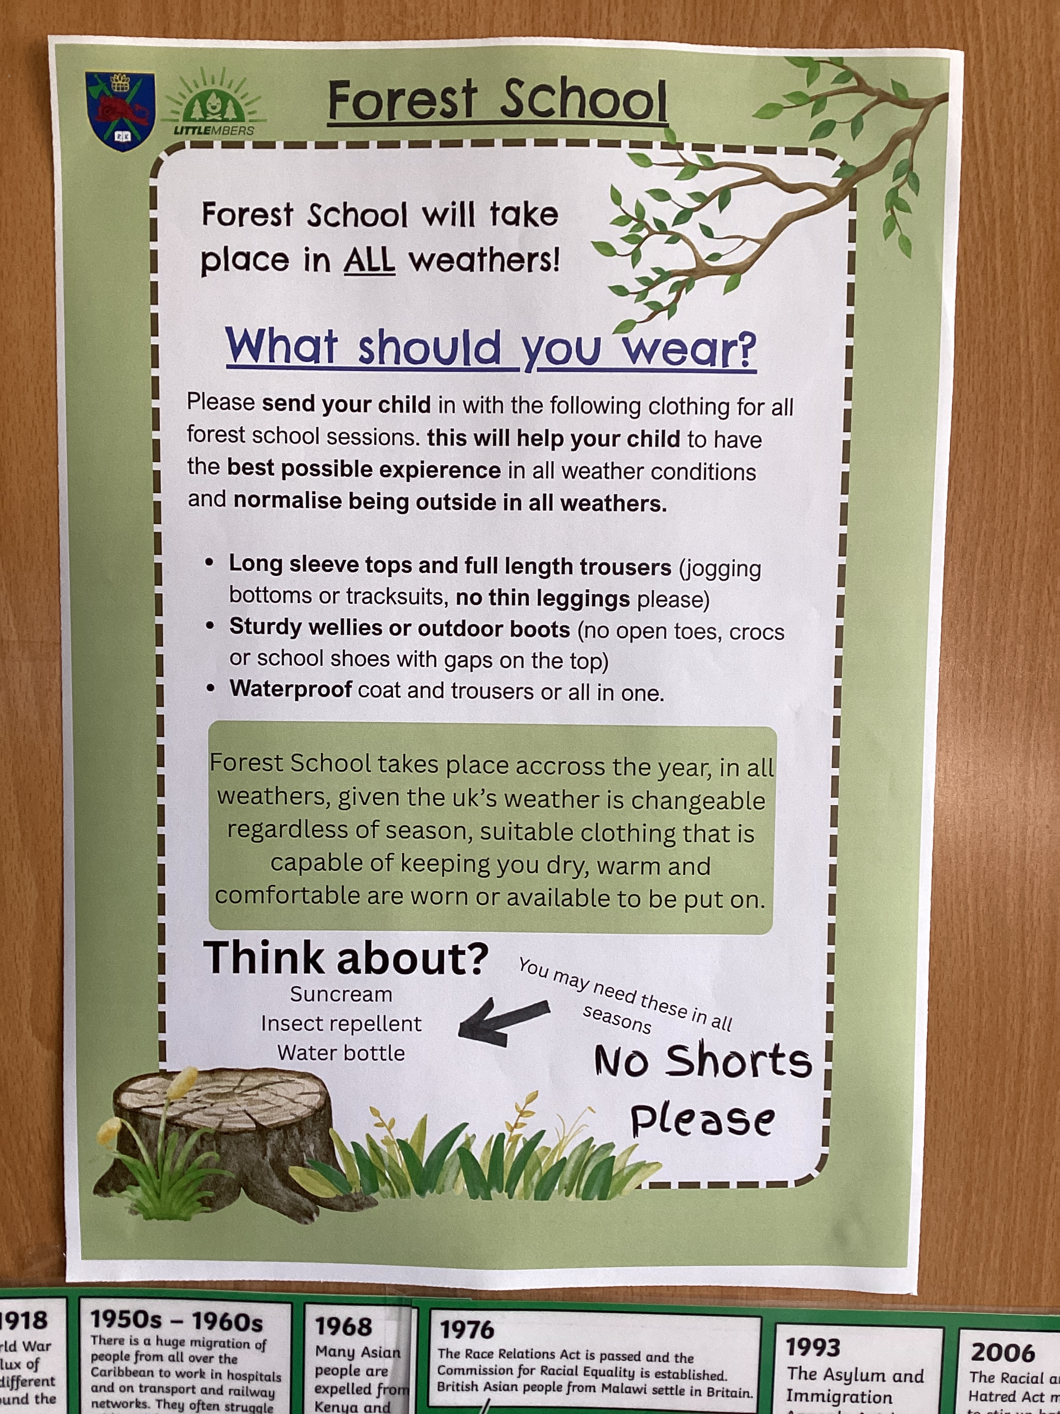
Forest school kit

Slide 19
SATs Week:
Date | Test
Monday 10th May 2027 | Grammar Spelling and Punctuation Paper: 1 Grammar Spelling and Punctuation Paper: 2
Tuesday 11th May 2026 | English: Reading
Wednesday 12th May 2026 | Maths Paper 1: Arithmetic Maths Paper 2: Reasoning
Thursday 13th May 2026 | Maths Paper 3: Reasoning

Slide 20
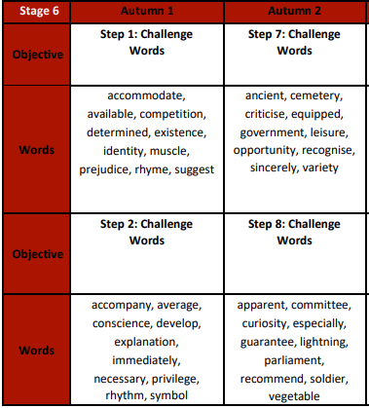
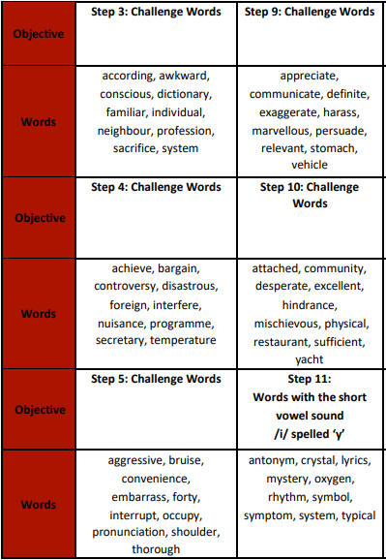
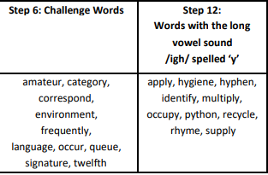
Spellings:
In year 6 we have to review all of KS2 spellings and learn the statuary spelling list for year 5 and for Year 6.
During Autumn, we will be focusing on:
Statuary spellings for year 3 & 4 and 5 & 6.

Slide 21

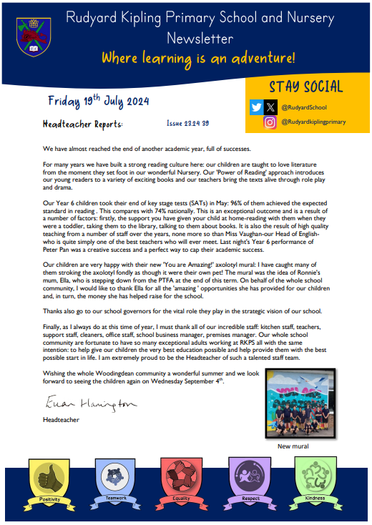
Parent Newsletters and Arbor
Use your Arbor account to receive important messages.

Slide 22
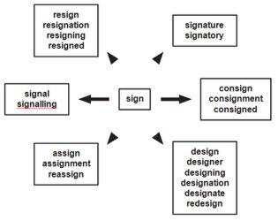
Spelling strategies

Slide 23
Spelling strategies
Impress
Press
Word Webs
Write down as many words with the root word press

Slide 24
Volunteers:
We would LOVE to have volunteers in Year 6
Forest School
School Readers
Please email admin@kipling.brighton-hove.sch.uk if you are interested ☺

Slide 25
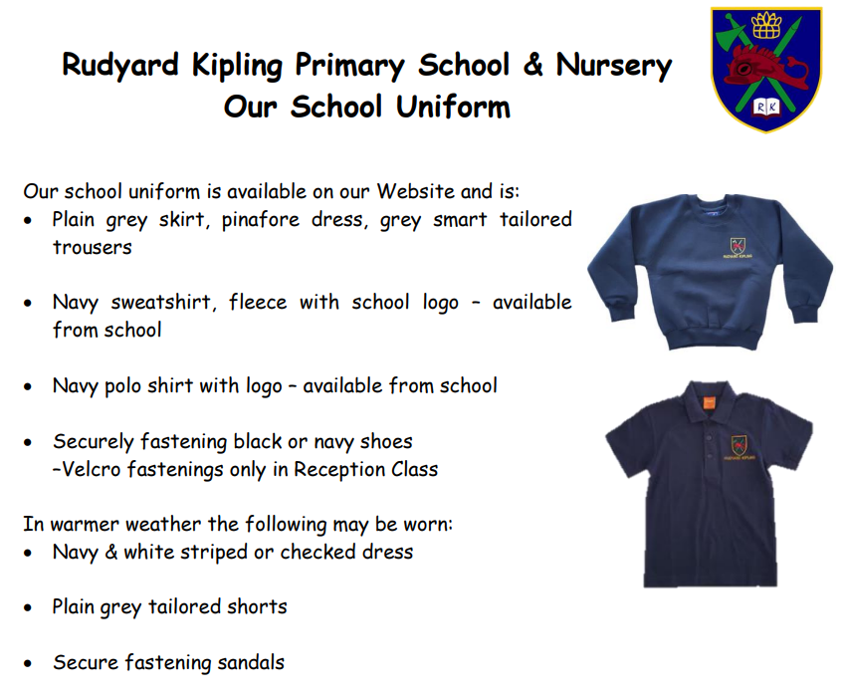
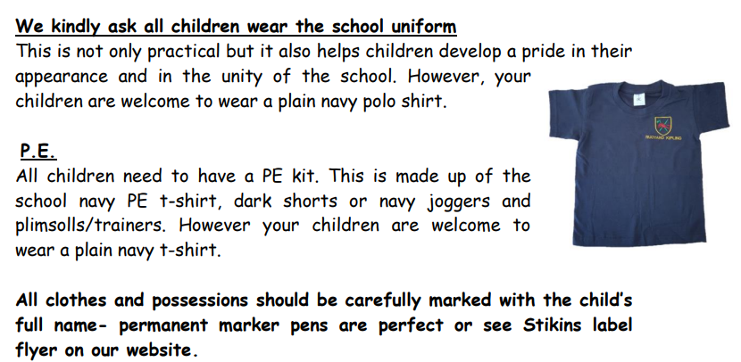
https://www.rudyardkiplingprimary.co.uk/assets/Documents/Attachments/School-Uniform-Code-2024-v3.pdf

Slide 26
Expectations
Toys
Behaviour
Readiness to learn

Slide 27

Extras…
Homework: INCOMING
Spellings
Timetables
CGP

Slide 28
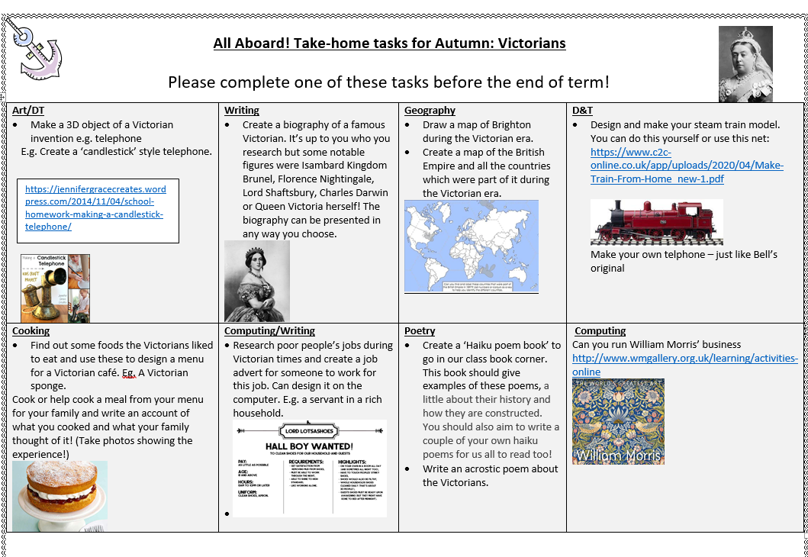
Take home tasks:

Slide 29


