Slide 1






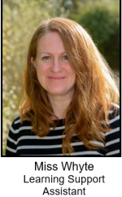
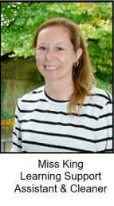
Classroom Connect
Autumn Term
Meet the adults in Parks class

Slide 2
Today, we will talk about:
Routines, timetable and any other parent/carer information
Year group, class and home-school learning information
Questions at the end

Slide 3


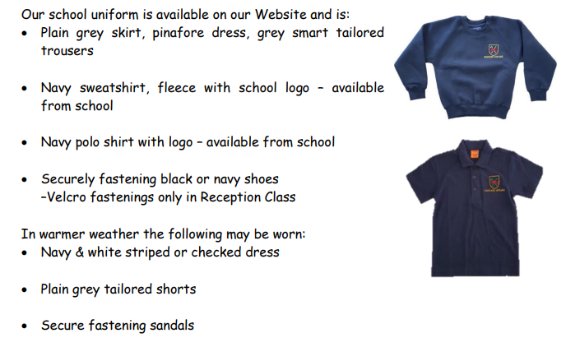
The children look so smart – thank you.

Slide 4
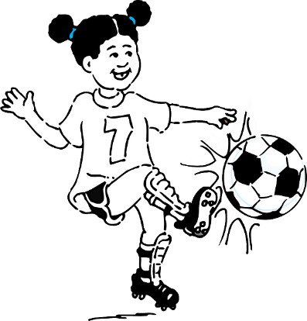
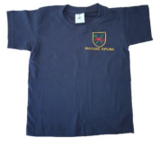
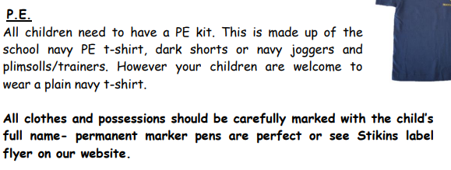

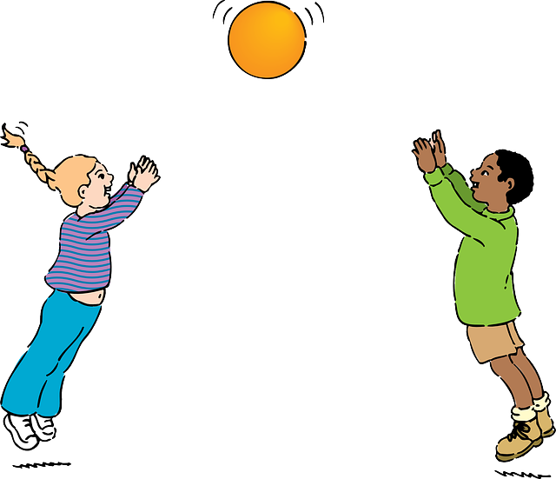
PE Days
Attenborough Class PE day
Monday

Slide 5
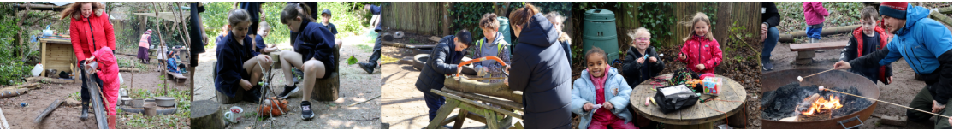
Forest School
Tuesday. Come prepared for all weather! Volunteers are greatly appreciated.

Slide 6




Special Mentions
Special Mentions assemblies are every Friday after Rock Up and Read.
You will receive an Arbor notification on the Friday before.
You will also receive an Arbor notification for Merit Star and Maths Mission Awards on the Friday before.

Slide 7


Rock Up And Read
Every Friday at 8:40-9:00
This is when I need your reading records.

Slide 8
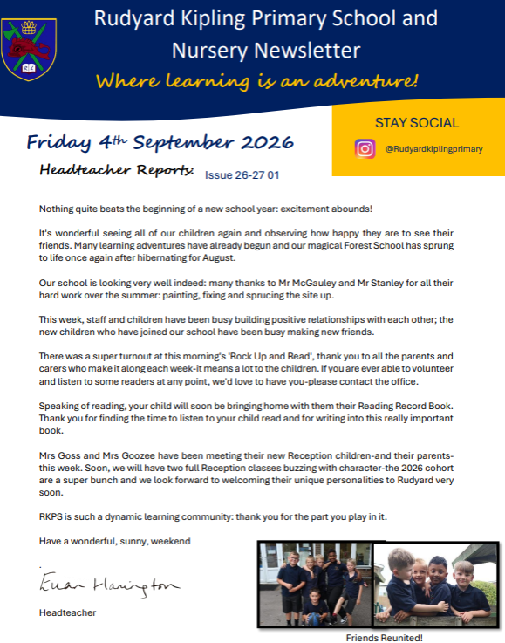
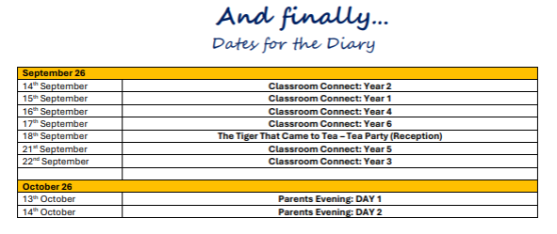
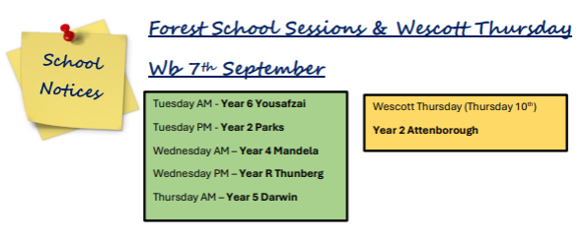
Parent Newsletters

Slide 9
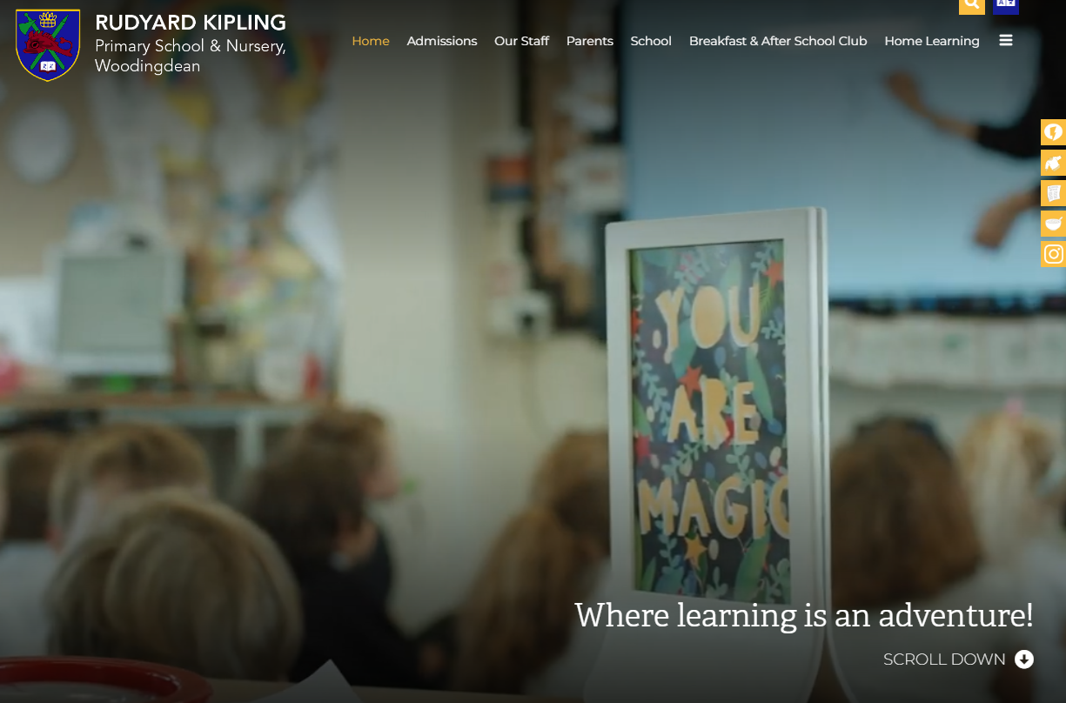
School Website
https://www.rudyardkiplingprimary.co.uk/

Slide 10
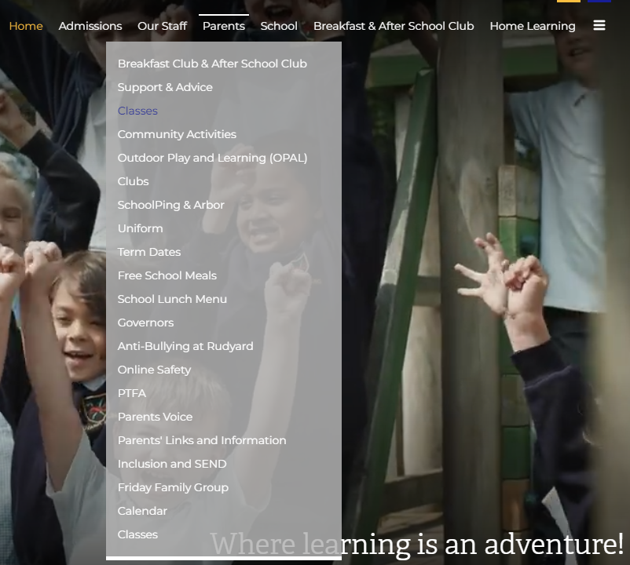
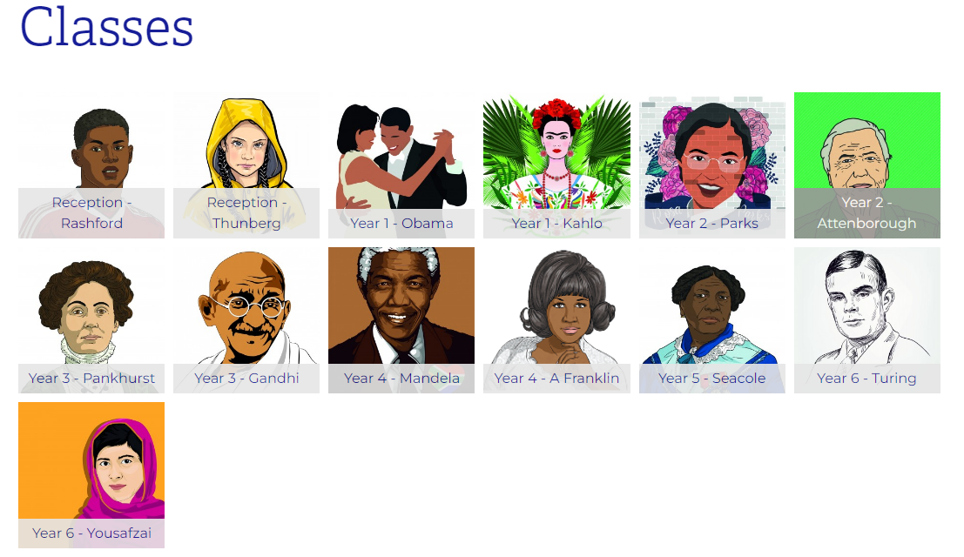
Class Page

Slide 11
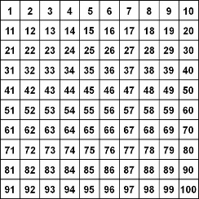
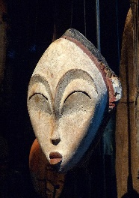
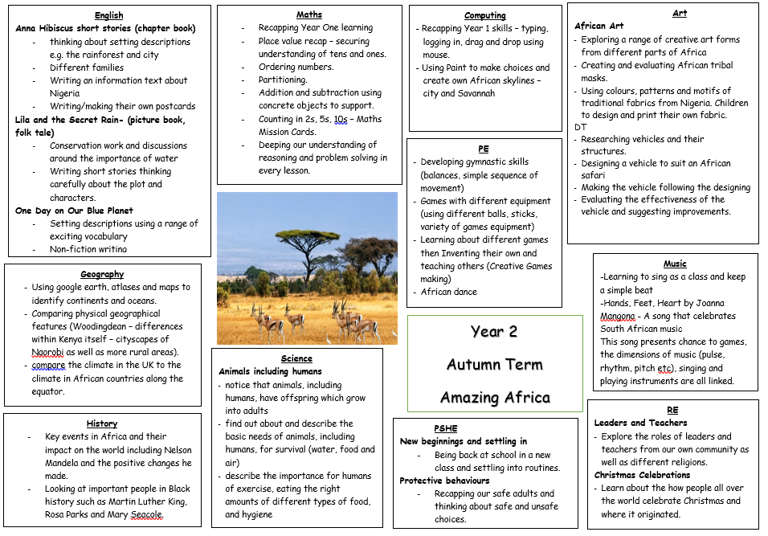






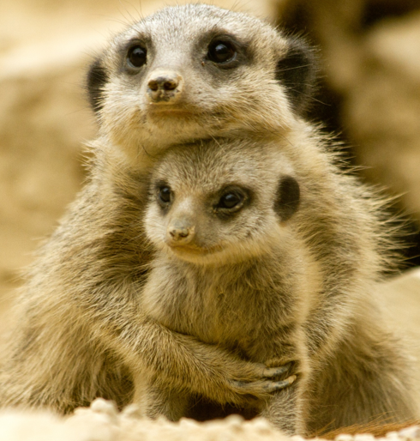


Curriculum Map

Slide 12
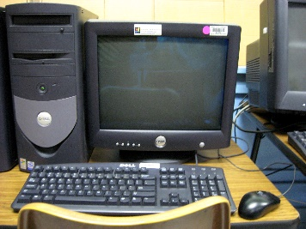



Parks Days for:
Computing: Friday
Dates:
Parents’ Evenings – 13th and 14th October
Christmas show – Dress on 7th and performances on 8th and 9th December at 9.15am
Upcoming trips – local walk in the spring, Drusillas in the summer!

Slide 13


Practise regularly
Increase confidence
Increase fluency
Times Tables homework will be starting later this year.
Tackle challenges
Login: surnam:@rkps.me
Password: words123

Slide 14
Reading
Read your reading book 3 times a week
Record this in your reading record
Choose a reading for pleasure book
Hand in your reading record weekly
3 reads = 1 raffle ticket drawn in Special Mentions assembly

Slide 15
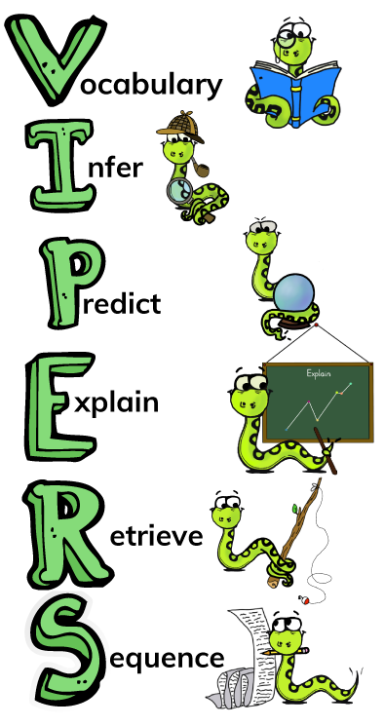
How can I support my child with reading?

Slide 16
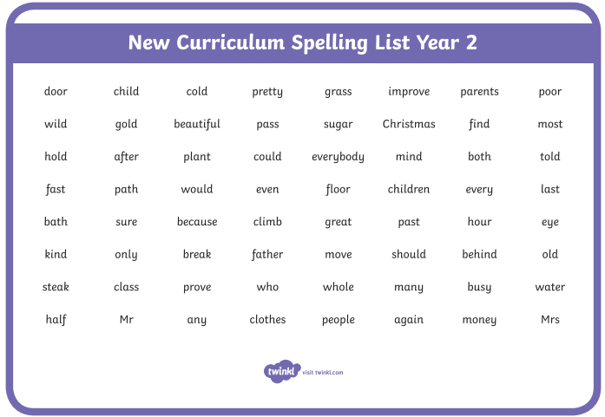
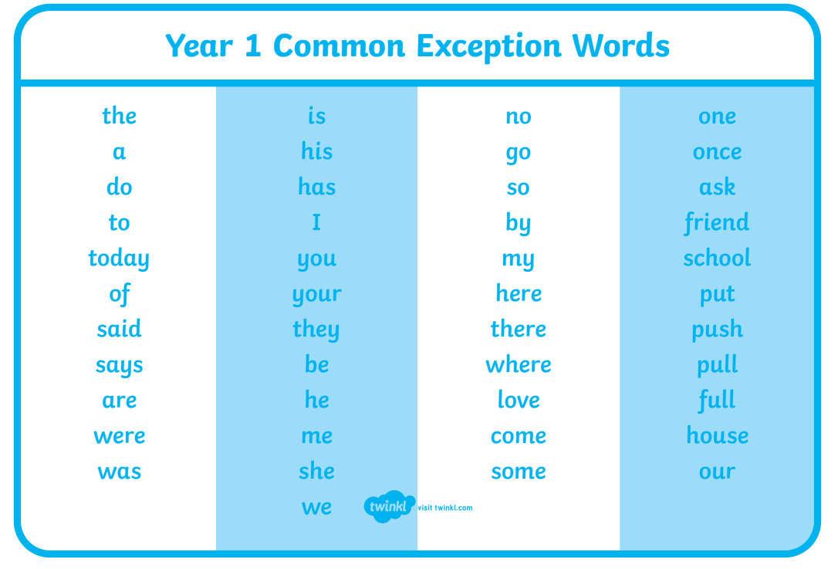
How can I support my child with spelling?
Year 2 Words
Year 1 Words

Slide 17
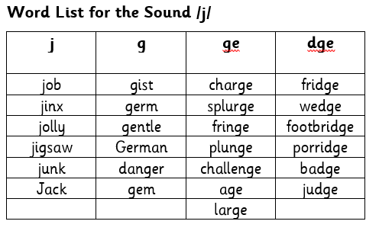
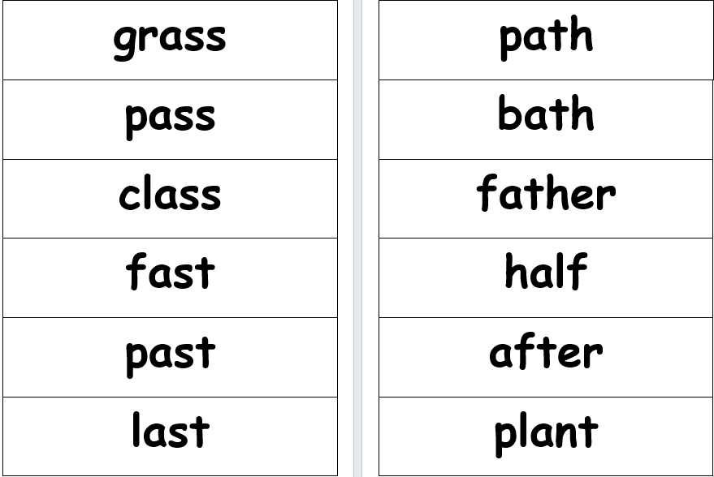
Phonics
Every 2 weeks, your child will be given a list of words that have our fortnightly sound. This will show how that sound is represented by different spellings.
They will also have a list of Year 2 words we are learning.

Slide 18
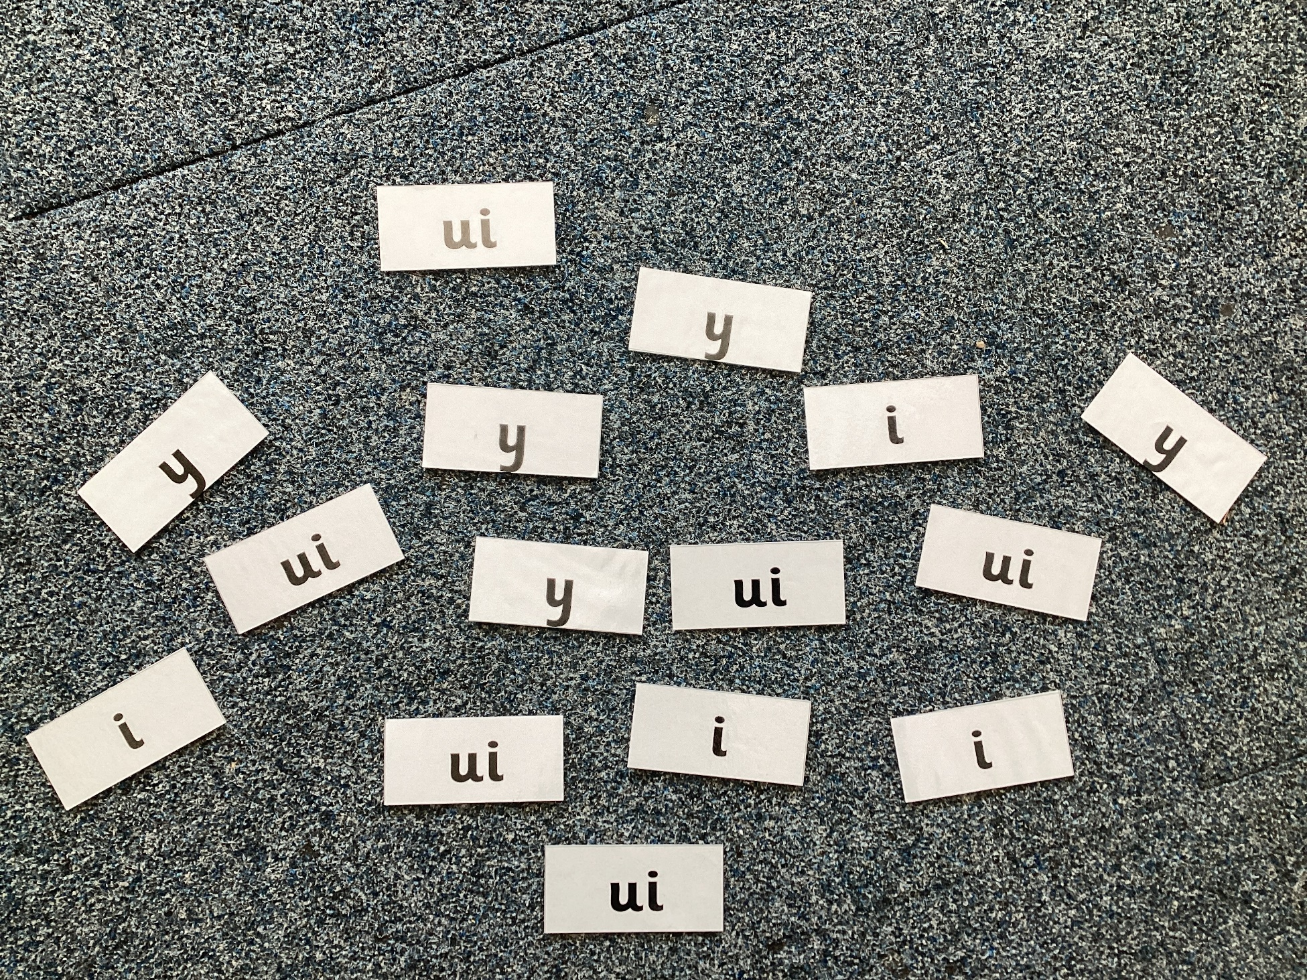
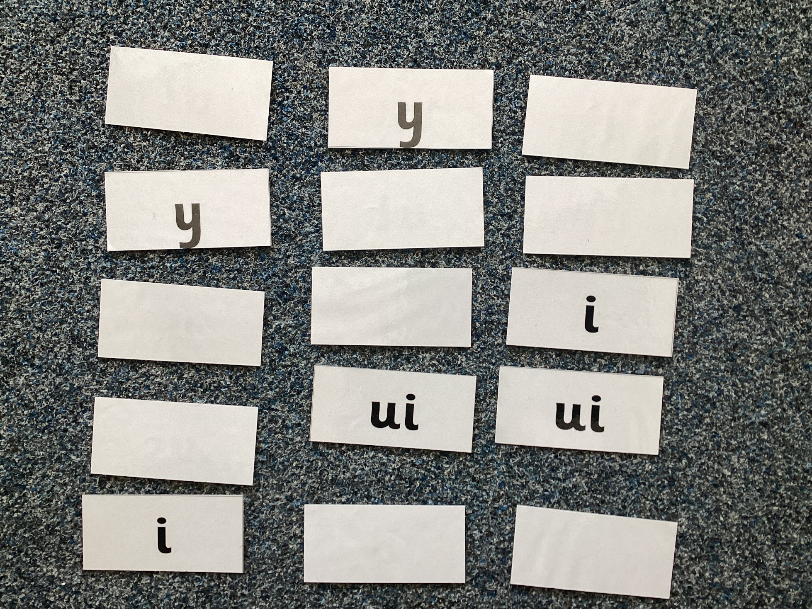
Examples of Phonics Games You Can Play
Spelling Word Hunt – single or multiplayer
Find all the one of the spellings as quickly as you can for that sound.
Matching Pairs – multiplayer
Have all spellings of the sound face down, turning two over at a time. If the spelling matches, keep it.

Slide 19
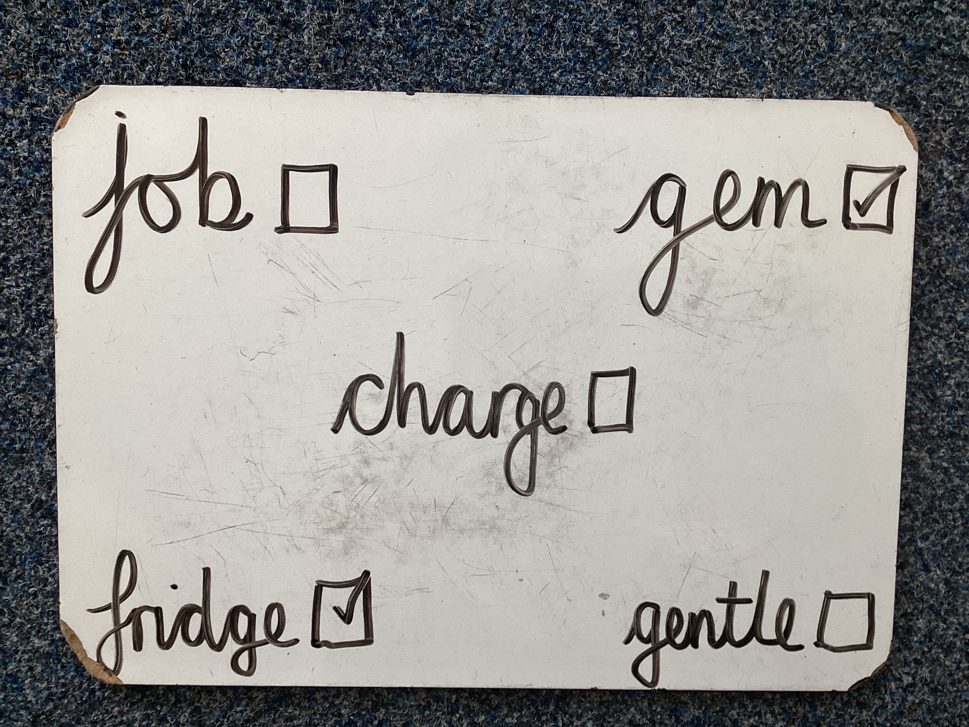
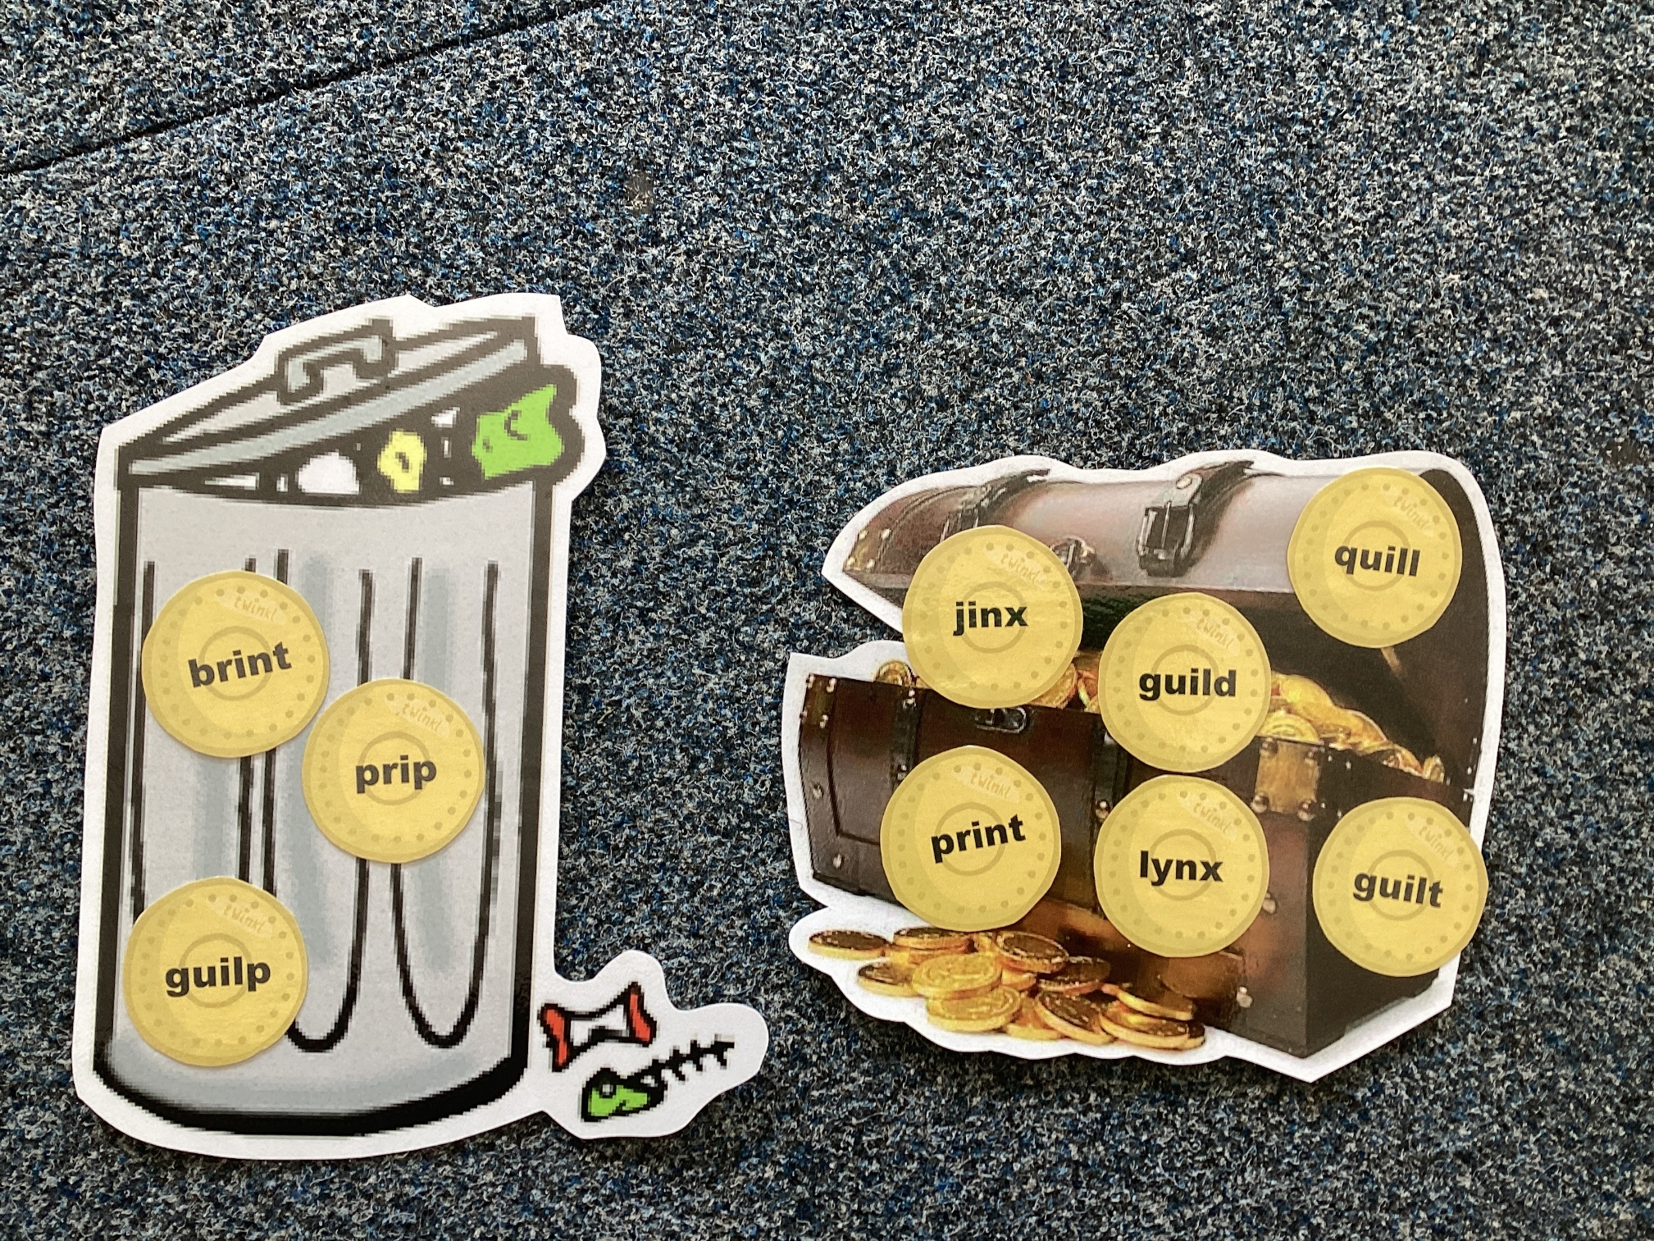
Examples of Phonics Games You Can Play
Word Bingo – multiplayer
Make words cards for 12 words. Your child copies 5 of them. Pull the words out of a hat/pot – the first to get their 5 words wins.
Treasure or Trash – single or multiplayer
Have a mix of real and unreal words. Sort them into treasure for real words and trash for unreal words.

Slide 20
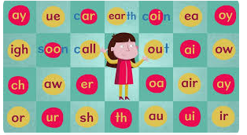
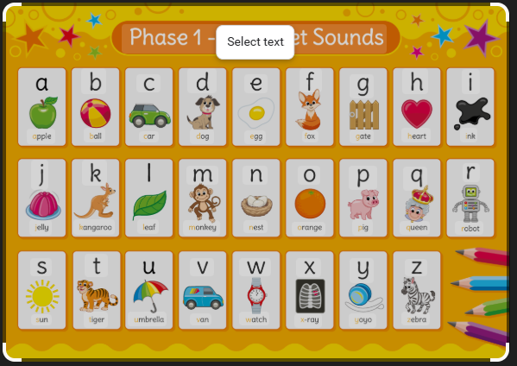
There will be a Phonics Workshop for parents and carers this term.
The workshop will explain more about Phonics and how to play these and other games.

Slide 21
Any questions?

