Slide 1



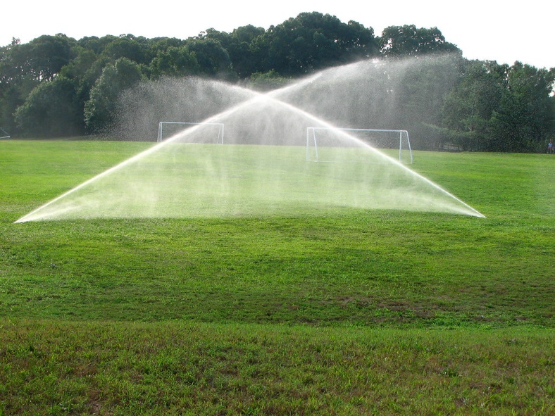


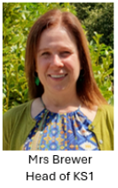
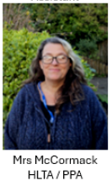
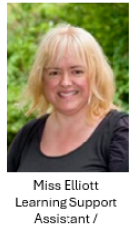
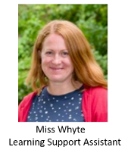
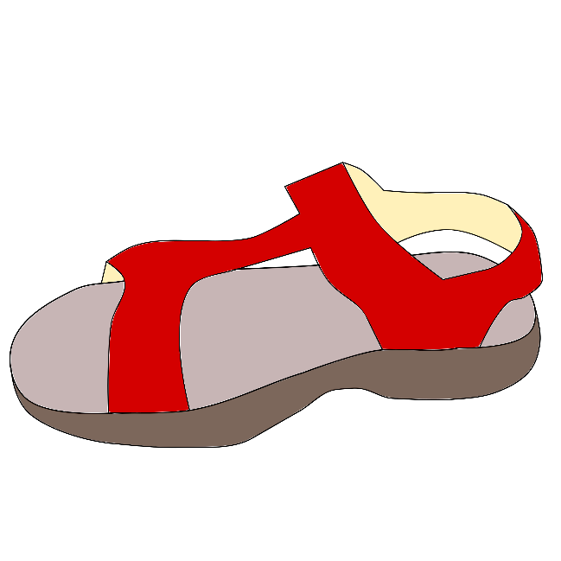
Classroom Connect
Summer Term
Attenborough Class
Meet the adults in Attenborough class

Slide 2


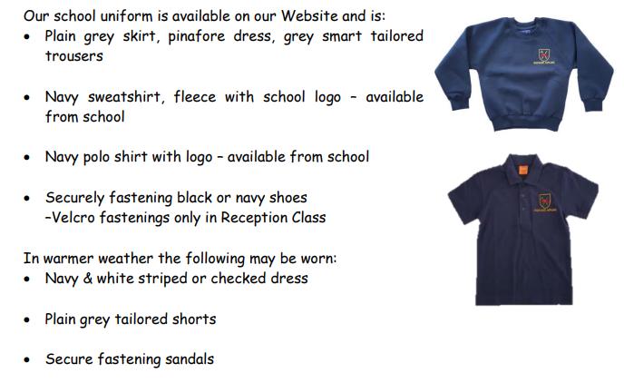

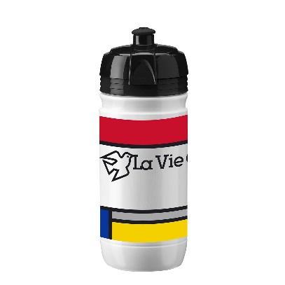


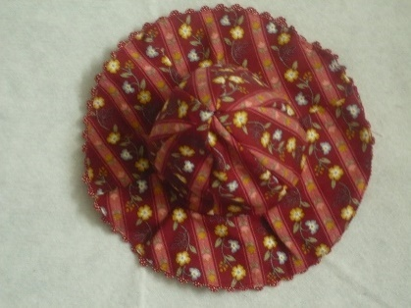
The children continue to look so smart – thank you.
Now it’s getting warmer and sunnier outside…

Slide 3

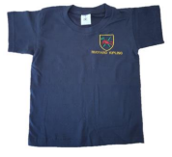
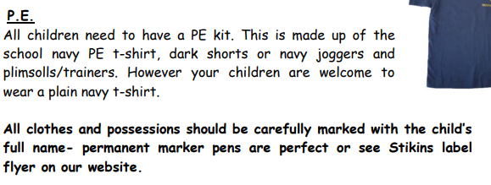


PE Days
Attenborough Class PE days are
Monday and Friday

Slide 4
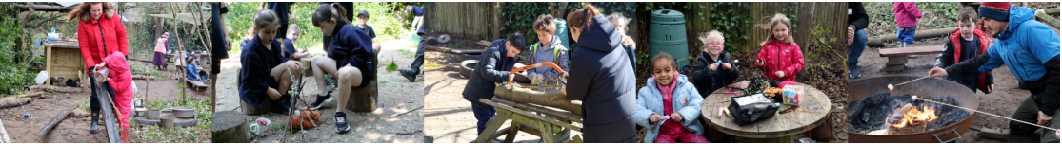
Forest School
Attenborough Forest School will be once a week next half term.

Slide 5




Special Mentions
Special Mentions assemblies are every Friday after Rock Up and Read.
You will receive an Arbor notification on the Friday before.
You will also receive an Arbor notification for Merit Star and Maths Mission Awards on the Friday before.

Slide 6


Rock Up And Read
Every Friday at 8:40-9:00

Slide 7
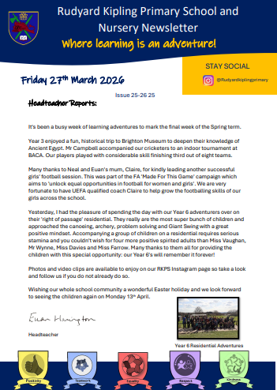
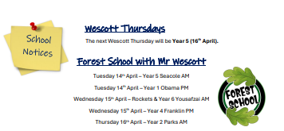

Parent Newsletters

Slide 8

Letters and admin
Bookings

Slide 9
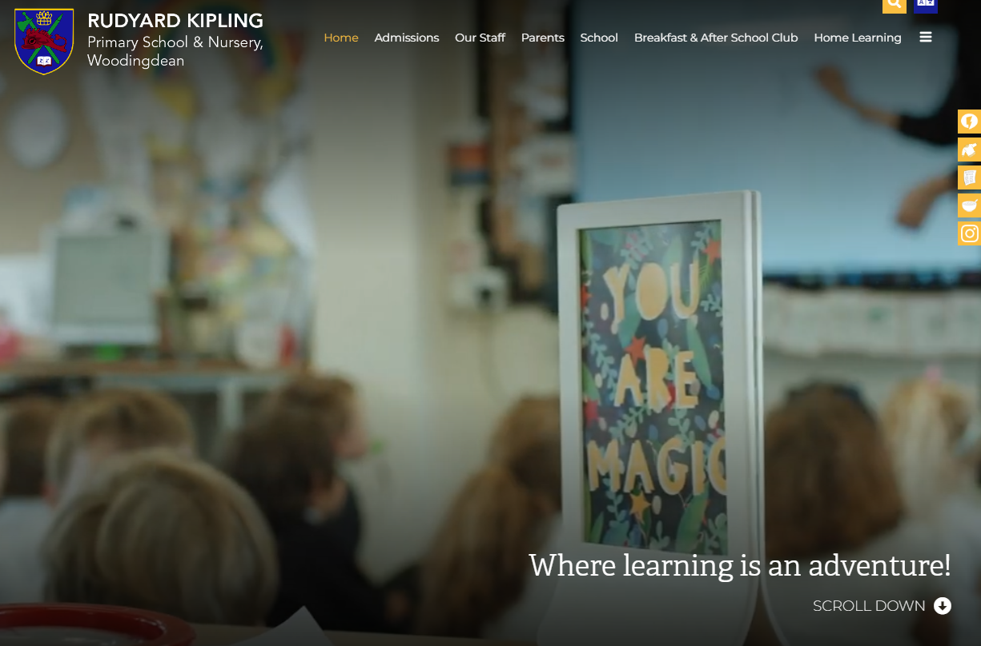
School Website
https://www.rudyardkiplingprimary.co.uk/

Slide 10
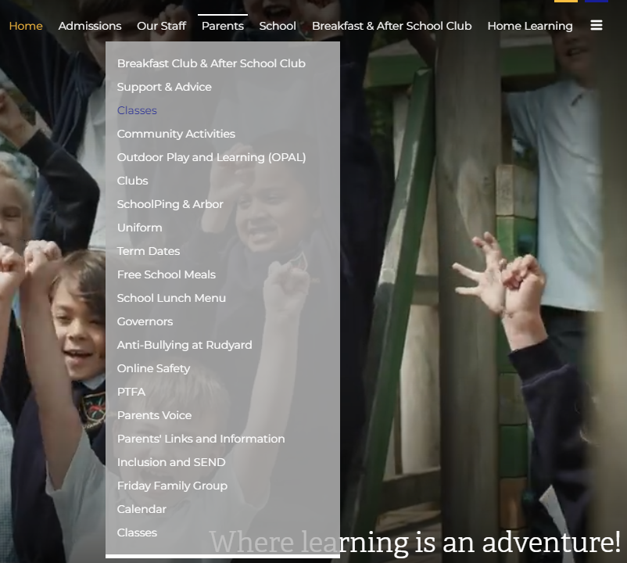
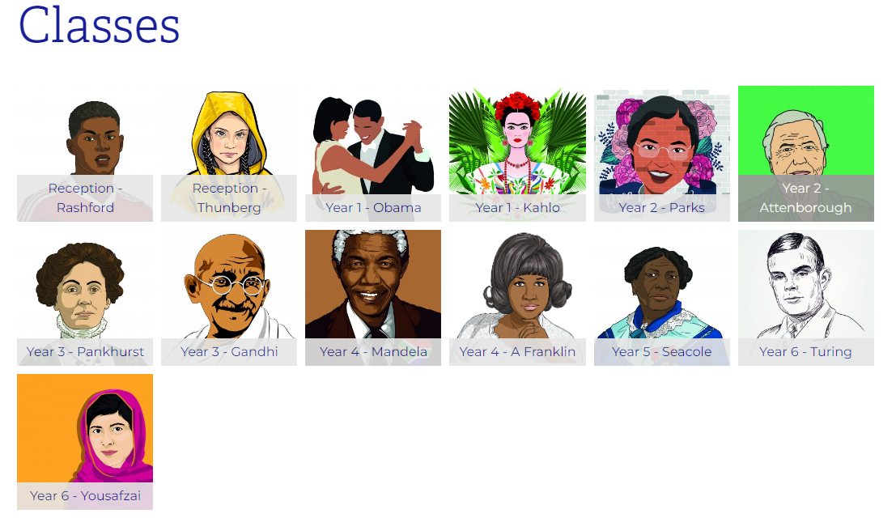
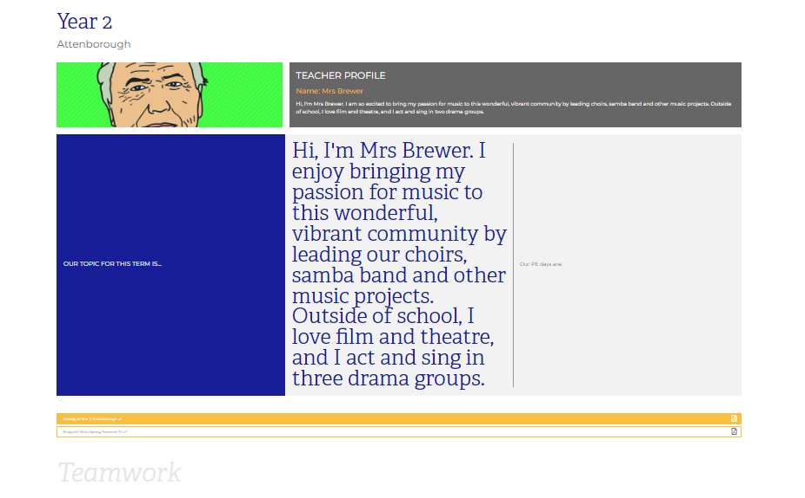
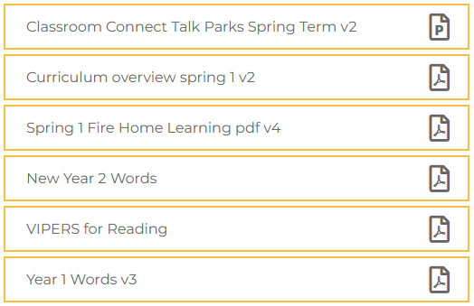
Class Page

Slide 11





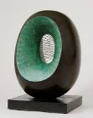







Curriculum
Map

Slide 12

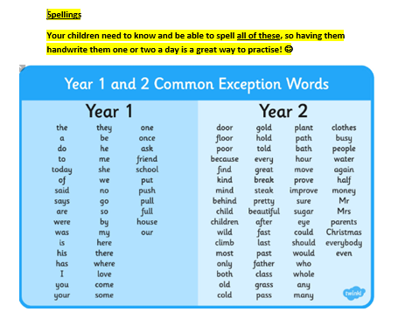

Slide 13
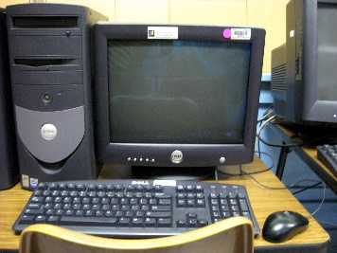

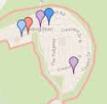


Attenborough Days for:
Computing: Tuesday
Library: Wednesday
Upcoming trips:
Local Walk - Friday 15th May, 9-10.45am
Drusillas - Tuesday 23rd June, all day

Slide 14


Practise regularly
Increase confidence
Increase fluency
Tackle challenges
Times Tables homework will be starting later this year.
First 3 letters of surname
First 3 letters of forename
Login:surnam surnam:@rkps.me
Password: words123

Slide 15
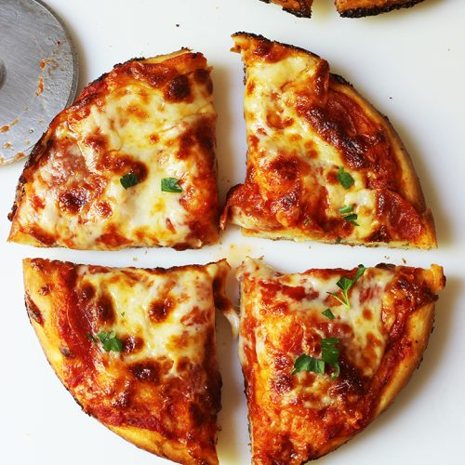
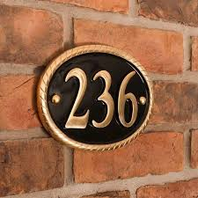
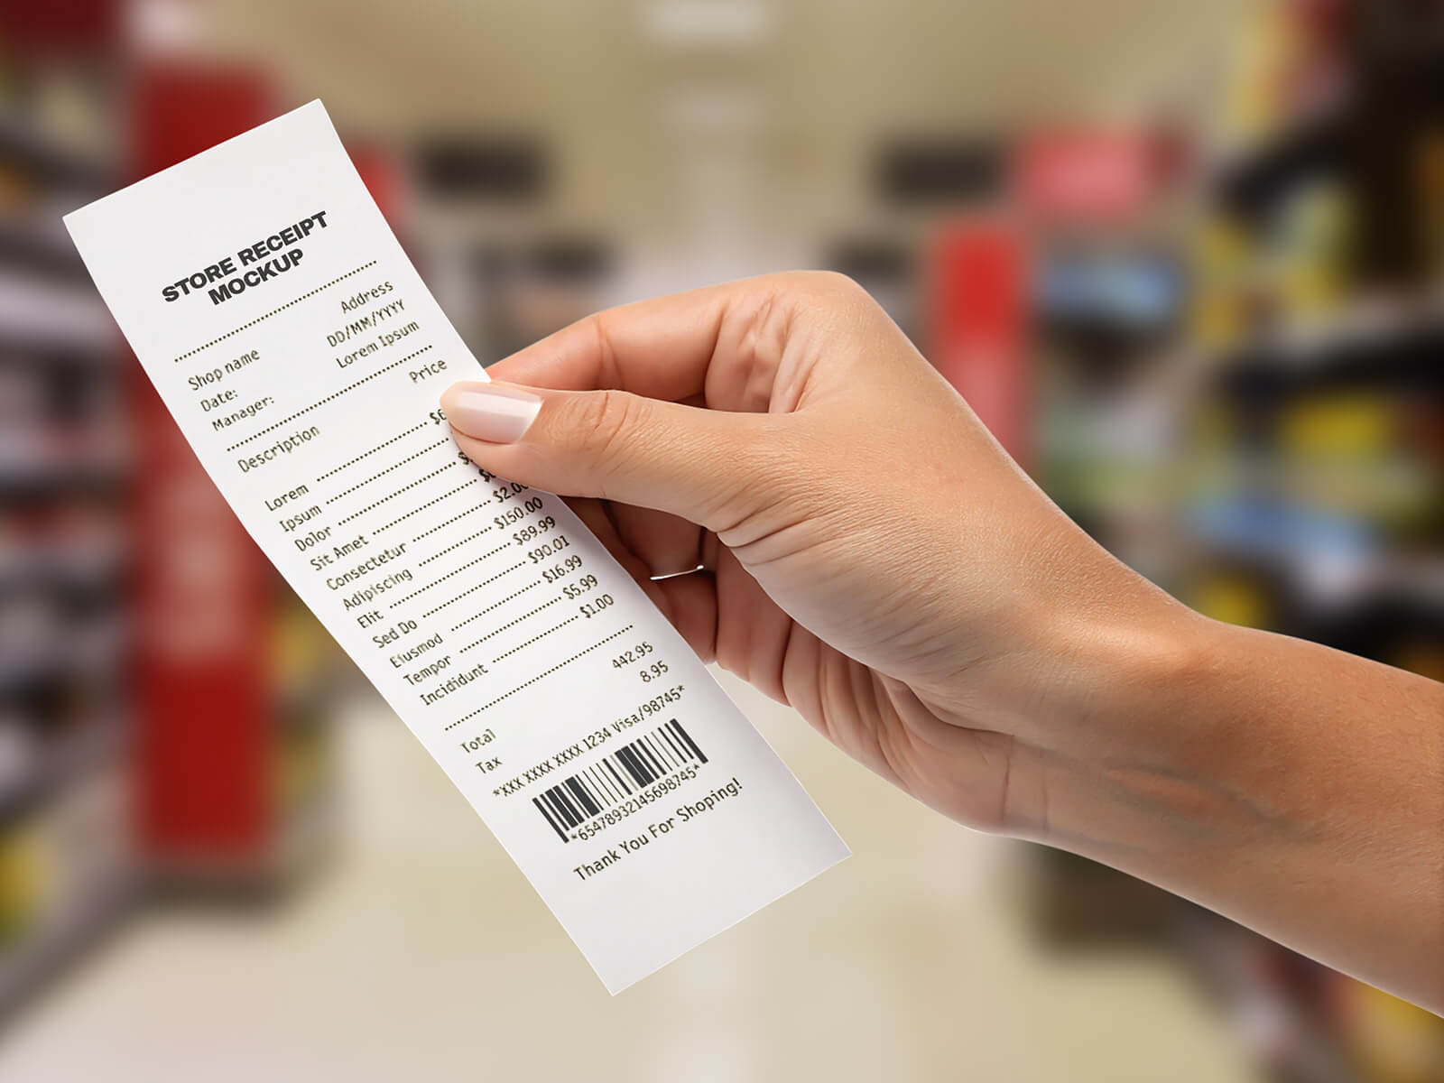
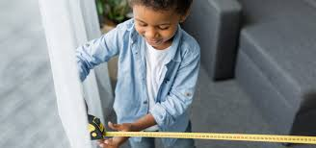
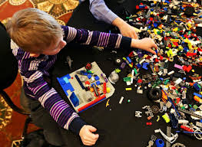
Maths at Home
Place Value:
House numbers
Shopping receipts
Car number plates
Prices
TV channels
Addition and Subtraction:
Adding prices when shopping.
Calculating change when spending money.
Adding or subtracting distances on a journey.
Fractions, Decimals and Percentages:
Sharing food
Reading prices
Measuring ingredients
Measures:
Cooking: weighing ingredients
Time: arrival times, length of travel, finishing times
Length: measure items around the house or outside with a rule or tape measure
Geometry:
Shape hunt at home and outside
Building models
Blindfolded directions
Shape spot competitions
Lego building
Multiplication and Division:
Times table recall
Increasing recipes
Packing: How many full boxes of 6 can we make?

Slide 16
Reading
Read your reading book 3 times a week
Record this in your reading record
Choose a reading for pleasure book
Hand in your reading record weekly
3 reads = 1 raffle ticket drawn in Special Mentions assembly

Slide 17

How can I support my child with reading?

Slide 18
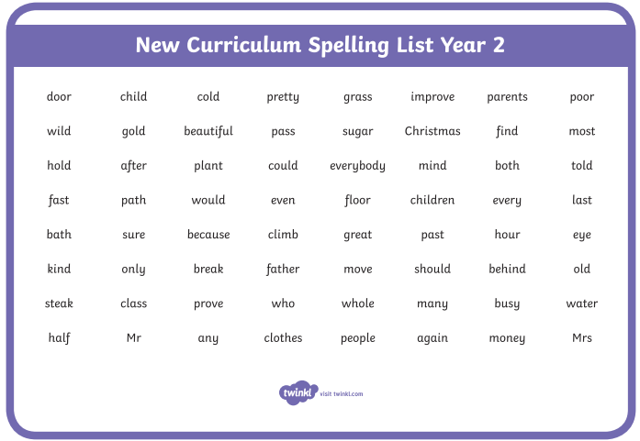
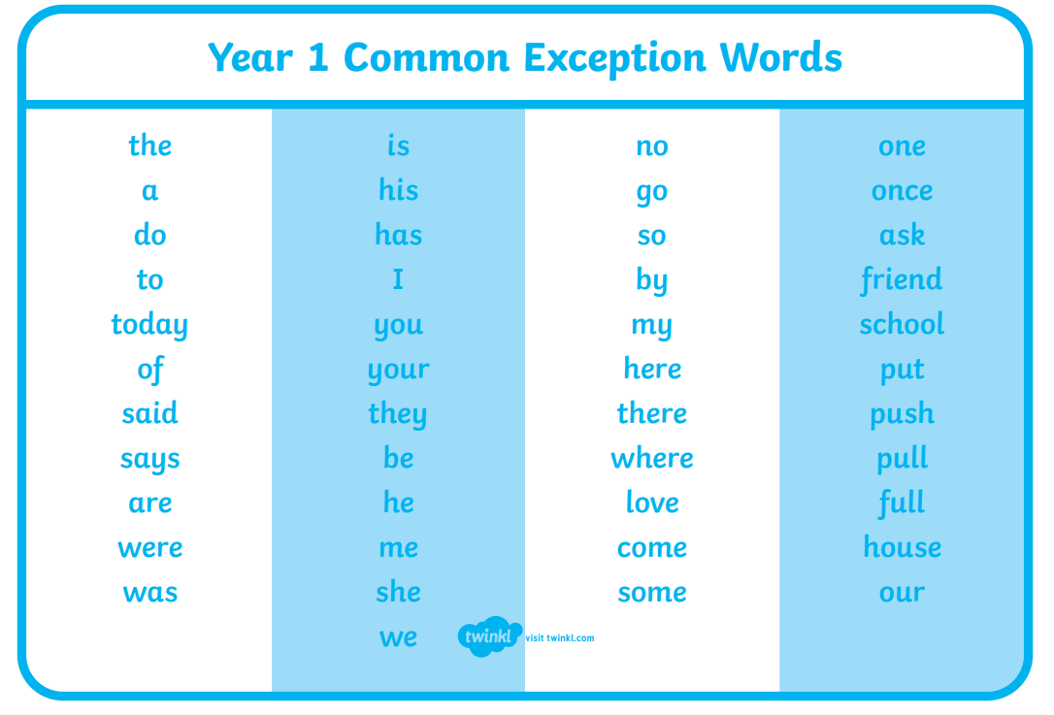
How can I support my child with spelling?
Year 2 Words
Year 1 Words

Slide 19
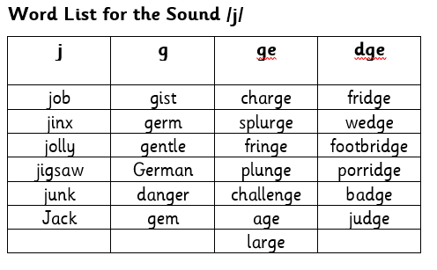
Phonics
Every 2 weeks, your child will be given a list of words that have our fortnightly sound. This will show how that sound is represented by different spellings.

Slide 20
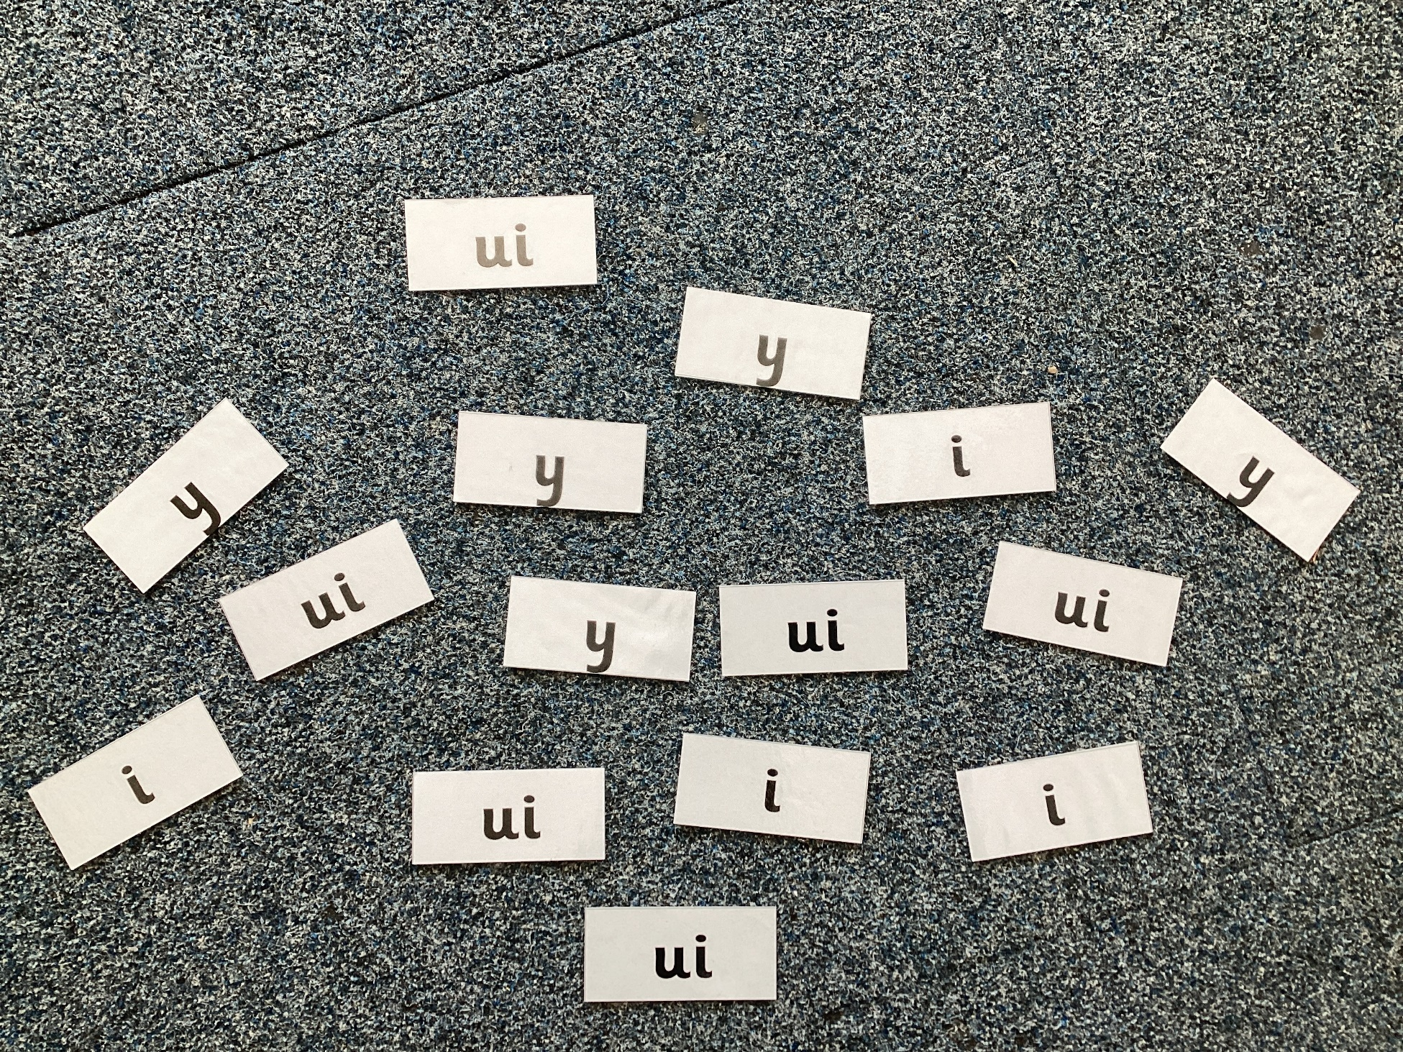
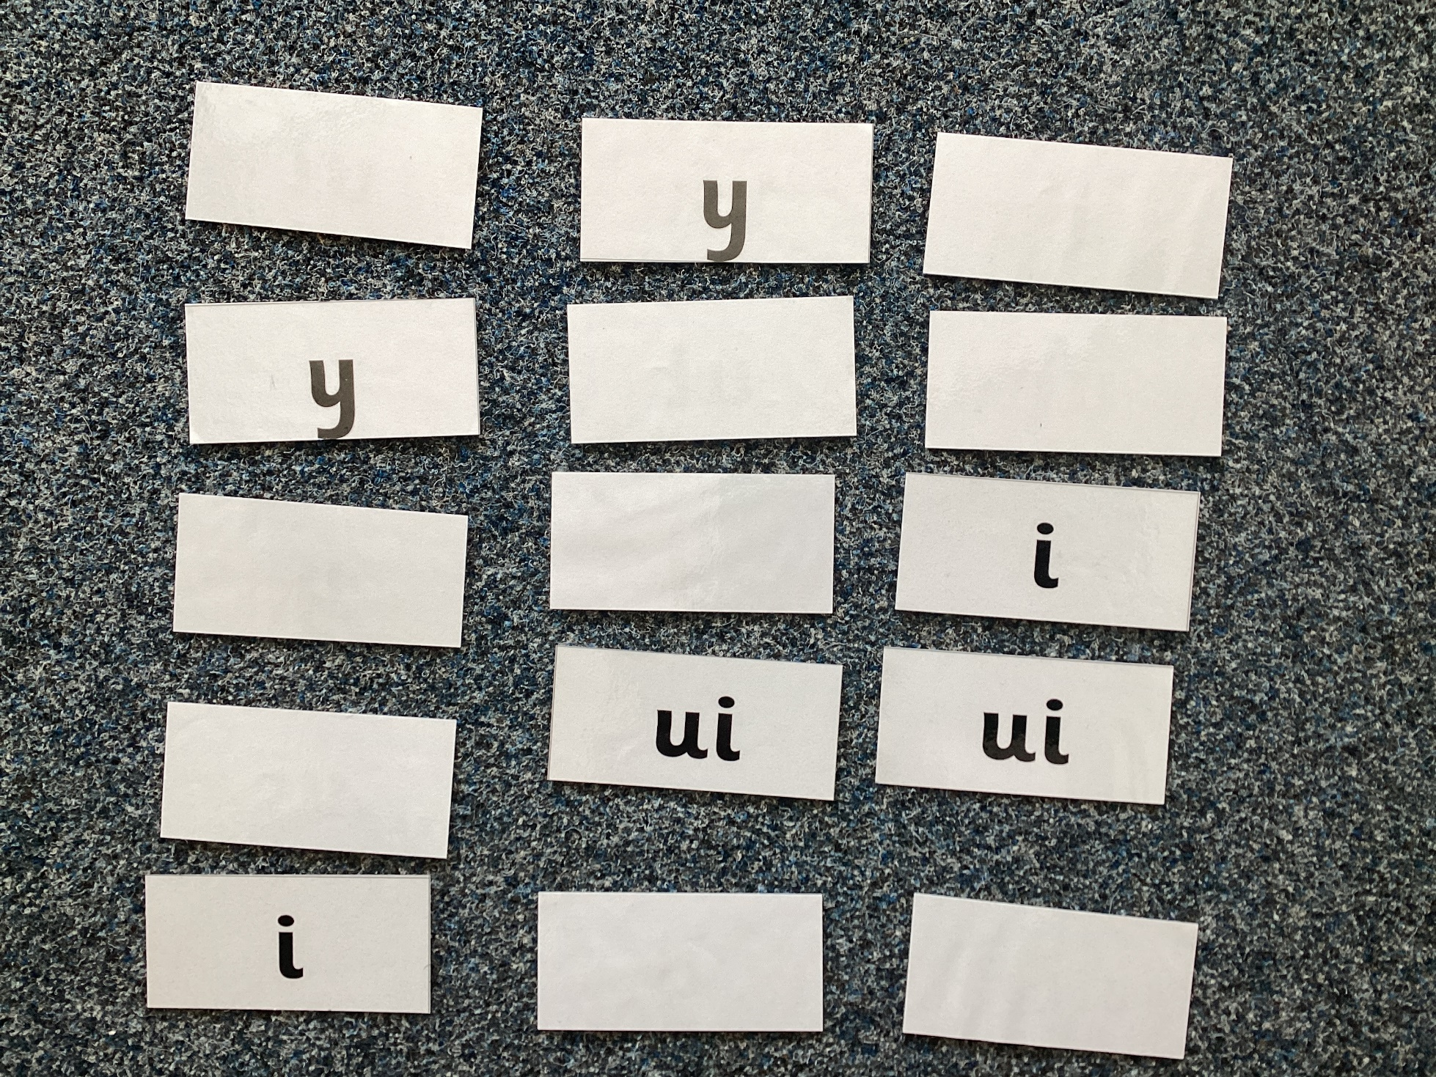
Examples of Phonics Games You Can Play
Spelling Word Hunt – single or multiplayer
Find all the one of the spellings as quickly as you can for that sound.
Matching Pairs – multiplayer
Have all spellings of the sound face down, turning two over at a time. If the spelling matches, keep it.

Slide 21
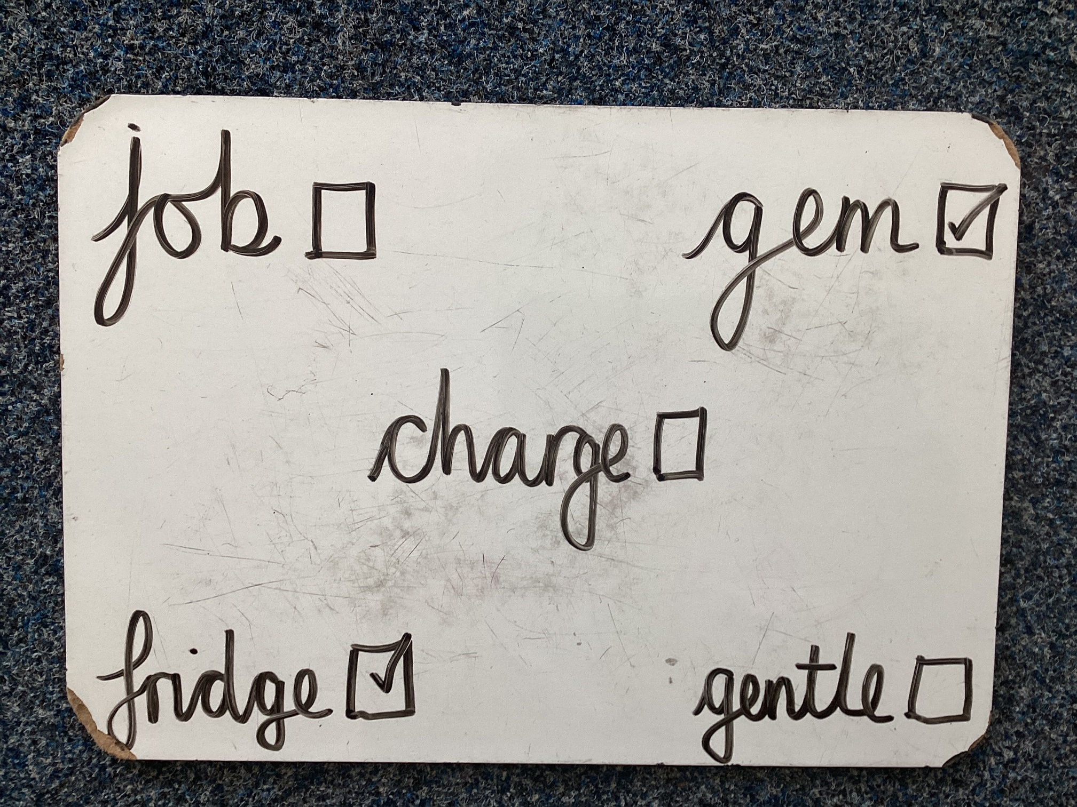
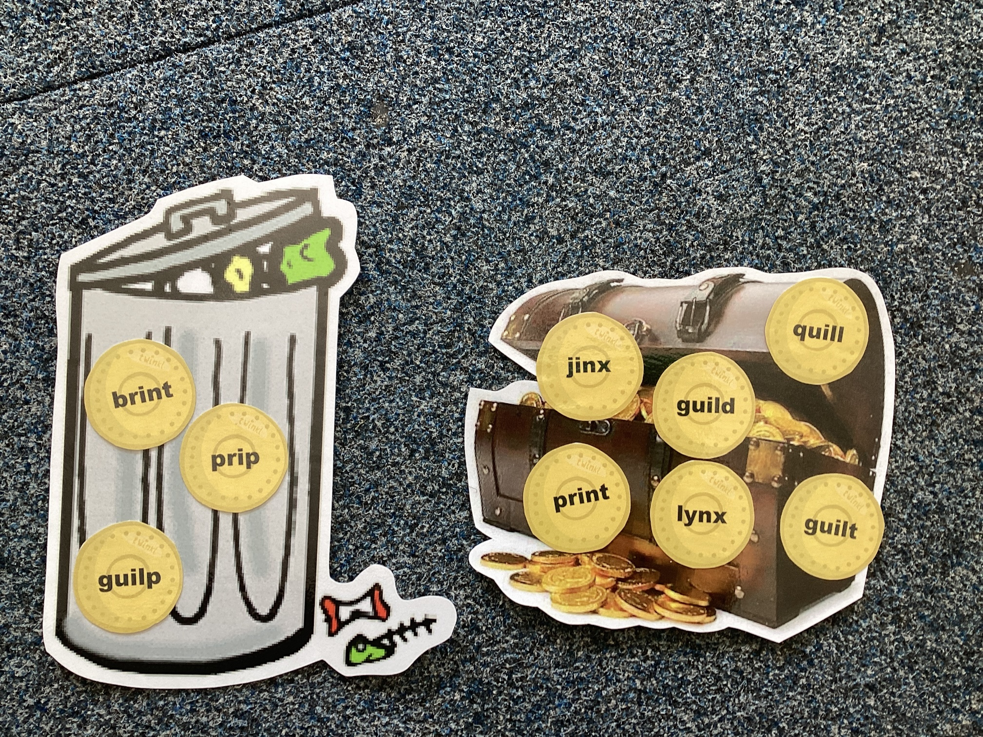
Examples of Phonics Games You Can Play
Word Bingo – multiplayer
Make words cards for 12 words. Your child copies 5 of them. Pull the words out of a hat/pot – the first to get their 5 words wins.
Treasure or Trash – single or multiplayer
Have a mix of real and unreal words. Sort them into treasure for real words and trash for unreal words.

Slide 22





Reading volunteers needed!
See Mrs. Brewer if you can help – even for just one session!

Slide 23


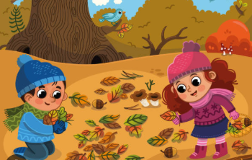

Forest School volunteers needed!
See Mrs. Brewer if you can help – even for just one session!

