Slide 1
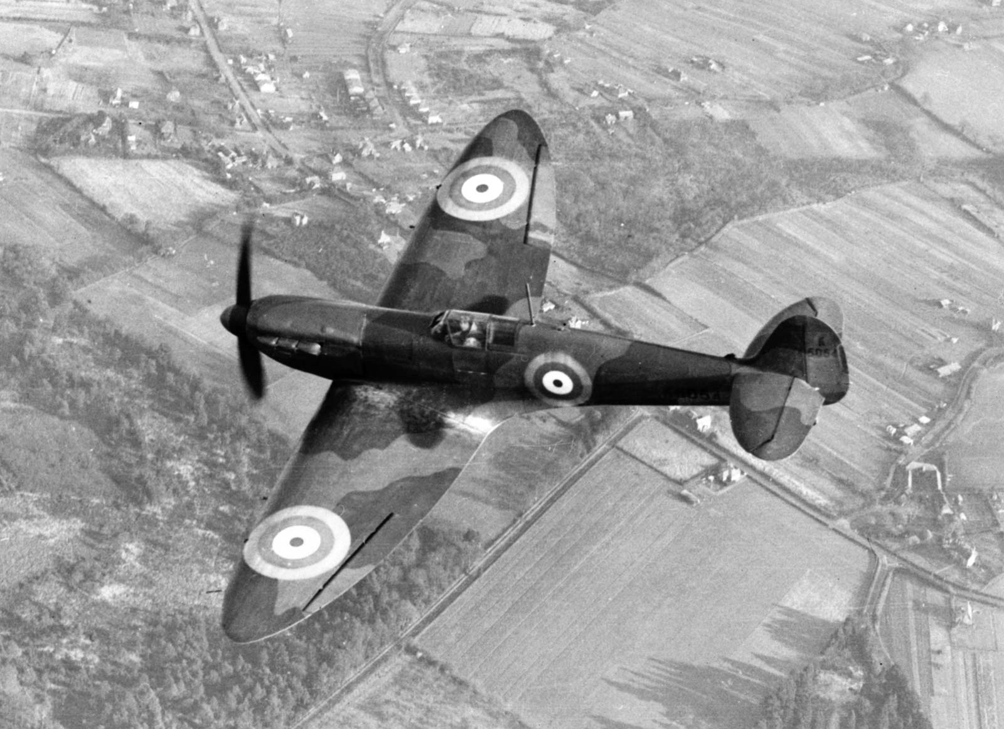
Year 6 Topic information: Chocks Away
Miss Vaughan, Mr Mack, Mr Chow & Mrs Woolven

Slide 2
Aims:
Curriculum overview
Important Days

Slide 3
Curriculum overview
Announcement of World War II
Evacuation – what they had to pack, why it happened, the effect on families
Propaganda
The Windrush generation
Anderson shelters
Timeline of WWII
Battle of Britain
Women in War
Look at Paul Nash as a wartime artist
Rationing during World War II
A local area effected by World War II
VE Day celebrations

Slide 4
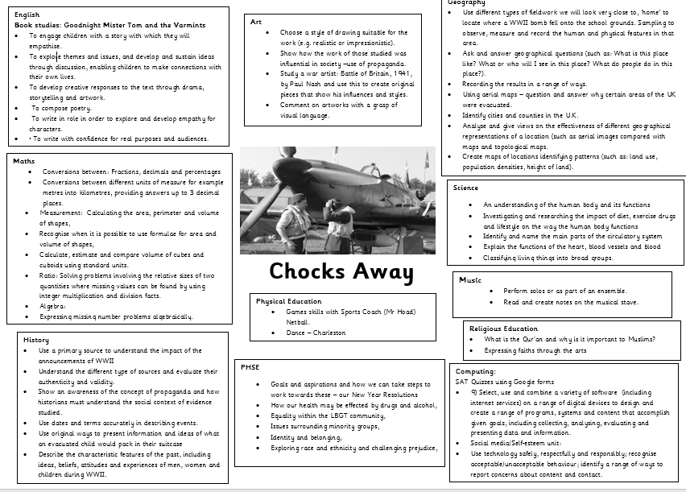
Curriculum overview

Slide 5


English Overview:
Kensuke’s kingdom & Goodnight Mister Tom
Book study: Goodnight Mister Tom
To engage children with a story with which they will empathise.
To explore themes and issues, and develop and sustain ideas through discussion, enabling children to make connections with their own lives.
To develop creative responses to the text through drama, storytelling and artwork.
To compose poetry.
•To write in role in order to explore and develop empathy for characters.
Book study: Kensuke’s Kingdom
To empathise with characters and explore their dilemmas
To enjoy a story and discuss its meanings
To explore these through role play and writing in role
To be able to write from the perspective of a character in a story
Discussion writing – arguments for and against
News report
Jungle setting description
Diary entries
Letter writing

Slide 6
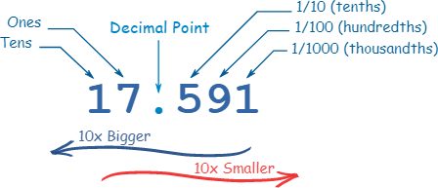
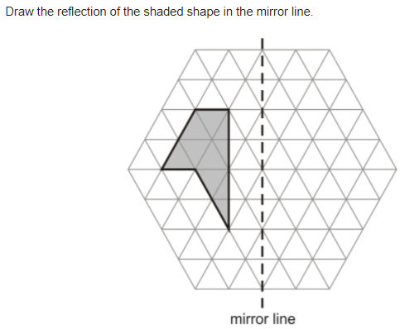
Maths overview
Ratio: Symbols, calculating, scale factors, problems.
Algebra: Finding rules, forming expressions, substitution, simple problems
Converting, equivalent, ordering and amounts: Fractions, decimals and percentages.
Perimeter, Area & Volume: Triangles, rectangles, cubes and cuboids.
Geometry: coordinates, quadrants, translation and reflection.

Slide 7

Maths FLuency
Practise regularly
Increase confidence
Tackle challenges
Login: surname:@rkps.me
Password: words123

Slide 8
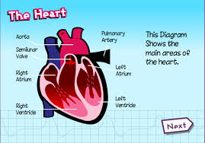
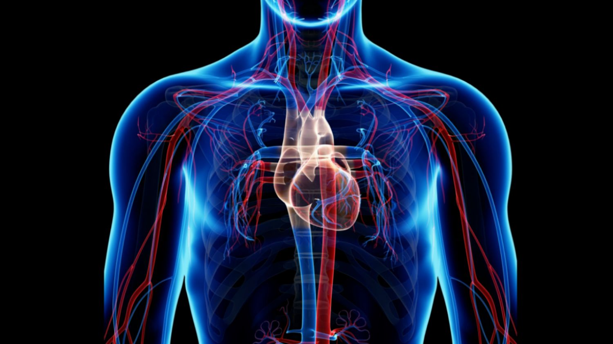
Science overview
An understanding of the human body and its functions
Investigating and researching the impact of diet, exercise drugs and lifestyle on the way the human body functions
Identify and name the main parts of the circulatory system
Explain the functions of the heart, blood vessels and blood
Classifying living things into broad groups.

Slide 9
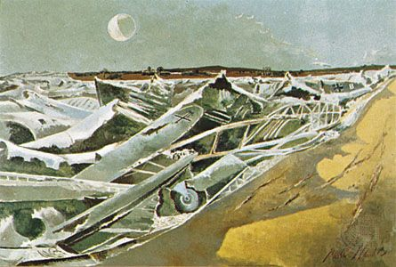
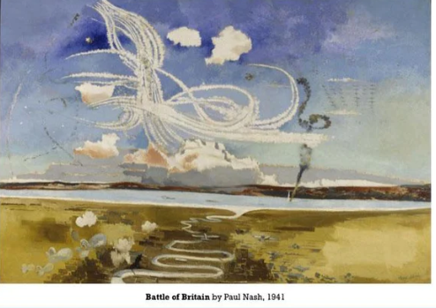
Art: study paul nash
I can express my personal of the Totes Meer (1940–41) installations and share it with my peers.
I can talk about the distinctive features of Paul Nash’s paintings and explain what they say to me
I can emulate Paul Nash’s style of painting

Slide 10

Rock up and Read & Special Mentions Assembly
Friday morning 08:40-09:00

Slide 11


Reading
Read your reading book 3 times a week
Record this in your reading record
Choose a reading for pleasure book
Hand in your reading record weekly
3 reads = 1 raffle ticket drawn in Special Mentions assembly

Slide 12


Reading - Home
“Students who read for pleasure make significantly more progress in vocabulary, spelling and maths than children who read very little.” Sullivan and Brown 2013.
Reluctant Readers
Book Recommendations

Slide 13

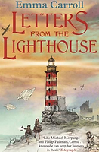
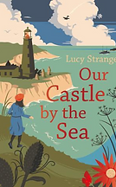





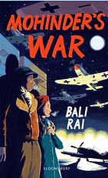

Year 6 World War II books

Slide 14
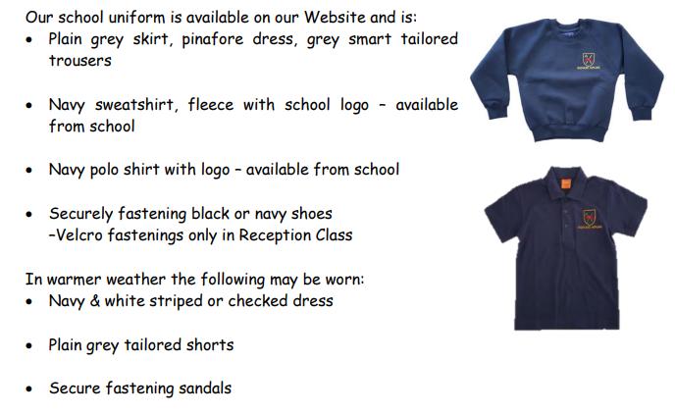
School uniform
Our children look smart, so thank you ☺

Slide 15
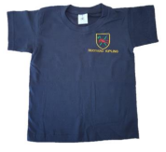
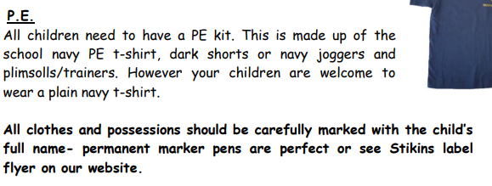

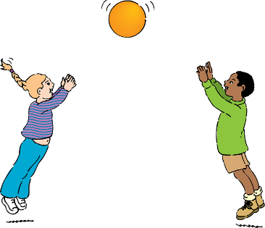
PE days:
- Yousafzai: Monday
- Turing: Wednesday

Slide 16

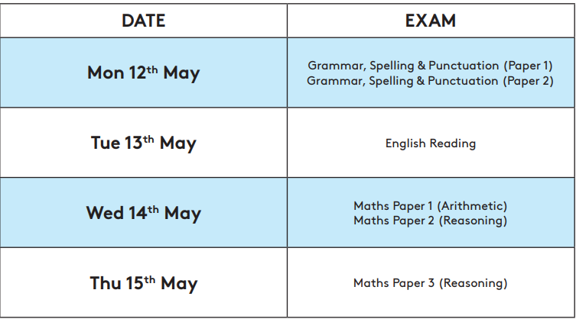
Dates for the Diaries
Residential: Wednesday 2nd April – Friday 4th April 2025
SATs will be held from Monday 12th May 2025 – Thursday 15th May 2024.
SATs and residential chat Thursday 13th February 2:35

Slide 17
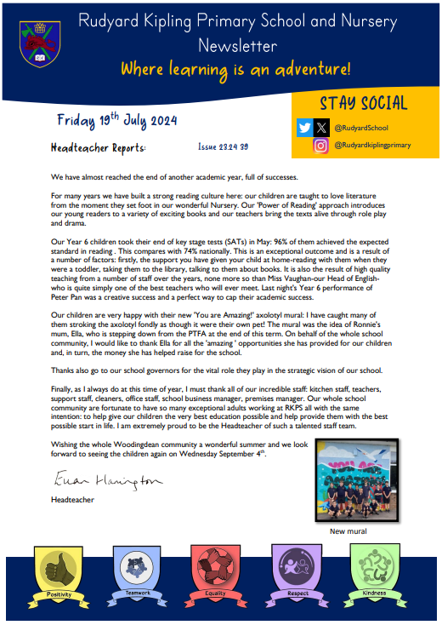

Parent Newsletters and SchoolPing
Use your SchoolPing account to receive important messages.

Slide 18




Special Mentions
Special Mentions assemblies are every Friday after Rock Up and Read.
You will receive a Ping on the Friday before.

Slide 19
Spellings
In year 6 we have to review all of KS2 spellings and learn the statuary spelling list for year 5 and for year 6.
In Spring we will be focusing on:
ough
cial & tial
Prefixes e,g replay
Suffix e.g. happening
Homophones (words that sound the same, but have different meanings)
Statutory spellings for year 3 & 4 and 5 & 6.

Slide 20

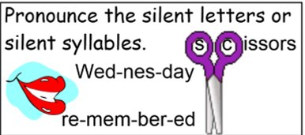
Spelling strategies

Slide 21
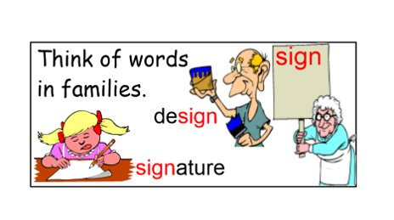
Spelling strategies

Slide 22
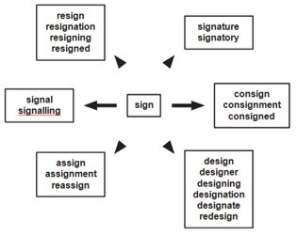
Spelling strategies

Slide 23
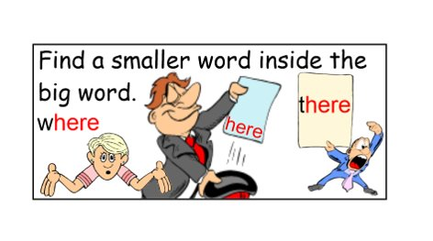
Spelling strategies

Slide 24
Spelling strategies
Impress
Press
Word Webs
Write down as many words with the root word press

Slide 25



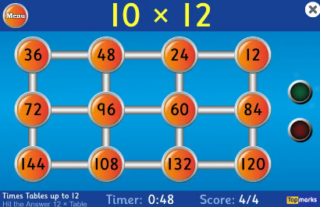
Home Learning apps
TTRS; Google Classroom:
Logins: surname:@rkps.me
Password: words123
White Rose 1minute maths: Free Apps, Top Marks (hit the button)

Slide 26
