Slide 1
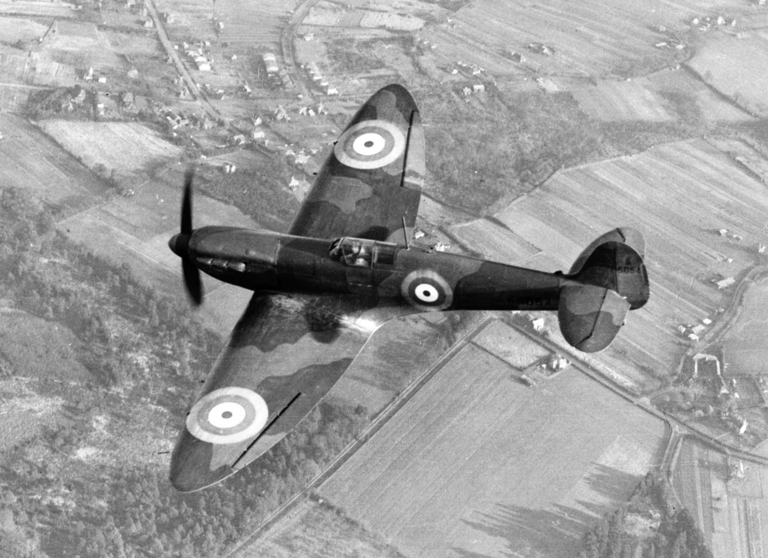
Year 6 Topic information: Chocks Away
Miss Vaughan & Mrs Woolven

Slide 2
Aims:
Curriculum overview
Important Days
Spellings

Slide 3
Curriculum overview
Announcement of World War II
Evacuation – what they had to pack, why it happened, the effect on families
Propaganda
The Windrush generation
Anderson shelters
Timeline of WWII
Battle of Britain
Women in War
Look at Paul Nash as a wartime artist
Rationing during World War II
A local area effected by World War II
VE Day celebrations

Slide 4
Curriculum overview

Slide 5
English Overview:
Goodnight Mister Tom & the Varmints
Book study: Goodnight Mister Tom
To engage children with a story with which they will empathise.
To explore themes and issues, and develop and sustain ideas through discussion, enabling children to make connections with their own lives.
To develop creative responses to the text through drama, storytelling and artwork.
To compose poetry.
•To write in role in order to explore and develop empathy for characters.
Book study: Varmints
• To explore, interpret and respond to illustrations in a picture book
• To empathise with characters and explore their dilemmas
• To enjoy a story and discuss its meanings
• To build an imaginative picture of a fantasy world, based on real life experiences
• To explore these through role play and writing in role
• To write own stories inspired by the book in a different format
• To be able to write from the perspective of a character in a story

Slide 6
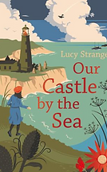
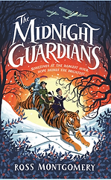
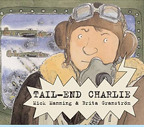
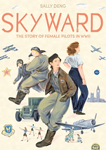
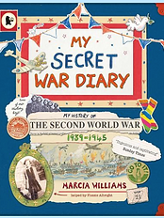
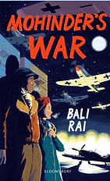
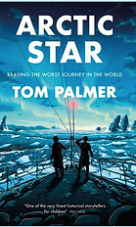
Year 6 World War II books

Slide 7
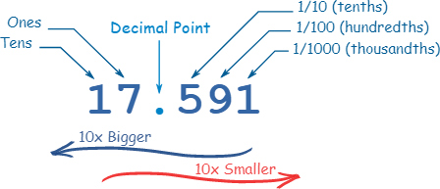
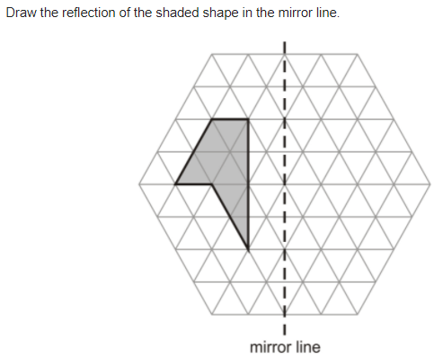
Maths overview
Converting, equivalent, ordering and amounts: Fractions, decimals and percentages.
Geometry: coordinates, quadrants, translation and reflection.
Algebra: Finding rules, forming expressions, substitution, simple problems
Converting Units: Metric measurement, miles & kilometres and imperial.
Perimeter, Area & Volume: Triangles, rectangles, cubes and cuboids.
Ratio: Symbols, calculating, scale factors, problems.

Slide 8
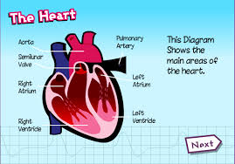
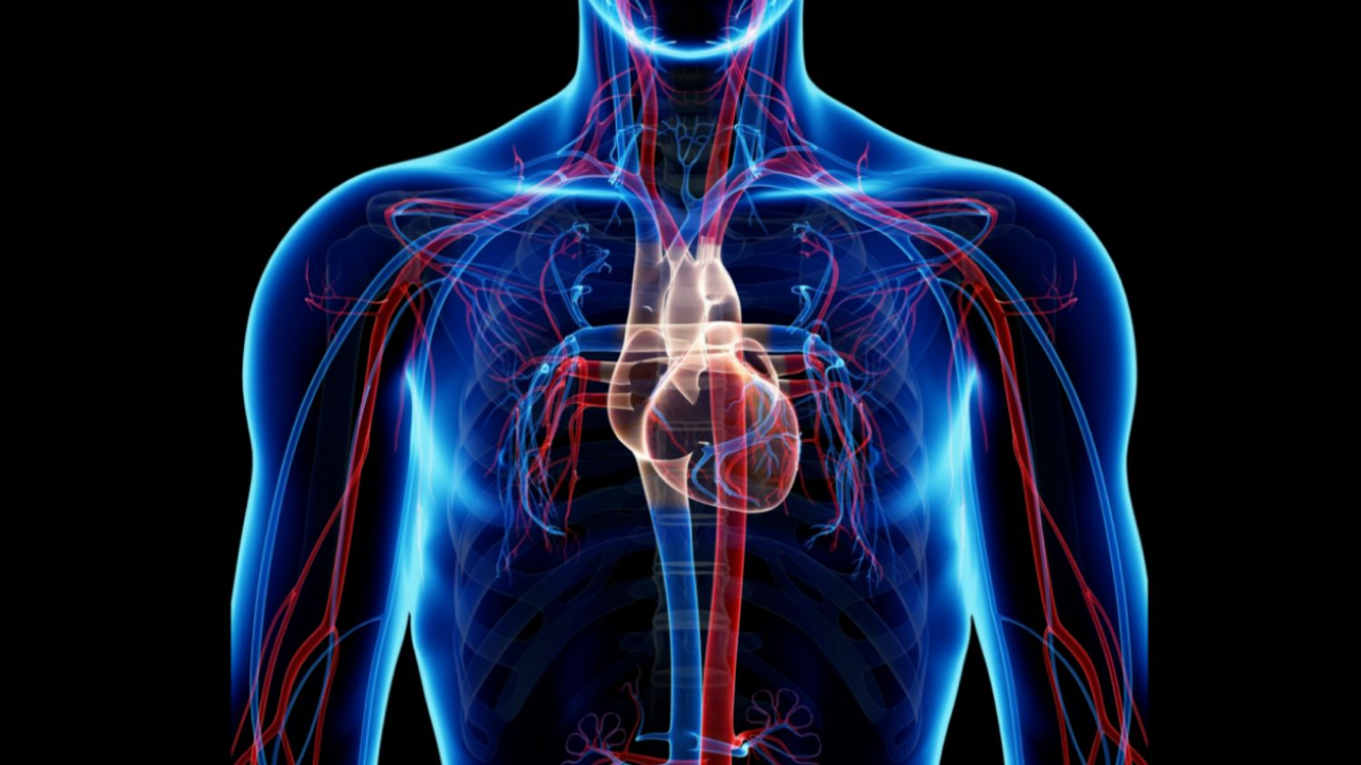
Science overview
An understanding of the human body and its functions
Investigating and researching the impact of diet, exercise drugs and lifestyle on the way the human body functions
Identify and name the main parts of the circulatory system
Explain the functions of the heart, blood vessels and blood
Classifying living things into broad groups.

Slide 9
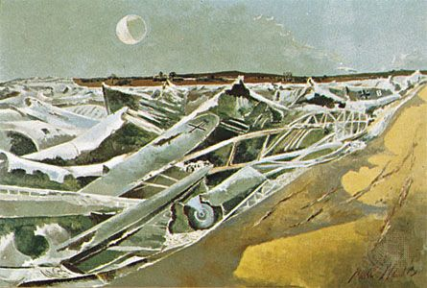
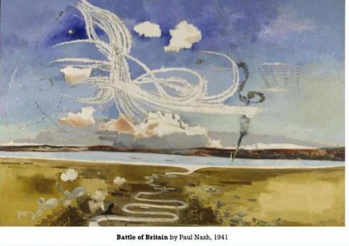
Art: study paul nash
I can express my personal of the Totes Meer (1940–41) installations and share it with my peers.
I can talk about the distinctive features of Paul Nash’s paintings and explain what they say to me
I can emulate Paul Nash’s style of painting

Slide 10
Important days
PE day: Thursday
Fieldwork trip – locating bomb sites in our local area (one even on our own grounds)
Chef John learning: Knife skills – 7th February
Plumpton – 7th March
VE Day celebrations

Slide 11
Spellings
In year 6 we have to review all of KS2 spellings and learn the statuary spelling list for year 5 and for year 6.
In Spring we will be focusing on:
Ough
Cial & tial
Prefixes e,g replay
Suffex e.g. happening
Homophones (words that sound the same, but have different meanings)
Statuary spellings for year 3 & 4 and 5 & 6.

Slide 12
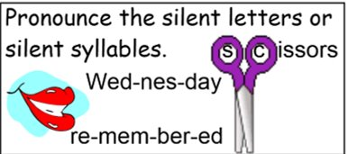
Spelling strategies

Slide 13
Spelling strategies

Slide 14
Spelling strategies

Slide 15
Spelling strategies

Slide 16
Spelling strategies

Slide 17
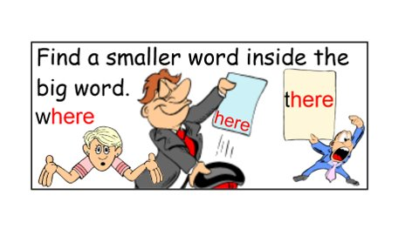
Spelling strategies

Slide 18
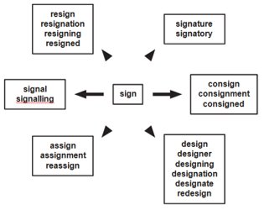
Spelling strategies

Slide 19
Spelling strategies
Impress
Press
Word Webs
Write down as many words with the root word press

