Slide 1

Year 6 Spring CLASSROOM Connect
Miss Davies, Miss Farrows and Miss Vaughan

Slide 2
WELCOME AND PURPOSE:
Working together to support your child
Curriculum overview
Important Dates/days

Slide 3

Dates for the Diaries
Maths Number Day – Wednesday 11th February – dress up
Chef John Workshops – Thursday 12th February and Tuesday 10th March 2026
World Book Day – Thursday 5th March 2026
Residential: Wednesday 25th Mach – Friday 27th March 2026
SATs and Residential chat Monday 26th January at 2:35 – KS2 hall
SATs will be held from Monday, May 11th to Thursday, May 14th, 2026

Slide 4
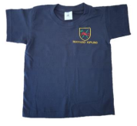
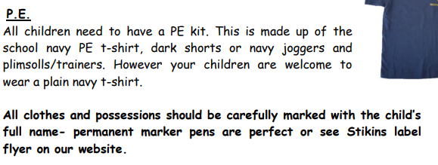

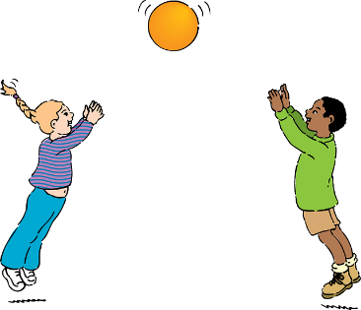
PE days:
- Yousafzai: Monday
Reminder - No jewellery should be worn on PE Days this includes Stud earrings.

Slide 5
Curriculum overview
Announcement of World War II
Evacuation – what they had to pack, why it happened, the effect on families
Propaganda
The Windrush generation
Anderson shelters
Timeline of WWII
Battle of Britain
Women in War
Look at Paul Nash as a wartime artist
Rationing during World War II
A local area effected by World War II
VE Day celebrations

Slide 6

English Overview:
Letters from the lighthouse
Book study: Letters from the Lighthouse
To empathise with characters and explore their experiences during WWII
To enjoy the story and discuss its meanings
To explore events through role play and writing in role
To be able to write from the perspective of a character in a story
Discussion writing – arguments for and against decisions made by characters
Diary entries
Letter writing
Historical recounts / news reports
Descriptive writing (settings, moods, emotions)

Slide 7
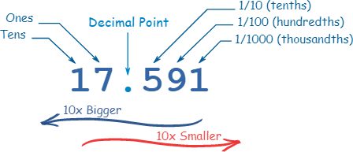
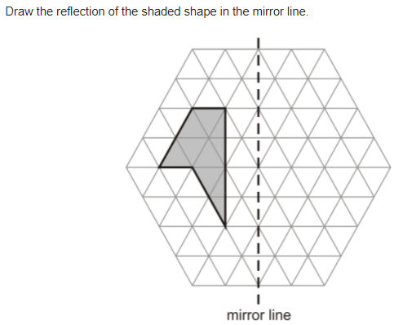
Maths overview
Ratio: Symbols, calculating, scale factors, problems.
Algebra: Finding rules, forming expressions, substitution, simple problems
Converting, equivalent, ordering and amounts: Fractions, decimals and percentages.
Perimeter, Area & Volume: Triangles, rectangles, cubes and cuboids.
Statistics: Reading and interpreting charts and graphs, drawing charts and graphs, understanding ‘the mean’.

Slide 8

Maths FLuency
Practise regularly
Increase confidence
Tackle challenges
Login: surname:@rkps.me
Password: words123

Slide 9
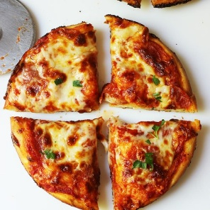
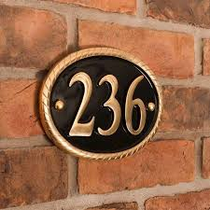
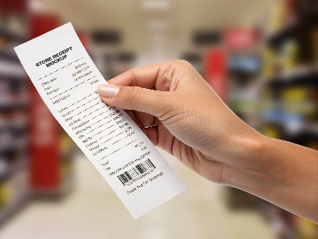
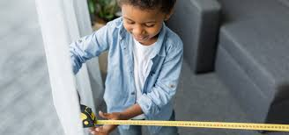
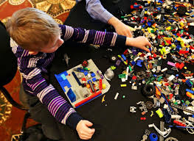
Maths at Home
Place Value:
House numbers
Shopping receipts
Car number plates
Prices
TV channels
Addition and Subtraction:
Adding prices when shopping.
Calculating change when spending money.
Adding or subtracting distances on a journey.
Fractions, Decimals and Percentages:
Sharing food
Reading prices
Measuring ingredients
Measures:
Cooking: weighing ingredients
Time: arrival times, length of travel, finishing times
Length: measure items around the house or outside with a rule or tape measure
Geometry:
Shape hunt at home and outside
Building models
Blindfolded directions
Shape spot competitions
Lego building
Multiplication and Division:
Times table recall
Increasing recipes
Packing: How many full boxes of 6 can we make?

Slide 10
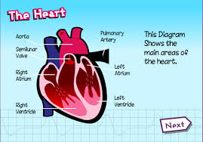
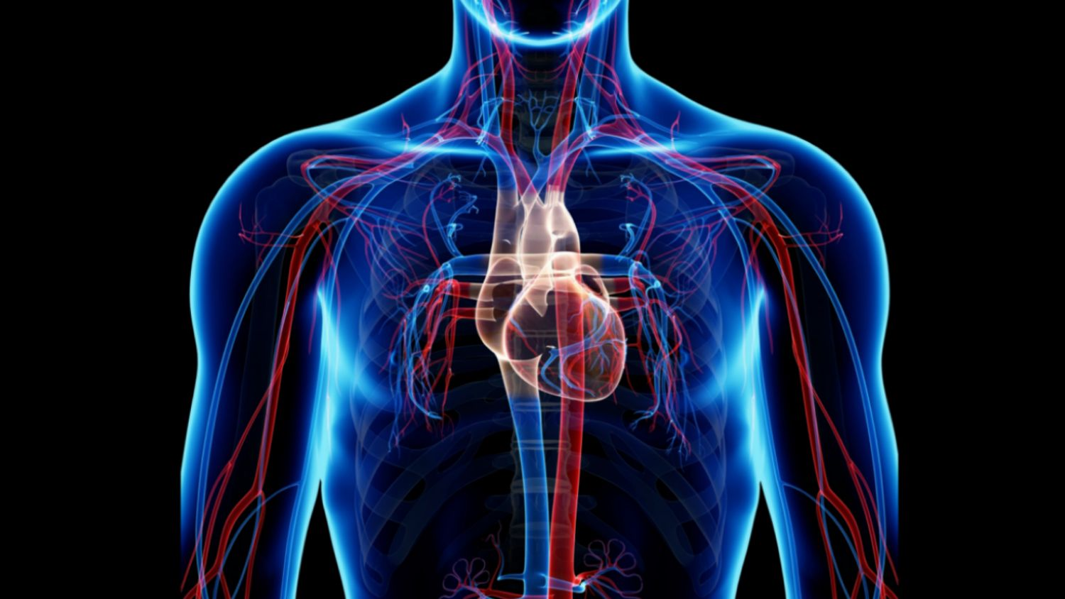
Science overview
An understanding of the human body and its functions
Investigating and researching the impact of diet, exercise drugs and lifestyle on the way the human body functions
Identify and name the main parts of the circulatory system
Explain the functions of the heart, blood vessels and blood
Classifying living things into broad groups.

Slide 11
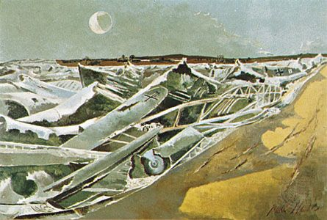

Art: study paul nash
I can express my personal of the Totes Meer (1940–41) installations and share it with my peers.
I can talk about the distinctive features of Paul Nash’s paintings and explain what they say to me
I can emulate Paul Nash’s style of painting

Slide 12

Rock up and Read & Special Mentions Assembly
Friday morning 08:40-09:00 – please do come along!

Slide 13

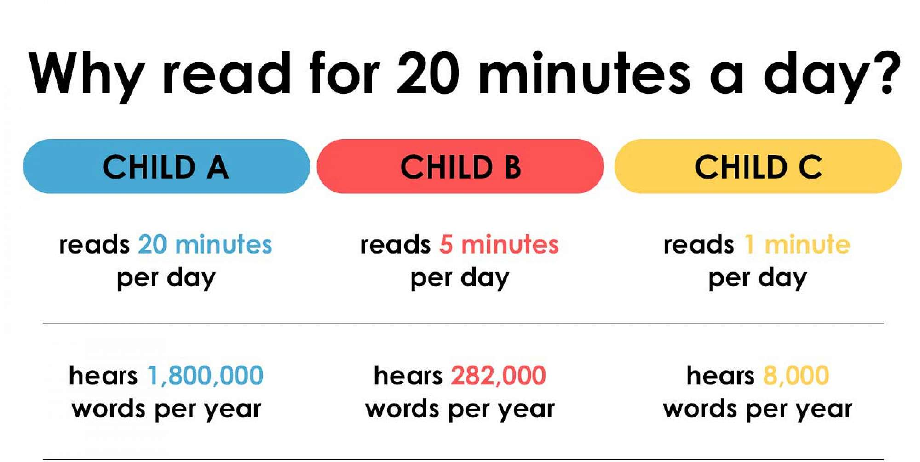
Reading - Home

Slide 14
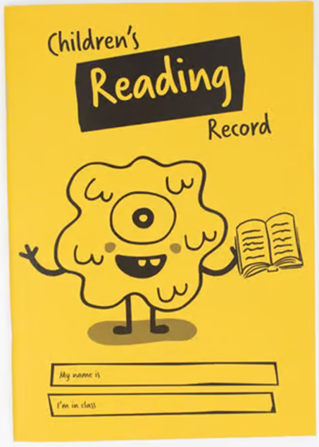
Expectations for reading records
Read your reading book 3 times a week
Record this in your reading record
Choose a reading for pleasure book
Hand in your reading record weekly
3 reads = 1 raffle ticket drawn in Special Mentions assembly

Slide 15
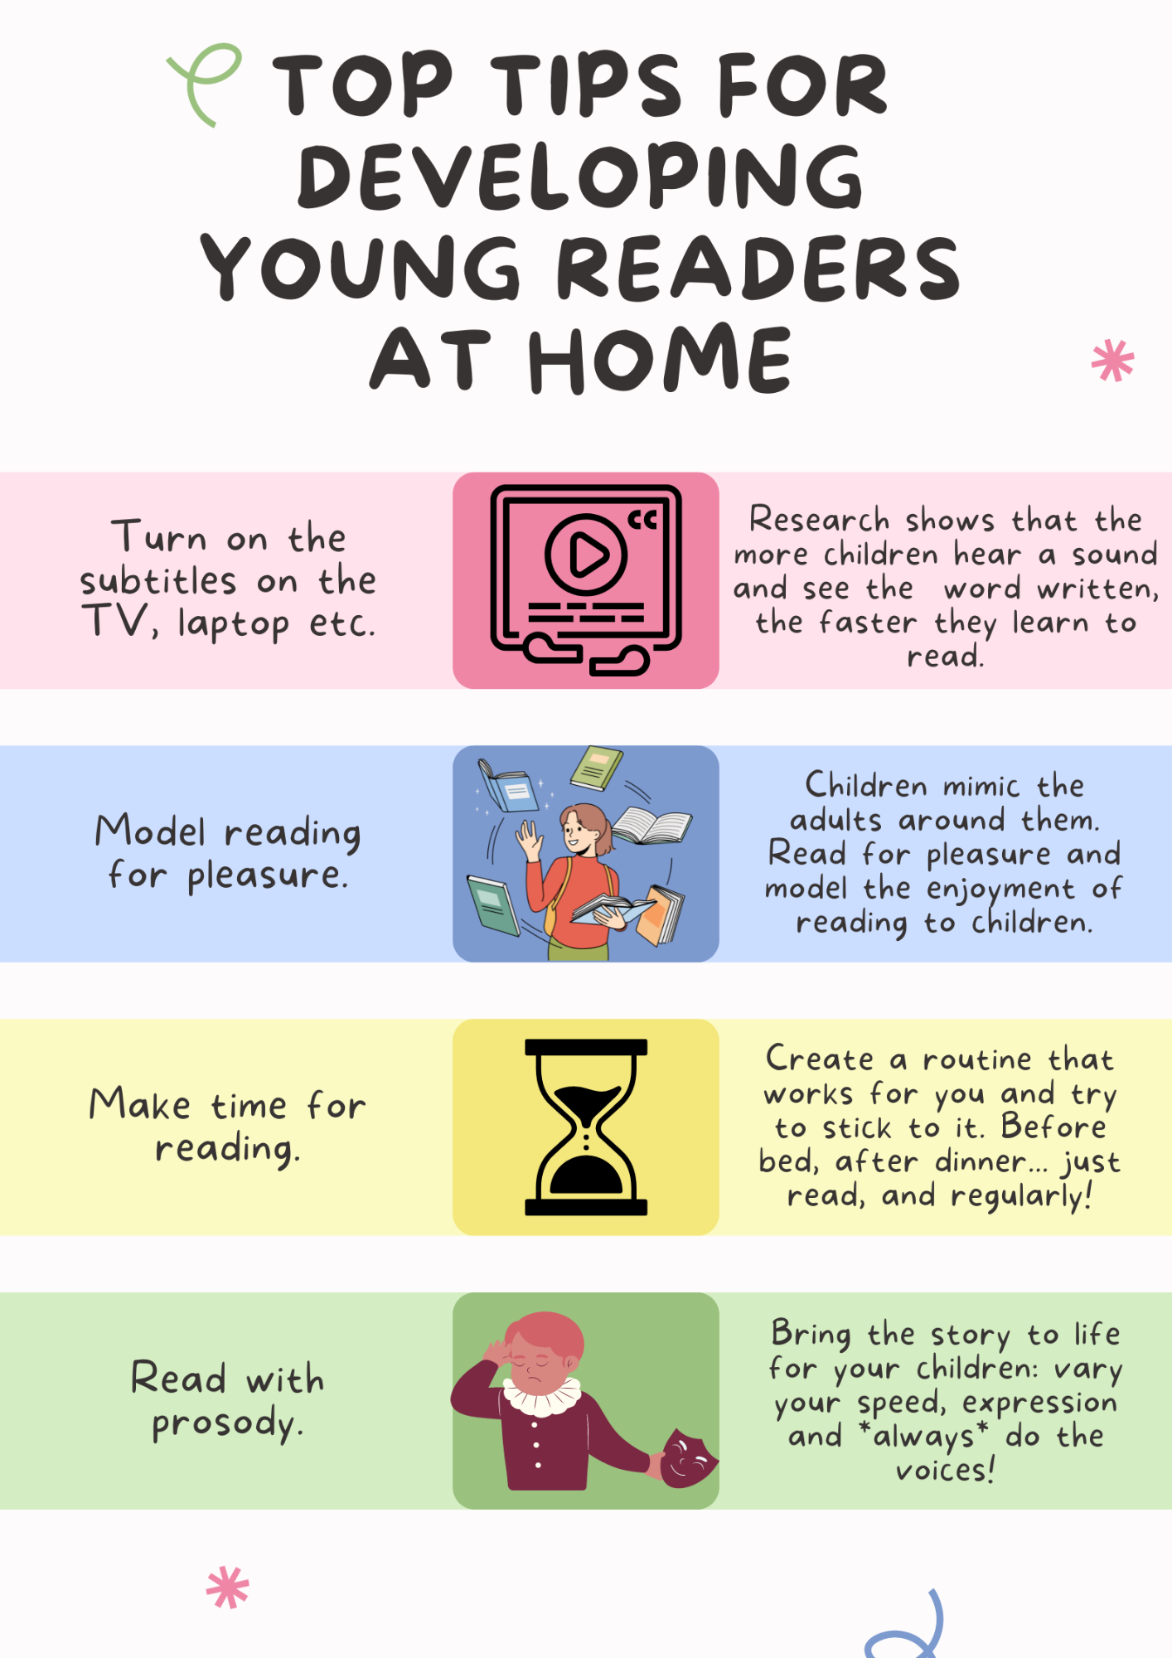
Reading - Home

Slide 16


Reading - Home
“Students who read for pleasure make significantly more progress in vocabulary, spelling and maths than children who read very little.” Sullivan and Brown 2013.
Reluctant Readers
Book Recommendations

Slide 17










Year 6 World War II books

Slide 18
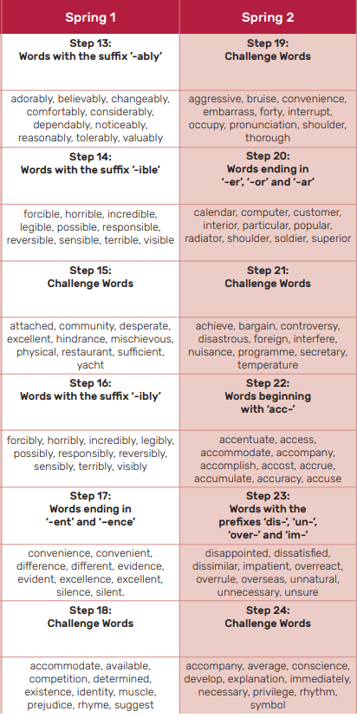
Spellings

Slide 19
Spelling strategies
Impress
Press
Word Webs
Write down as many words with the root word press

Slide 20

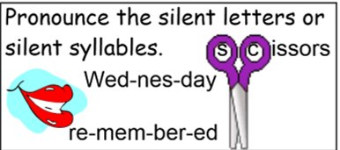
Spelling strategies

Slide 21
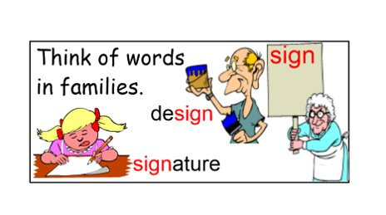
Spelling strategies

Slide 22
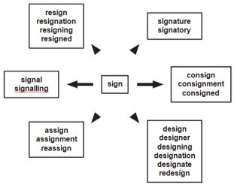
Spelling strategies

Slide 23
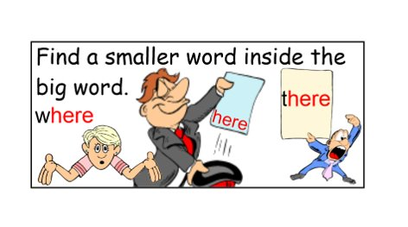
Spelling strategies

Slide 24
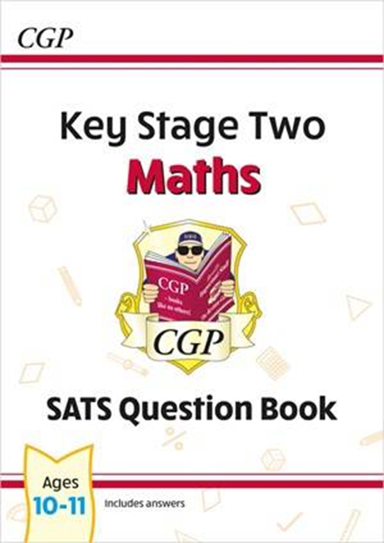
Maths Home Learning (CGP Books)
Each child will receive a CGP Maths SATs practice book
Children will be set specific sections to complete each week
This will be given every Friday – children should bring it back by the following Wednesday
Answers are in the back so children are encouraged to check their own answers and reflect on any mistakes
Place a ⭐ next to any questions your child finds tricky — we are happy to support with these
Please encourage children to be as independent as possible
This home learning is meant to be supportive for your child, not stressful

Slide 25
Support
Children are encouraged to bring their book into school if they need help
Miss Vaughan will offer an open support time every Tuesday at 12:00, where children can:
Get help with anything they are unsure about
Check answers
Get help with anything they are unsure about
Children who are play mentors will not carry out their role during this time so they can attend the session.

Slide 26
Why This Is Helpful for SATs
Why are we doing this?
Builds confidence and independence
Helps children become familiar with SATs style questions
Encourages children to identify and fix mistakes themselves
Reduces anxiety by making SATs-style work feel normal and manageable
Notes:
The purpose of using CGP books for maths home learning is not to add pressure, but to help children feel confident and capable ahead of SATs.
The questions are similar in style to what children will see in the SATs, so they become familiar with the layout and expectations over time.
Having the answers in the back encourages children to check their own work, spot mistakes, and learn from them — which is a really important skill.
Children are always welcome to bring their book into school, and I will have an open time where they can come and ask for help, go through answers, or talk through anything they find tricky.
This approach helps children feel supported, independent, and prepared, rather than anxious about SATs.

Slide 27

Why This Is Helpful for SATs
Why are we doing this?
This is not marked or judged
Mistakes are expected and encouraged
Support is always available in school
The aim is confidence, not pressure
Notes:
The purpose of using CGP books for maths home learning is not to add pressure, but to help children feel confident and capable ahead of SATs.
The questions are similar in style to what children will see in the SATs, so they become familiar with the layout and expectations over time.
Having the answers in the back encourages children to check their own work, spot mistakes, and learn from them — which is a really important skill.
Children are always welcome to bring their book into school, and I will have an open time where they can come and ask for help, go through answers, or talk through anything they find tricky.
This approach helps children feel supported, independent, and prepared, rather than anxious about SATs.

Slide 28
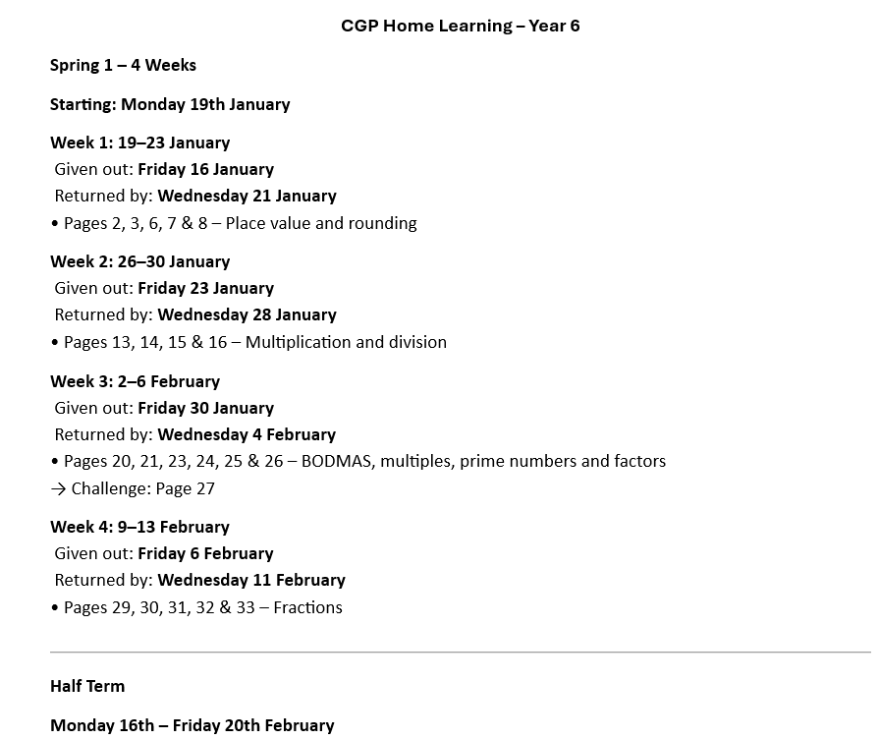
CPG home learning
Notes:
The purpose of using CGP books for maths home learning is not to add pressure, but to help children feel confident and capable ahead of SATs.
The questions are similar in style to what children will see in the SATs, so they become familiar with the layout and expectations over time.
Having the answers in the back encourages children to check their own work, spot mistakes, and learn from them — which is a really important skill.
Children are always welcome to bring their book into school, and I will have an open time where they can come and ask for help, go through answers, or talk through anything they find tricky.
This approach helps children feel supported, independent, and prepared, rather than anxious about SATs.

Slide 29



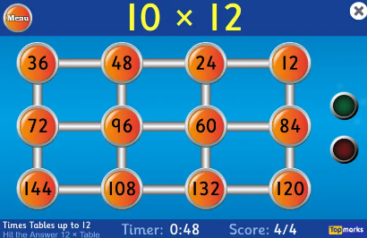
Home Learning apps
TTRS; Google Classroom:
Logins: surname:@rkps.me
Password: words123
White Rose 1minute maths: Free Apps, Top Marks (hit the button)

Slide 30
